Slide 1
SEARCHING TRAJECTORIES BY LOCATIONS -AN EFFICIENY STUDY
Presentation by:
Arun Vadivel
Kirthika Muthukumaran
Neha Mahajan
Saranya Manoharan

Slide 2
OUTLINE OF THE PAPER
Introduction
Saranya Manoharan
Query Processing-IKNN Algorithm
Neha Mahajan
Adaption of λ-NN Algorithm
Kirthika Muthukumaran
Optimization and Experiments
Arun Vadivel

Slide 3
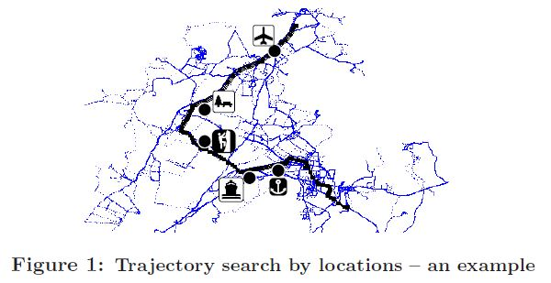
SEARCHING TRAJECTORIES BY LOCATIONS

Slide 4
INTRODUCTION
Searching trajectories by locations.
Query is only a small set of locations with or without specified order.
Target is to find the k-BCT* from database where it best connects the designated locations.
*k-BCT – k- Best Connected Trajectories

Slide 5
PROCESS
Similarity function
how good trajectory connects the query location with both spatial and order constraint.
Efficient k-BCT search
based on Incremental k-NN Algorithm (IKNN).
IKNN refines trajectories by using Lower and Upper bound similarity.
Adapting Best-first and Depth-first k-NN algorithms in IKNN properly.
IKNN adopting the depth-first strategy achieves a good search performance comparable to the best-first strategy.

Slide 6
BENEFITS
Tourist / Travel agency
Survey popular routes through some attractions.
Zoologists
Finding nearest trajectory of animals to some stationary point (eg. Source of food).
Transport Department
Investigate the driving habits of local residence within a suburb and onwards analyze the traffic causes of some critical road intersections.

Slide 7
K-BEST CONNECTED TRAJECTORY Query for searching trajectories by multiple geographical locations.
Indicated by coordinates like (latitude, longitude)
For example, a query with three locations A, B and C appears as
{A(37.2601,122.0941) ,B(37.2721,122.0648) ,C(37.3344,122.1538)}
A(37.2601,122.0941)
If an order constraint further applies, the found trajectories connecting A, B and C should also preserve the visiting order (A → B → C)
Latitude of A
Longitude of A

Slide 8
K-BEST CONNECTED TRAJECTORY
Trajectories recorded by GPS devices in the form of a series of locations/points:
{ p₁, p₂, · · · , p_{l} } where p_{i} is a trajectory point represented by (latitude, longitude), and l is the number of points in the trajectory.
The k Best-Connected Trajectory (k-BCT) query Q is represented by a set of locations:
Q = {q₁, q₂, · · · , q_{m}}
where m is the number of query locations, and the user may further assign a visiting order to the locations, in which case Q is treated as a sequence of locations from q₁ to q_{m}

Slide 9
K-BEST CONNECTED TRAJECTORY
To determine the Similarity function we define the distance between query location q_{i} and trajectory R = {p₁, p₂, · · · , p_{l}} as:
Dist_{e}(q_{i}, p_{j}) is the Euclidean distance between q_{i} and p_{j}
Dist_{q}(q_{i},R) is the shortest distance from q_{i} to any point on R
<q_{i}, p_{j}> a matched pair.
Query Q is without an order constraint, we define the similarity Sim(Q,R) between Q and R based on the distance of each matched pair as follows:

Slide 10
K-BEST CONNECTED TRAJECTORY
Suppose the user wishes to make visits in the order of
q₁ → q₂ → q₃.

Slide 11
K-BEST CONNECTED TRAJECTORY
We define the similarity Sim_{o}(Q,R) for ordered query locations in a recursive way as:
where Head(∗) is the first point ∗ , and Rest(∗) indicates the rest part of ∗ after removing the first point, e.g.,
Head (Q)=q₁
Rest(Q) = {q₂, q₃, · · · , q_{m}}.

Slide 12
Query Processing
The IKNN algorithm uses the spatial index to search close-by trajectories for each query point and then merges the result to get exact k-BCT.
With points of all database trajectories indexed by one single R-tree, once we find the nearest point with respect to a query location, the trajectory which contains this point must be the closest trajectory to the query location.
The support access to whole trajectory points from same trajectory are connected by double linked list.

Slide 13
Definition (k-BCT Query)
Given a set of trajectories T= {$R_{1},R_{2},………R_{n}$} n >= k, a set of Locations Q, and a corresponding similarity function, the k-BCT query is to find the k trajectories $T^{′}$ from T, such that

Slide 14
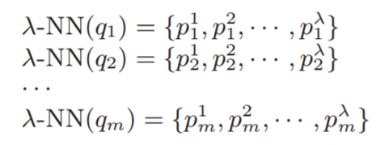
IKNN Algorithm
Assume there is a query Q comprising of m locations {$q_{1}$, $q_{2},q_{3}………….q_{m}$} without order constraint.
Now we retrieve λ-NN of each query location (λ > 0)
The set of scanned trajectories which contains at least one point from λ-NN($q_{i}$) forms a candidate set $C_{i}.$
|$C_{i}$| <= λ
By merging the candidate sets generated by all the λ-NN($q_{i}$) we get totally f different trajectories as candidate.

Slide 15
IKNN continued…
We calculate the lower bound for each of the candidate $R_{x} \left(x ∈\left[1,f\right]\right).$
Here {$q_{i}$ | i $∈$ [1,m] and $R_{x}∈$ $C_{i}$} denotes the set of query locations that have been already matched with some point on $R_{x}$ and the $p_{i}^{j}$ which achieves the maximum $e^{{−Dist}_{e}\left(q_{i},p_{i}^{j}\right) }$with respect to $q_{i}$ is the point on the $R_{x}$ that is closest to $q_{i}$.

Slide 16
IKNN continued…
A similarity function between Q and A is based on the distance of each matched pair.

Slide 17
IKNN continued…
For those trajectories that are not contained in C, they have not been scanned by any of the λ-NN search, and any point on them must have a distance to $q_{i}$ no less than the distance of the ${\text{λ}}^{th}$ NN of $q_{i}$i.e ${Dist}_{e}\left(q_{i},p_{i}^{\text{λ}}\right)$.
We define an upper bound U$B_{n}$ of similarity for all the non-scanned trajectories as follows:
We use both the LB and UB to set-up pruning mechanism to avoid scanning the whole trajectory databases and thus restrict the search space.

Slide 18
IKNN continued…
Theorem 1
For a k- BCT query without an order constraint, if we can get a subset of k trajectories $C^{′}$ from the candidate set C after searching the ${\text{λ}}^{th}$ NN of each query location, and we have $\min_{R_{x}∈C^{′}}\left\{LB\left(R_{x}\right)\right\}≥UB_{n}$, then the k-best connected trajectories must be included in the C.
Proof:
For any $R_{x}∈C^{′}$, Sim(Q, $R_{x}$) >= LB($R_{x}$), while for any $R_{y}∉$ C (i.e. $R_{y}$ $∈$ $\overline{C}$), $UB_{n}$ >= Sim(Q, $R_{y}$).
When theorem 1 is satisfied, which is $\min_{R_{x}∈C^{′}}\left\{LB\left(R_{x}\right)\right\}≥UB_{n}$ we can conclude that $∀R_{x}$ $∀R_{x}$ ($R_{x}∈C^{′}$ $∧$ $R_{y}$ $∈$ $\overline{C}$) implies
(Sim(Q, $R_{x}$) >= Sim(Q, $R_{y}$)). Therefore, no k-BCT result can be from $\overline{C}$, and they must be from C.

Slide 19
IKNN continued…
Critical Question: How do we select the size of λ?
If we set λ to be very large value, it is probable that the k-BCT results will all be retrieved, but the search space will be huge as well.
If we set λ to small it may not be enough to make sure that k-BCT results are included in the set C and thus leads to false dismissal.
Hence we use Incremental k-NN based Algorithm for efficient retrieval of the candidate trajectories in a filter-and-refine fashion.
We start the algorithm by setting the value of λ = k. If the generated candidate set C does not satisfy the Theorem I, we increase the search region by some $∆$ and search for the (λ + $∆$)- NN. This process keeps going until the k-BCT is found.

Slide 20
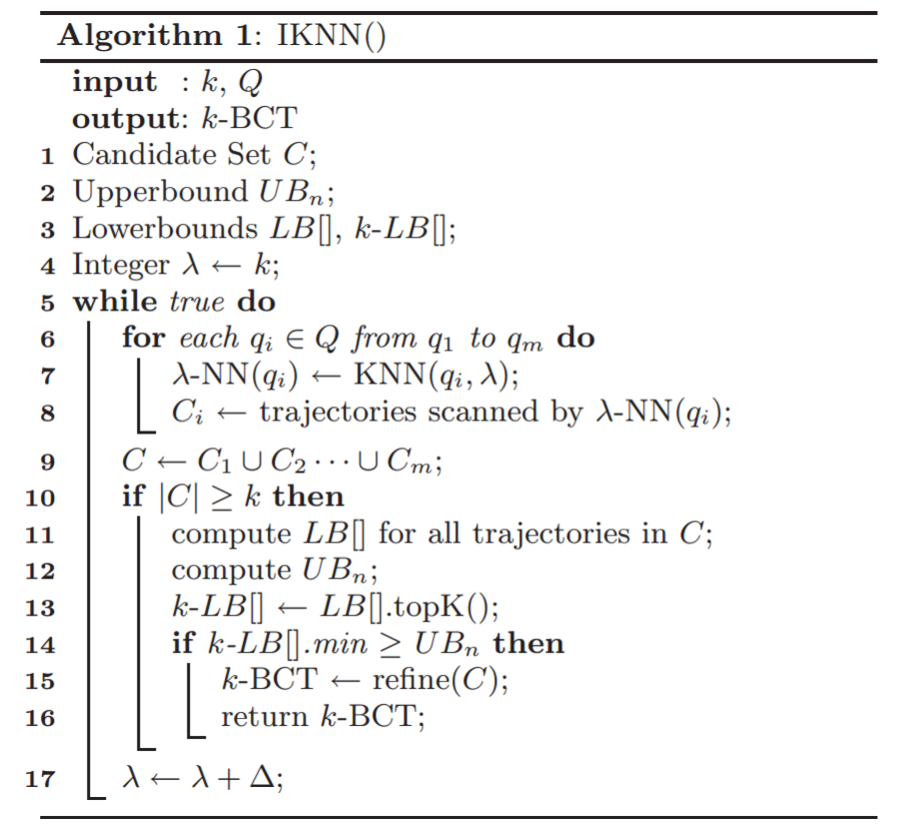
IKNN continued…

Slide 21
IKNN continued…
The refine() function in Algorithm 1 performs a refinement step and its further prunes un-qualified candidates from C to get the final k-BCT results.
We define an upper bound UB of similarity for the candidate trajectories in C as follows:

Slide 22
IKNN continued…
Thus for any candidate $R_{x}$within C, we have Sim(Q, $R_{x}$) <= $UB_{r}$

Slide 23
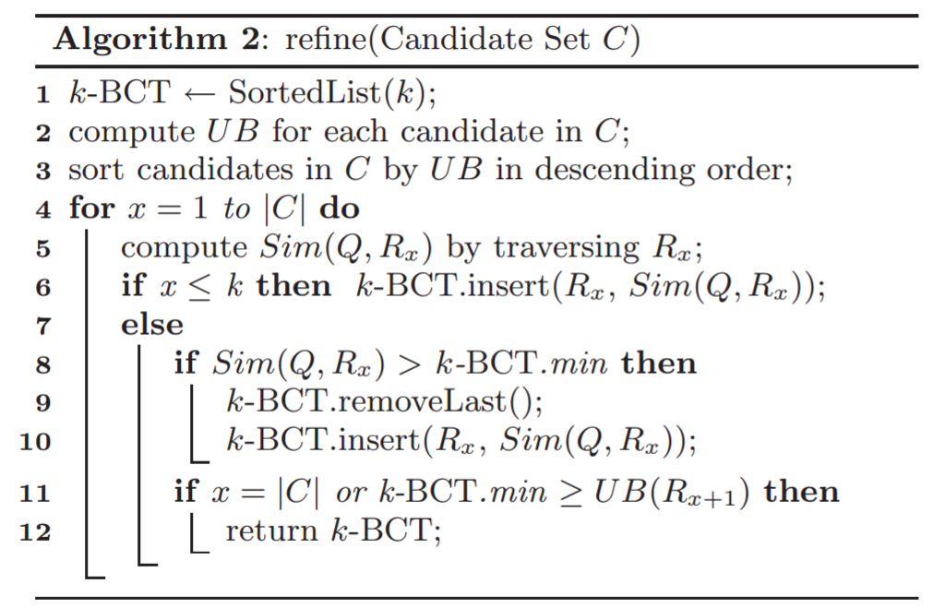
IKNN continued…

Slide 24
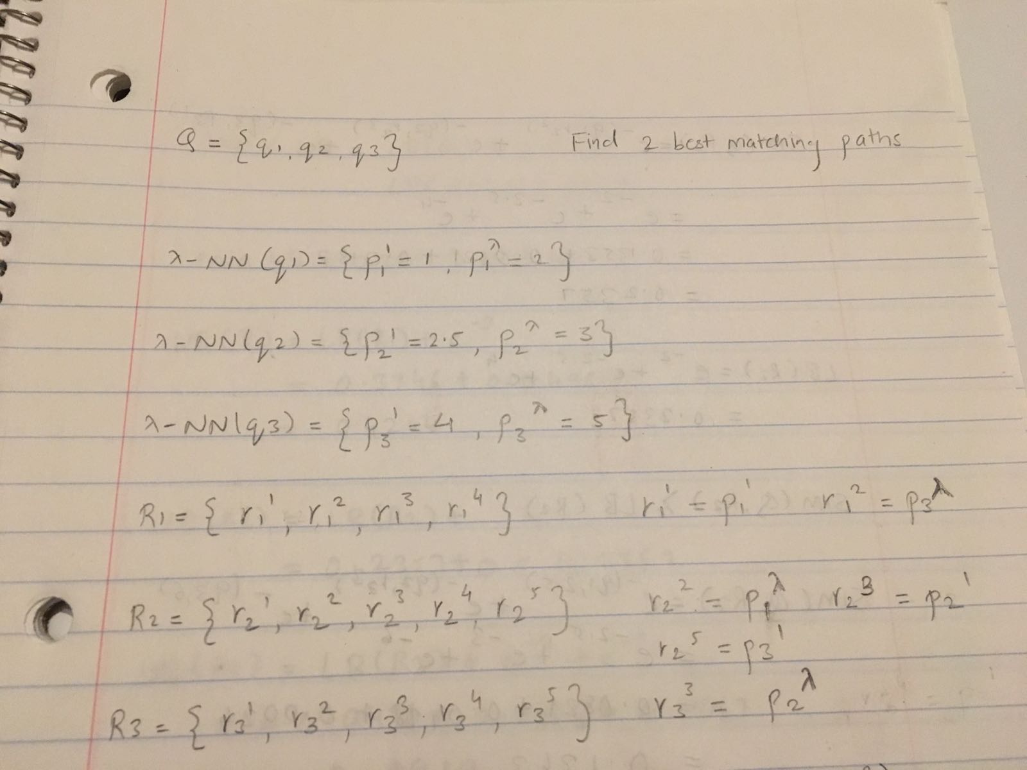
IKNN Example

Slide 25
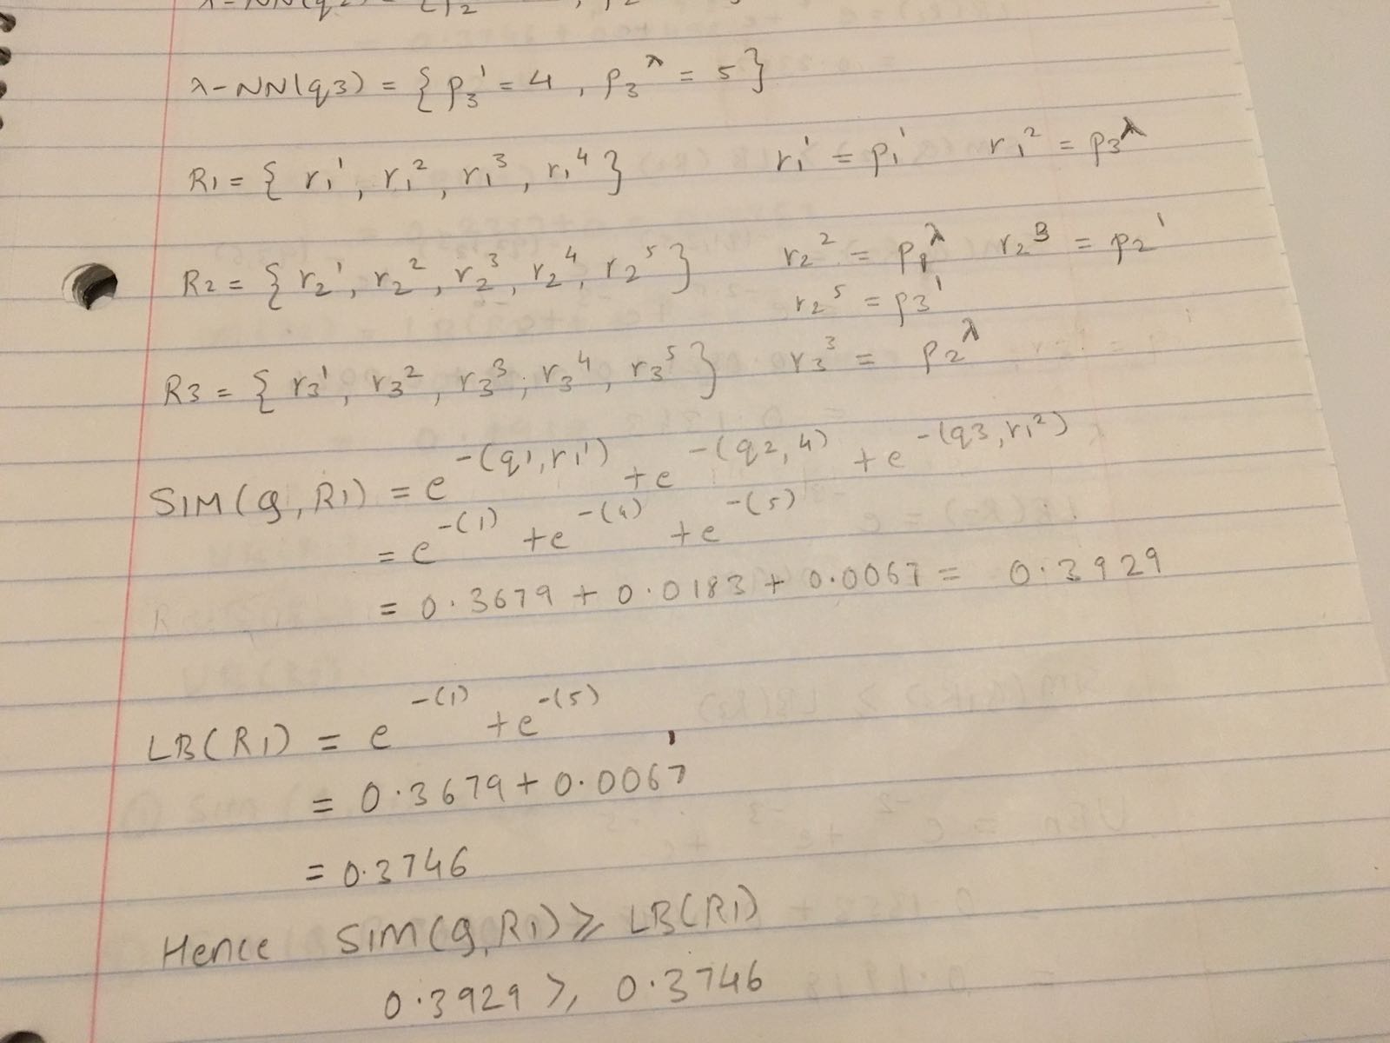
IKNN Example continued…

Slide 26
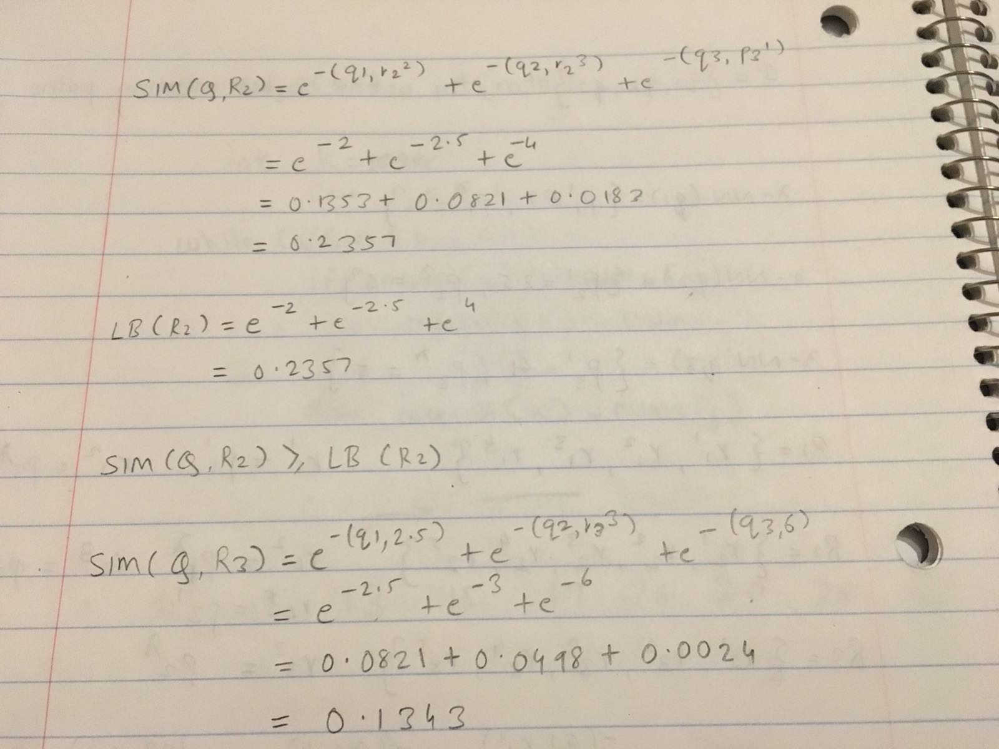
IKNN Example continued…

Slide 27
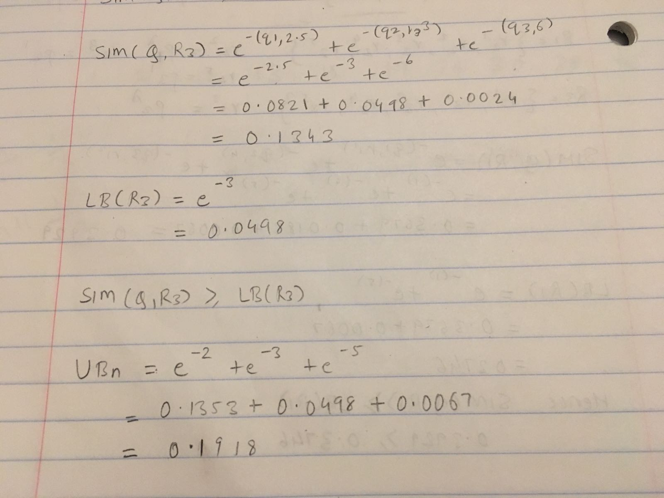
IKNN Example continued…

Slide 28
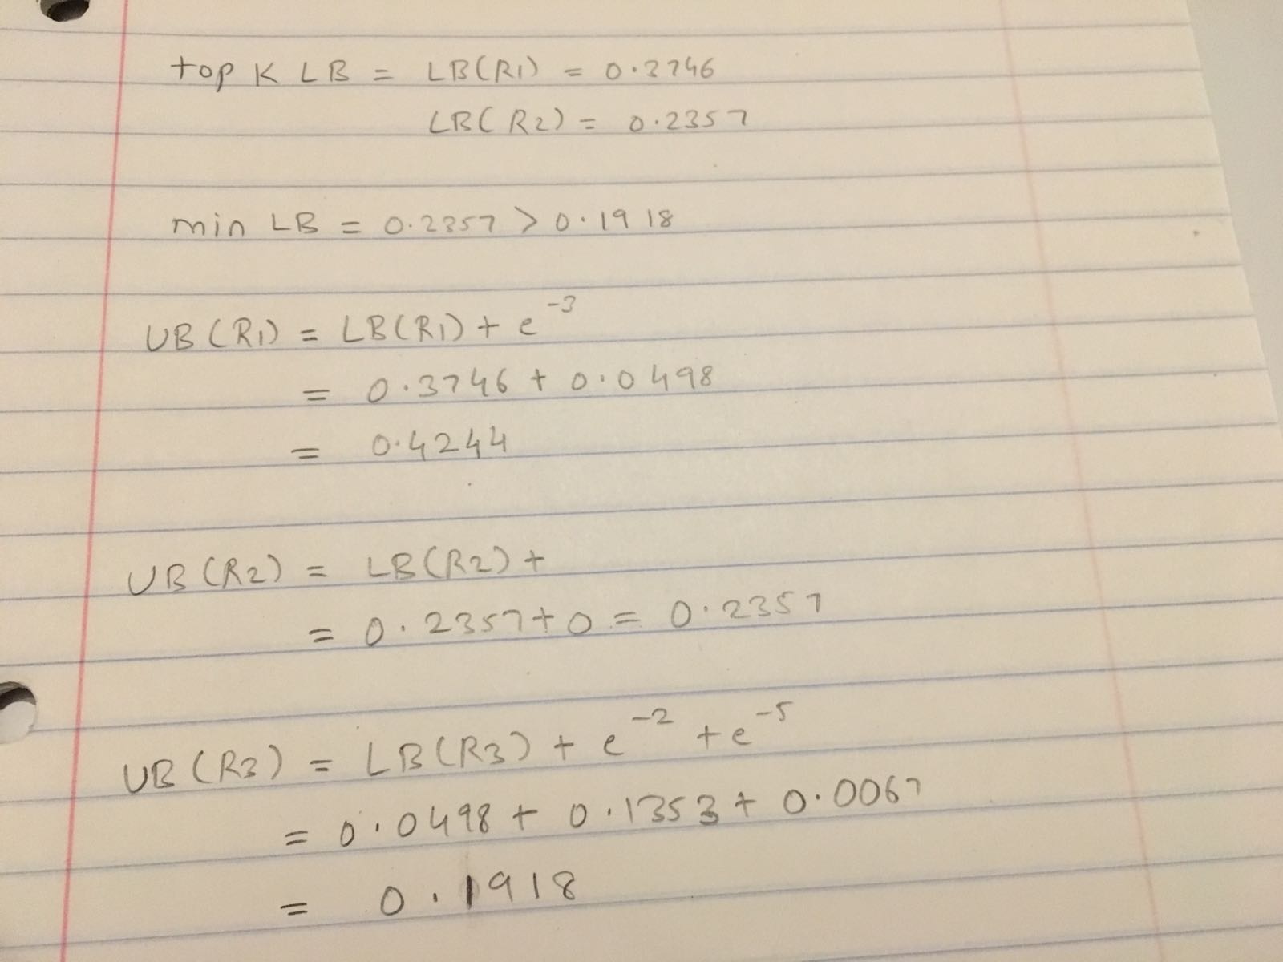
IKNN Example continued…

Slide 29
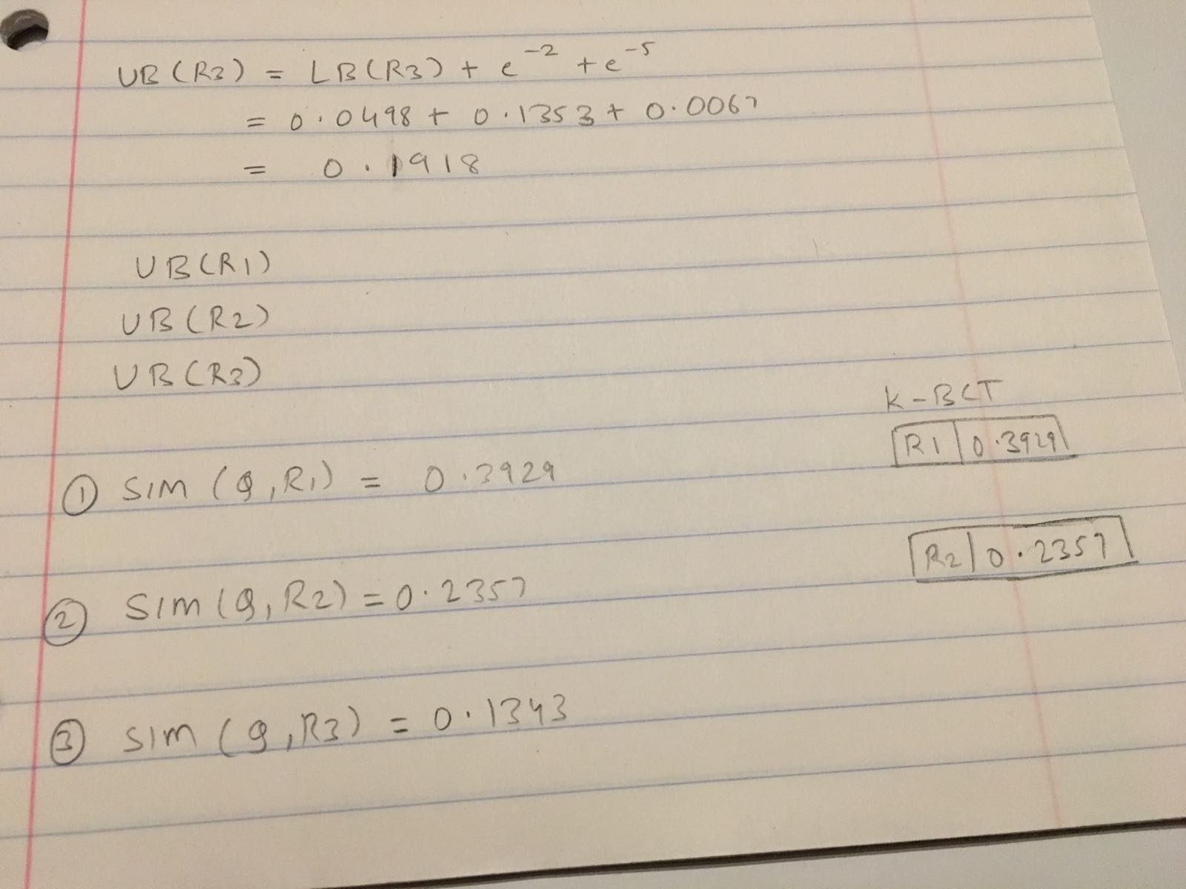
IKNN Example continued…

Slide 30
Adaption of $λ$-NN Algorithm
Two options in designing λ-NN function
Best-First Strategy
Depth-First Strategy

Slide 31
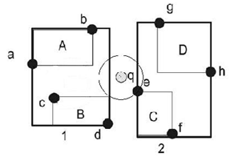
Best-First Strategy(${IKNN}_{bf})$
Uses priority queue to keep track of R-Tree entries that are yet to be visited
Entry with least MINDIST is picked to traverse next
MINDIST($q_{i}$,r) = minimum distance of r from query point $q_{i}$
Example

Slide 32
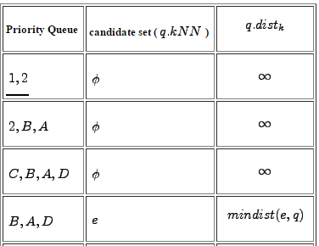
${IKNN}_{bf}$ continued
Nearest Neighbour Query R- TREE
q.${dist}_{k}$ = distance of the $k^{th }$nearest neighbour from q

Slide 33
${IKNN}_{bf}$ continued
Priority queue from λ-NN search can be reused for (λ+$∆)$-NN search
Restart the traversal to get (λ + 1)th, (λ + 2)th, · · · , (λ + )th nearest points
Complexity = cost of best-first λ-NN search * m(number of query points) = m * O($\sqrt{λ}$+ $λ$)

Slide 34
${IKNN}_{bf}$ Drawback
Size of priority queue may become very large which could occupy the whole main memory
May bring down the system

Slide 35
Depth First Strategy(${IKNN}_{df}$)
Recursively traverse R-Tree level by level
Entries are sorted according to MINDIST from query location
MINDIST($q_{i}$,r) = minimum distance of r from point $q_{i}$
Maintains a global list of k-nearest candidates

Slide 36
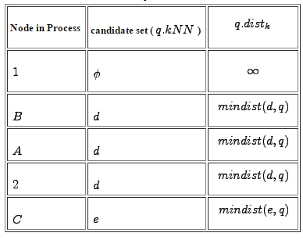
Nearest Neighbour Query R- TREE
q.${dist}_{k}$ = distance of the $k^{th }$nearest neighbour from q
Note: DFS prunes node D because mindist(D,q) > mindist(e,q)

Slide 37
${IKNN}_{df}$ continued..
Cannot resume search from $λ$-NN for ($λ$+$∆$)NN search
Restart search – rescan previous $λ$-NN for ($λ$+$∆$)NN search
Performance degrades, O($\frac{λ^{2}}{k}$)

Slide 38
${IKNN}_{df}$ continued
Theoretical solution: Guess correctly how large $λ$ will eventually be?
Alternate solution: Double $λ$ at each round instead of increasing it by a constant $∆$
$Λ$ = k * $2^{round},$ round = 0,1,2,….
so, $∆ =$k * $2^{round}$
Reduces complexity from quadratic to linear O($λ$)

Slide 39
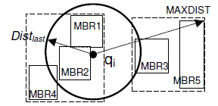
${IKNN}_{df}$ continued..
How to improve efficiency?
Pruning by MAXDIST

Slide 40
${IKNN}_{df}$ Algorithm

Slide 41
Comparison between ${IKNN}_{bf}$ and ${IKNN}_{df}$
Improved complexity of ${IKNN}_{df}$ = m * O($\sqrt{\text{λ}}$+λ)
${IKNN}_{df}$ provides high memory usage when compared to ${IKNN}_{bf}$
However in normal cases, ${IKNN}_{bf}$is faster than ${IKNN}_{df}$

Slide 42
Optimization
Approach:
Varying ∆ value in the (λ + ∆)- KNN algorithm
Different query locations contribute to different values of LB/UB

Slide 43
For Upper Bound:
.
<
Find how fast the contribution to UB decays as λ increases

Slide 44
Assign ∆, based on decay rate
λ fixed, radius: 0 to ∞
Decay rate => bell curve, first ↑, then ↓
Inference: ∆ => More for denser trajectories and vice versa
Cut down the UB, reducing Query Time

Slide 45
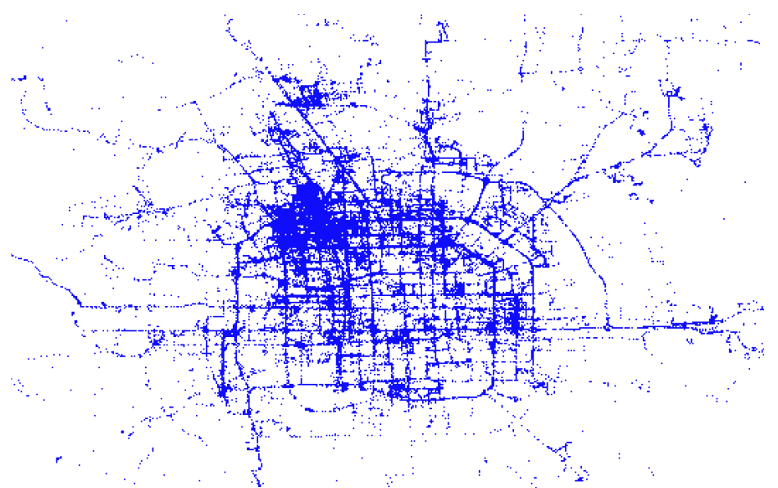
Experiments
Dataset
Obtained from Beijing
12, 653 GPS trajectories
Computing Power
IKNN algorithm implemented in Java
Intel Core 2 CPU (2.13GHz)
1.0 GB RAM

Slide 46
Metrics of Measurement
For Performance:
Query Time
Nodes Access Time
For Memory Usage:
Queue Size

Slide 47
Experiment Settings
Number of k : 1 to 25, default 15
Number of locations : 2 to 10, default 8
Constant ∆ for BF and DF-C : 50

Slide 48
Different Number of Query Locations
BF vs DF
BF is much faster than DF
DF revisits pre-visited λ-NN more times
BF uses 10 times more memory than DF
Thus DF is considered

Slide 49
Effect of Adaption
DF is considered due to memory efficiency
DF with constant ∆ doesn’t scale well
DF with double λ reduces the re-visits

Slide 50
DF with pruning by MAXDIST reduces repetition area, further reduces re-visits
DF-D-M better than BF
Search cost same as BF
Less Queue operations
Less compute for upper/lower bounds

Slide 51
Effect of Optimization
DF-D-M with Optimization
Node access reduced by ¼ ~ ½
Query time reduced by 20%
BF with Optimization
Queue size reduced to 2/3

Slide 52
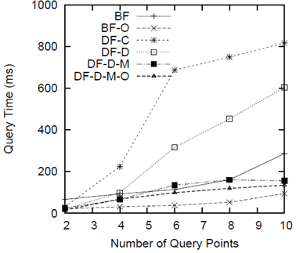
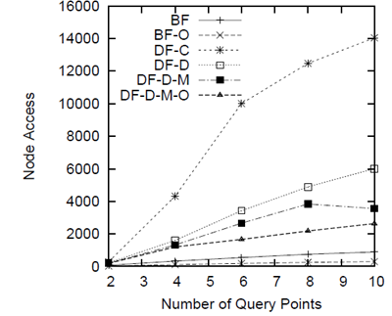
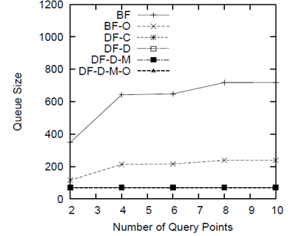

Slide 53
For different ‘K’ value
BF with Optimization
Highly stable with k <= 25
Queue size is also low for k <= 25
DF with pruning MAXDIST Optimized
Highly scalable with ‘k’
Stable increase in Query Time and
Node Access for ↑ ‘k’

Slide 54
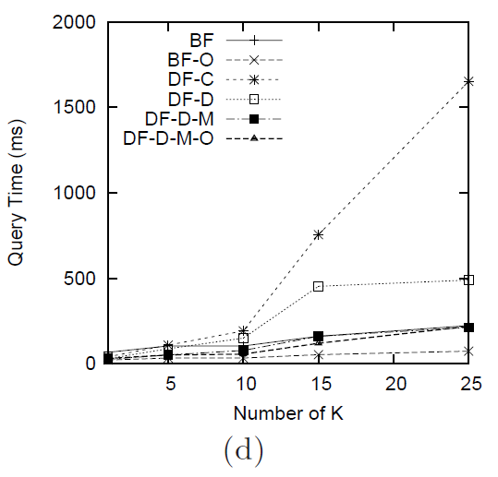
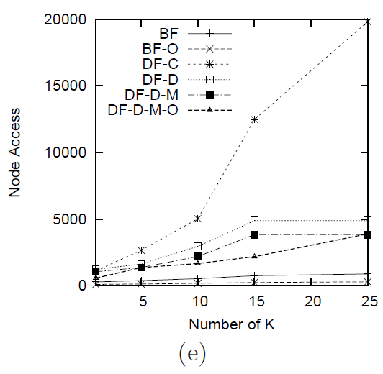
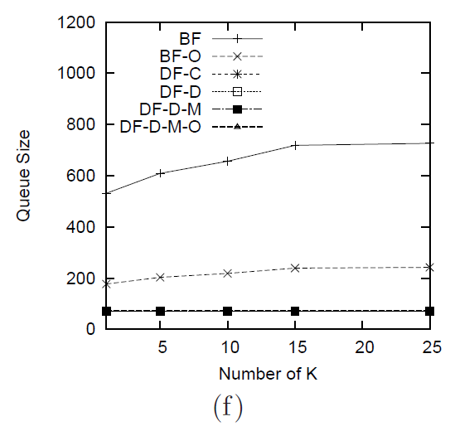

Slide 55
Conclusion
Searches k-Best Connected Trajectories
BF with optimization
Best query performance, high memory usage
DF with constant ∆
Low memory usage, poor efficiency
DF pruning MAXDIST with Optimization
Best query performance, low memory usage

