Slide 1
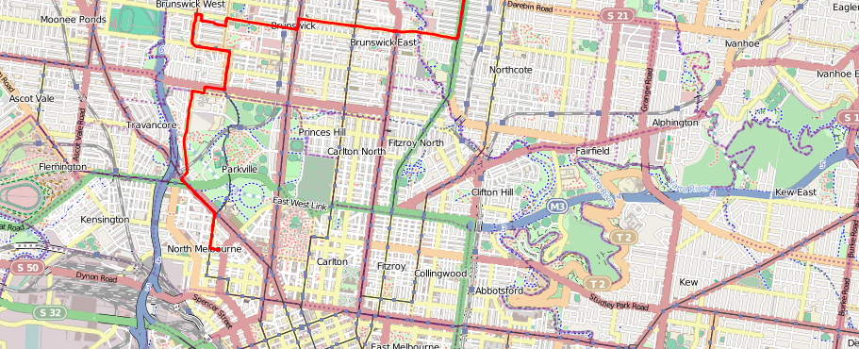
An Interactive-Voting Based Map Matching Algorithm
Team 3

Slide 2
Background
Map-matching is widely used in:
Vehicle Navigation
Fleet Management
Intelligent Transport System (ITS)
Location Based Services (LBS)
Therefore, Reliable Map-matching Algorithm is needed!

Slide 3
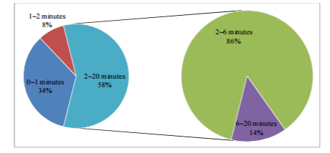
Challenges
High percentage of low-sampling rate GPS tracking data in practice

Slide 4
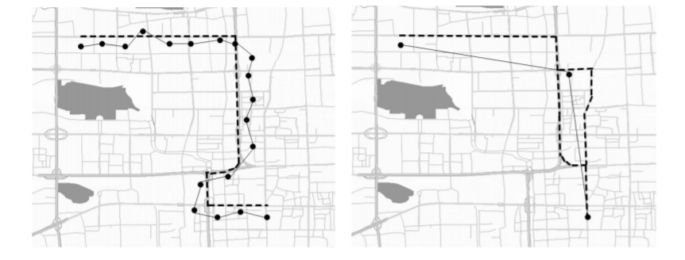
Challenges (Cont’d)
The performance of traditional methods gets worse when sampling rate is not high
High-sampling Rate Low-sampling Rate

Slide 5
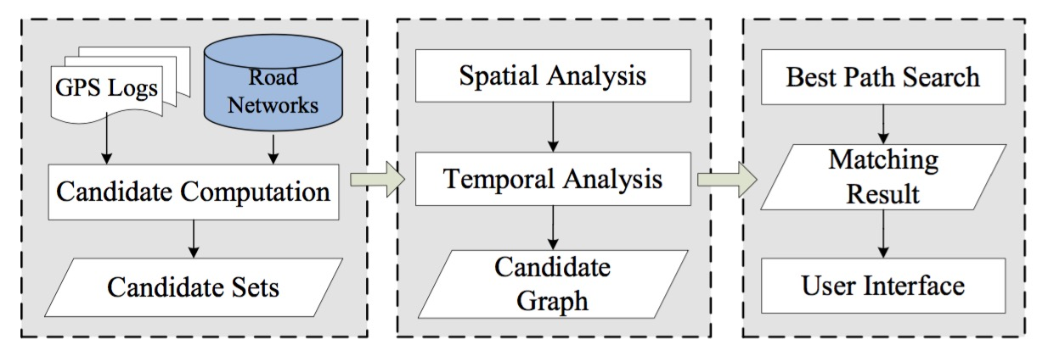
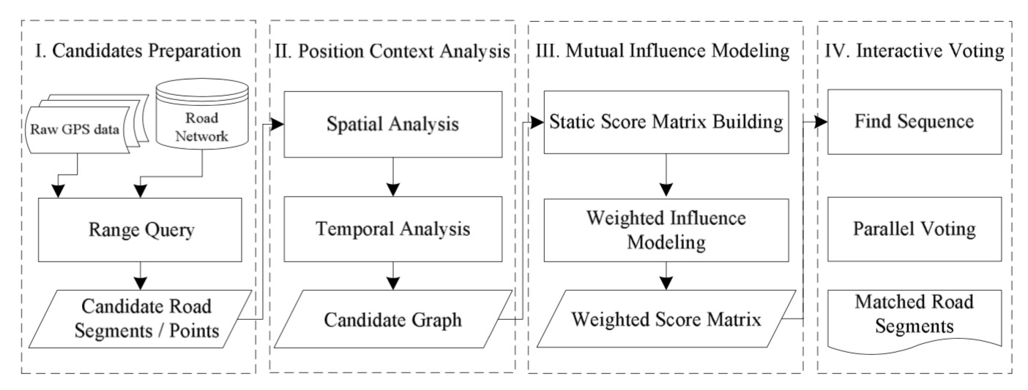
Solution Overview
ST-Matching
Spatial
Temporal
IVMM
Mutual Influence Modeling
Interactive Voting

Slide 6
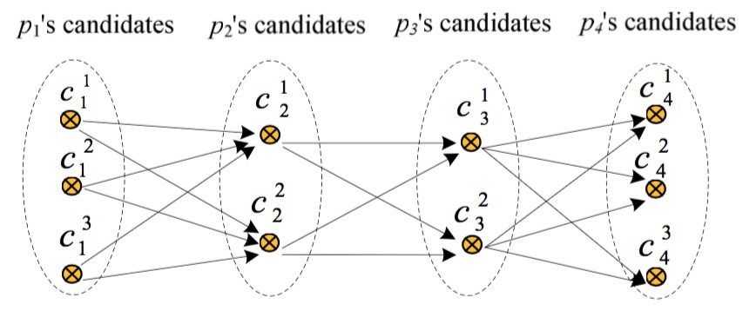
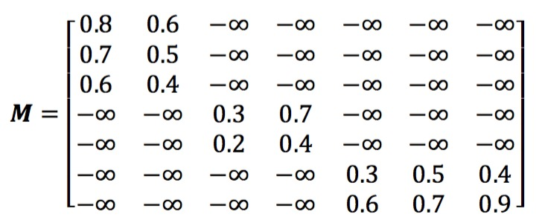
Solution Details
Mutual Influence Modeling : Static Score Matrix Building
! For ST-Matching, the final optimal path will derive from “M”.
! For IVMM, we try to introduce “global” view.

Slide 7
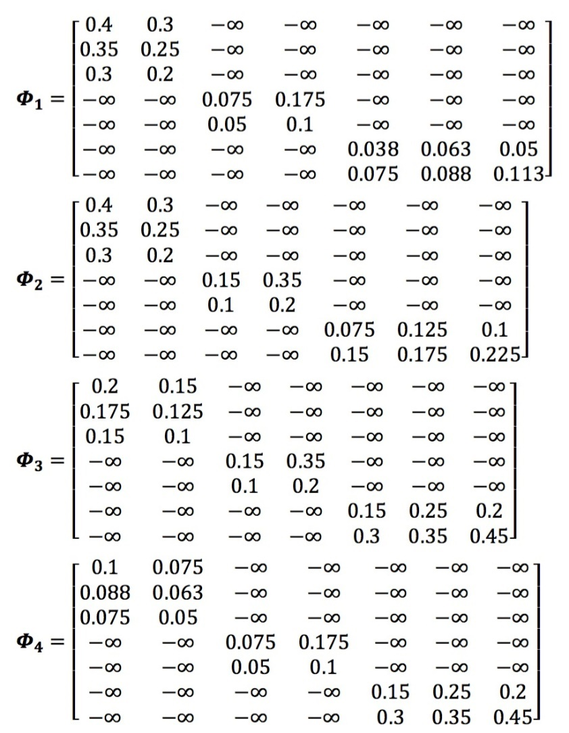
Solution Details
Mutual Influence Modeling : Weighted Influence Modeling
2⁻¹
2⁻²
2⁻³
Distance: Any Definition of Distance
Weight = $f$(Distance)
$$dist=|i−j|$$
$$f(dist)=2^{−dist}$$
$$f(dist)=e^{−\frac{{dist}^{2}}{β^{2}}}$$
$$euclidean dist$$

Slide 8
Solution Details
Interactive Voting
$c_{1}^{1}$ : ${Candidate Path }_{1}^{1}$
... ...
... ...
... ...
$c_{3}^{2}$ : ${Candidate Path }_{3}^{2}$
... ...
... ...
... ...
$$Φ_{1}$$
$$Φ_{3}$$
use fValue to break
Votes tie
$$The Global Optimal Path$$
$$c_{1}^{1}→c_{2}^{1}→c_{3}^{2}→c_{4}^{3}$$

Slide 9
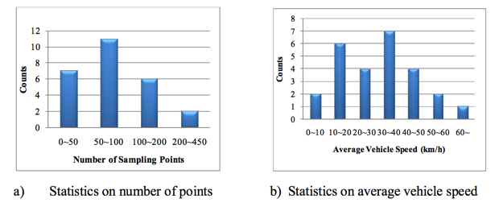
Evaluation
Data Source
Road network: 58,624 vertices, 130,714 road segments. (Beijing)
vertical length: 47.7 km, horizontal length: 52.6 km.
GPS data: 26 trajectories, varying number of points and average speed.
Ground truth: real human labeled true path.

Slide 10
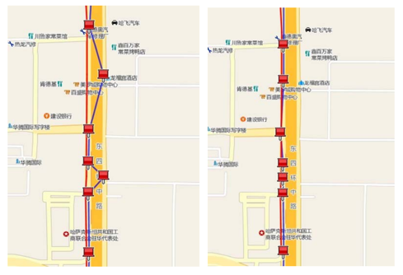
Evaluation
Approaches
ST-Matching
IVMM algorithm with
k=5 (maximum candidates number)
radius=100 meters
μ=5 meters, σ=10 meters in normal distribution
β=7 km in weighted function

Slide 11
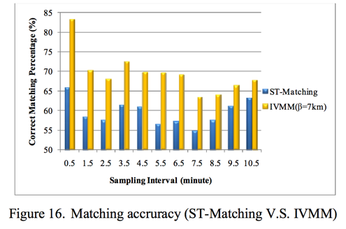
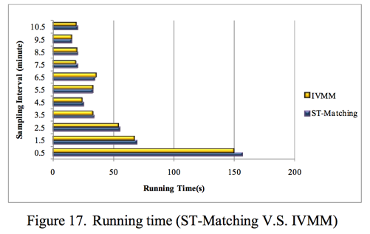
Evaluation
Evaluation error

Slide 12
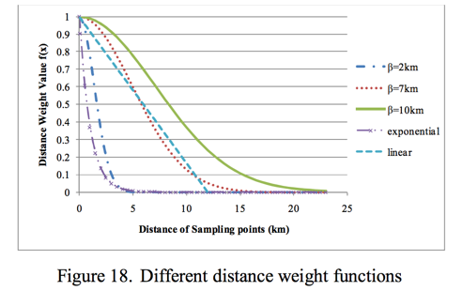
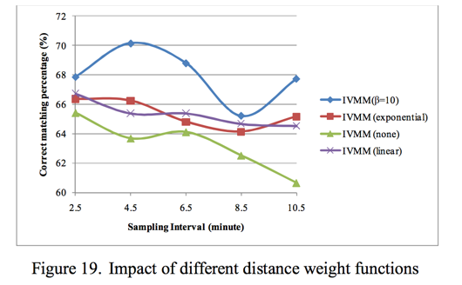
Evaluation
Weighted function evaluation

Slide 13
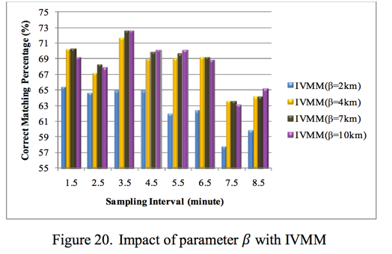
Evaluation
Weighted function evaluation

Slide 14
Conclusion
This algorithm employs a voting-based approach to reflect the mutual influence of the sampling points.
When the sampling interval ranges from 2 to 6 minutes, the accuracy rate of IVMM algorithm always has a more than 10% improvement over the ST-Matching algorithm.

Slide 15
Thank you
Yihan Bao
Weina Chen
Duanduan Liu
Kanrong Yu

