Slide 1
iGSLR: Personalized Geo-Social Location Recommendation - A Kernel Density Estimation Approach
Group 2: Mingyan Zhao, Chengle Zhang, Biao Yin, Yuchen Liu

Slide 2
Motivation
Image References: http://www.zerohedge.com/news/2015-12-22/foursquare-now-twosquare-latest-tech-bubble-casualty-has-valuation-slashed-60
http://ecopeakwebstrategy.com/2010/12/facebook-places/

Slide 3
location-based social networks (LBSNs)
Essential Task:
Utilize user
preferences and other information (e.g., social friendships)
to make location recommendation to users

Slide 4
Challenges
Geographical influence of users：
the distance between the residences of users with social friendships
Limited
Improvement
collaborative filtering (CF)
Limited
Improvement
Geographical influence of locations：
the distance between every pair of locations visited by the same user

Slide 5
Why not choose universal model?
The geographical influence of locations on these three users’ check-in behaviors is unique.

Slide 6
Challenges
Geographical influence of users：
the distance between the residences of users with social friendships
Limited
Improvement
collaborative filtering (CF)
Limited
Improvement
Geographical influence of locations：
the distance between every pair of locations visited by the same user
Should be personalized

Slide 7
Objective
iGSLR: a new personalized geo-social location recommendation framework.
Contributions:
Explore the personalized geographical influence of locations on a user’s check-in behavior.
Design a unified geo-social recommendation framework fusing user preference, social influence, the geographical influence of users, and the personalized geographical influence of locations.
Conduct extensive experiments to evaluate the performance of iGSLR.

Slide 8
Related Work
Previous Recommendation techniques
Collaborative Filtering
Social Collaborative Filtering
iGSLR:
User preference, geographical influence of users, social influence, personalized location

Slide 9
Collaborative Filtering
User A
A is closed with B while not with C
User B with rating vector r(b)
User C with rating vector r(c)

Slide 10
Collaborative Filtering
Frequency of user i visiting location j
Where
Or
Where

Slide 11
Social Collaborative Filtering
Considering social relationship among users
Where
F(ui) is the set of users have relationship with ui

Slide 12
Involve user’s Location Record
Kernel Density Estimation
Probability a new location
Where
The p of user i from its previous locations to a new location j
Where

Slide 13
iGSLR
Integrated work:
user preference, social influence, geographical inference of users and the personalized geographical influence of locations
How?
Input: user preference, social influence, geographical inference of users
Output: Input & the personalized geographical influence of locations

Slide 14
iGSLR? How?
Input Fusion (combine user preference, social influence and geo influence of users)
Output Fusion
Where
Two ways to combine personalized geographical influence of locations and the input fusion
or

Slide 15
Experimental Evaluation
Focus:
The accuracy of iGSLR (precision & recall)
Deal with cold-start users with only a few check-in POIs.
Deal with data sparsely problem.

Slide 16
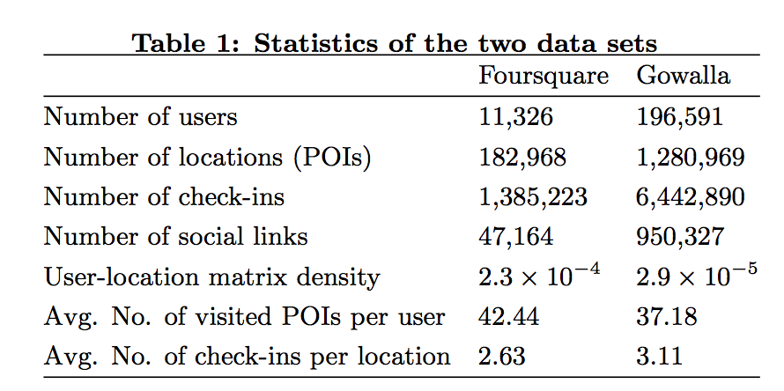
Dataset Description
Two publicly available large-scale real check-in data sets crawled from Foursquare and Gowalla.
Divide the datasets into training set(90%) and testing set(10%) according to the check-in time.

Slide 17
Evaluated Recommendation Techniques
U: user-based CF
L: location-based CF
S: user preference with social influence
SG: integrates user preference, social influence, and the geographical influence of the users
iGSLR, PD, MGM: fuse above features and the geographical influence of locations based on kernel density estimation, power-law distribution, and multi-center Gaussian model.

Slide 18
Performance Metrics
Precision: the ratio of the number of discovered POIs to the k recommended POIs.
Recall: the ratio of the number of discovered POIs to the number of positive POIs, which are number of the POIs visited in the test set.
Average of P&R over all users for various values of k from 5 to 50. k is the number of recommendation results to the target user.
For cold-start users, k is from 1 to 10, called given-n method.

Slide 19
Overall Performance

Slide 20
Overall Performance

Slide 21
Performance on Cold-start Users

Slide 22
Performance on Cold-start Users

Slide 23
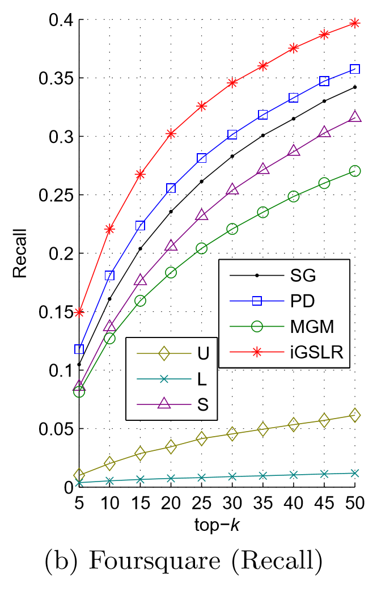
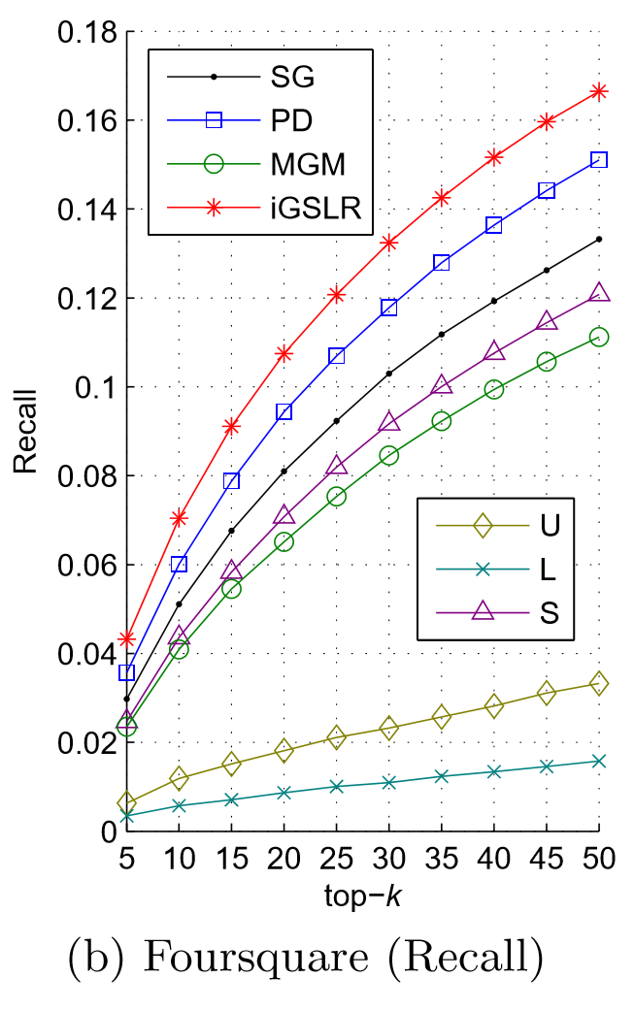
Effect of Data Sparsity
Training set : 50% of the check-in data
Recall
$$\frac{\# discovered POIs}{positive POIs}$$
density
positive POIs
performance
before
after

Slide 24
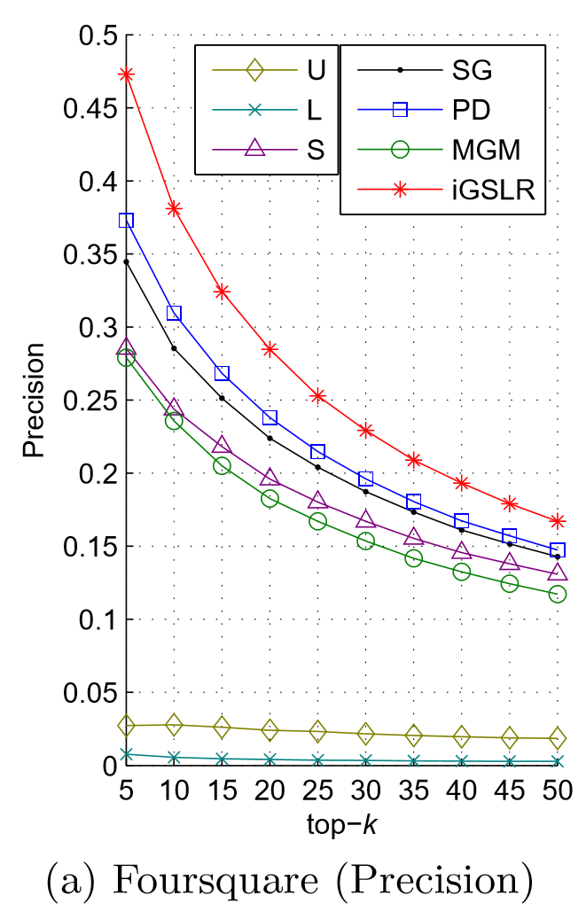
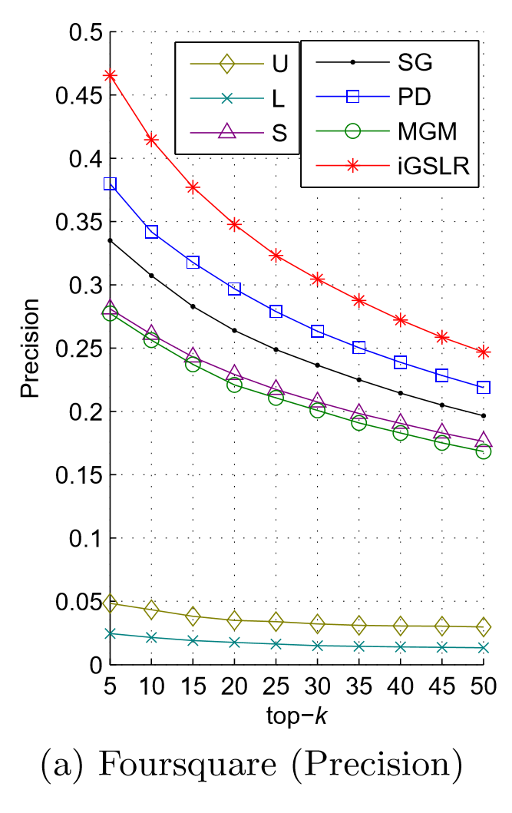
Effect of Data Sparsity
Training set : 50% of the check-in data
Precision
$$\frac{\# discovered POIs}{k recommended POIs}$$
positive POIs
prior possibility
Performance
before
after

Slide 25
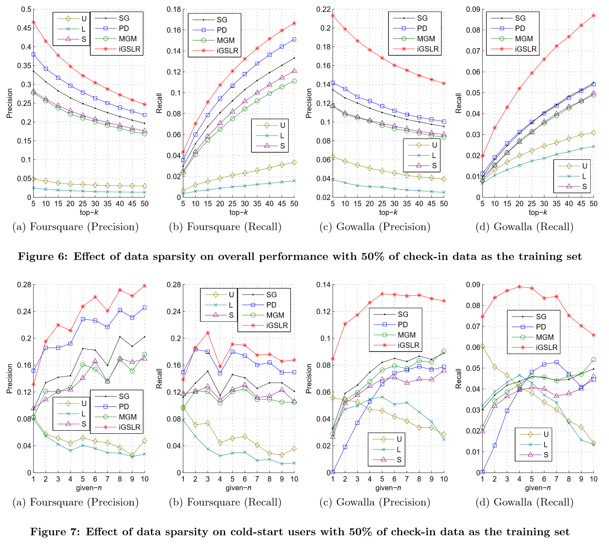

Slide 26
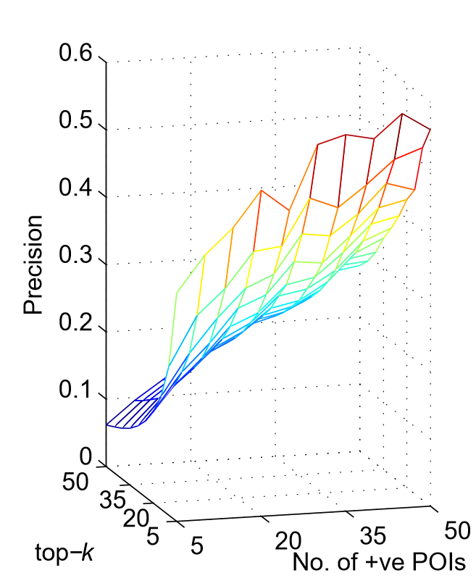
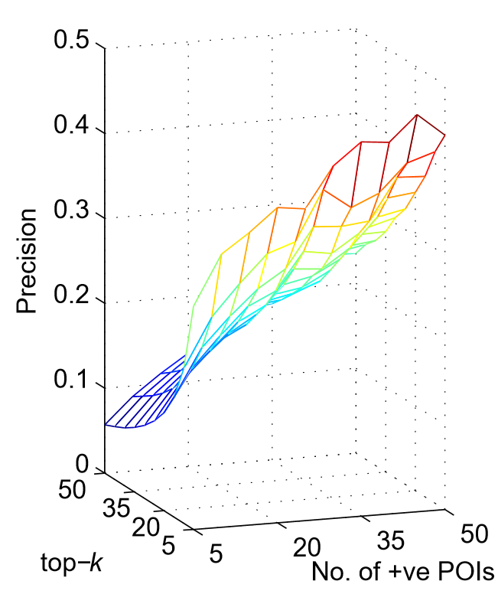
Effect of the Number of Positive Locations
iGSLR vs PD
positive POIs
discover one
discover all
iGSLR is always better
0.34
0.26
iGSLR
PD

Slide 27
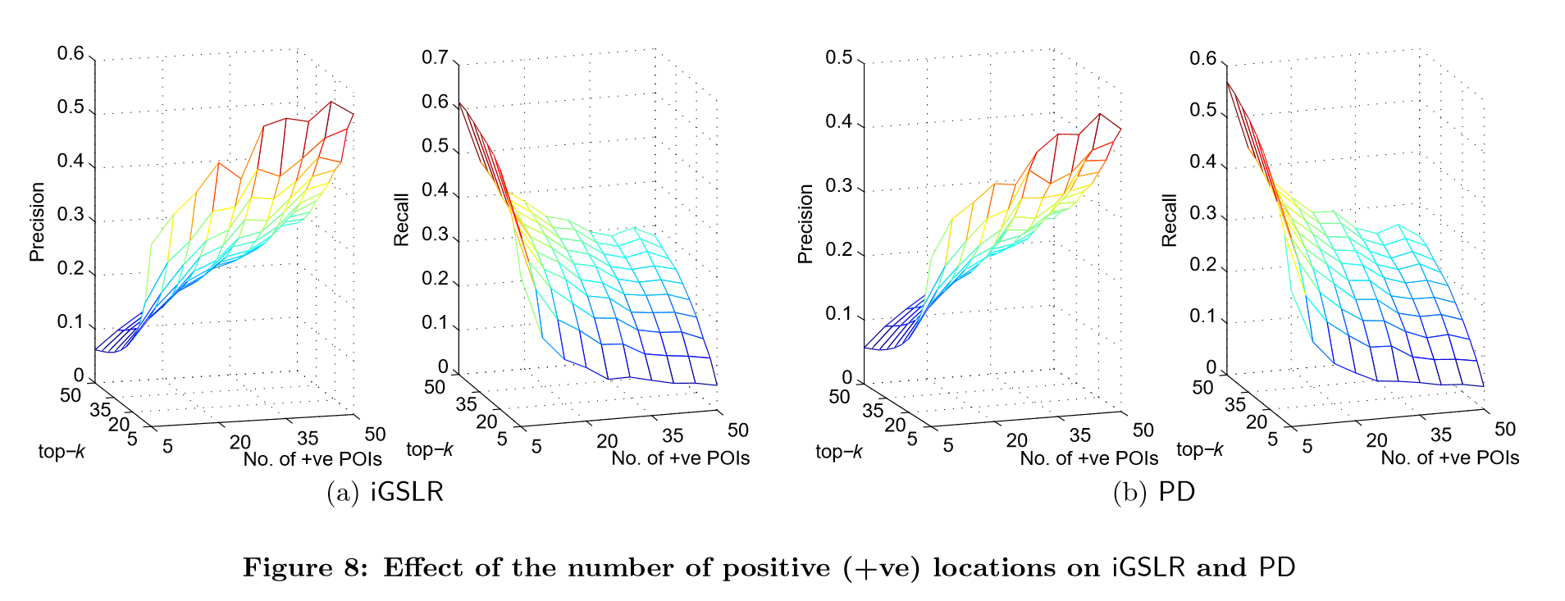
Effect of the Number of Positive Locations

Slide 28
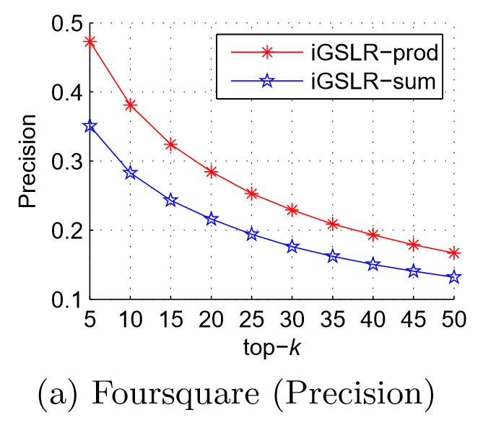
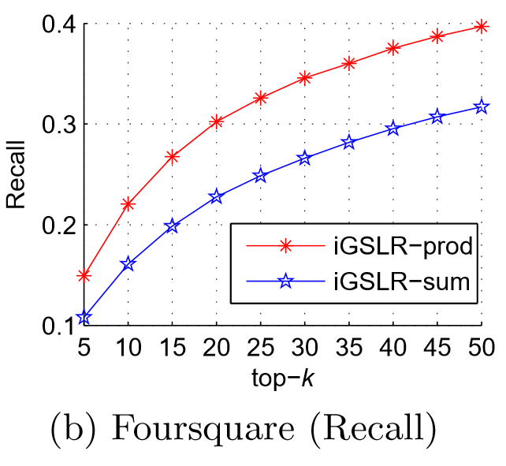
Comparison of Fusion Rules
Product rule is better
from the personalized geographical inﬂuence of locations
from the estimated rating

Slide 29
Conclusion
uniﬁed location recommendation framework
user preference
social inﬂuence
personalized geographical inﬂuence
iGSLR provides signiﬁcantly superior location recommendation

Slide 30
Thank you!

