Slide 1
Sub-Trajectory Clustering DS 504 - Big Data Analytics
Team - 6
Ashok, Harsh, Qianchao, Zhiyuan, Zach

Slide 2
Contents
Introduction
Design Overview
Trajectory Partition
Line Segment Clustering
Results and Conclusions

Slide 3
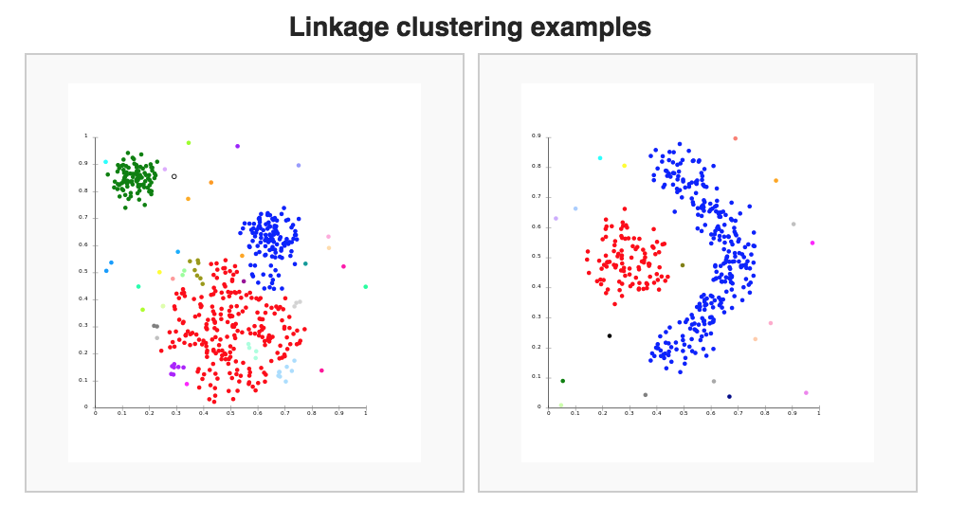
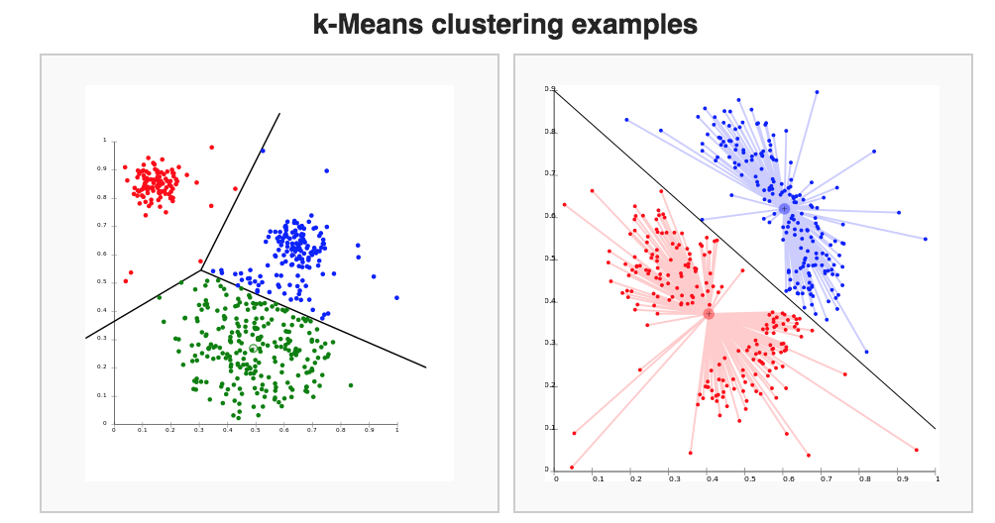
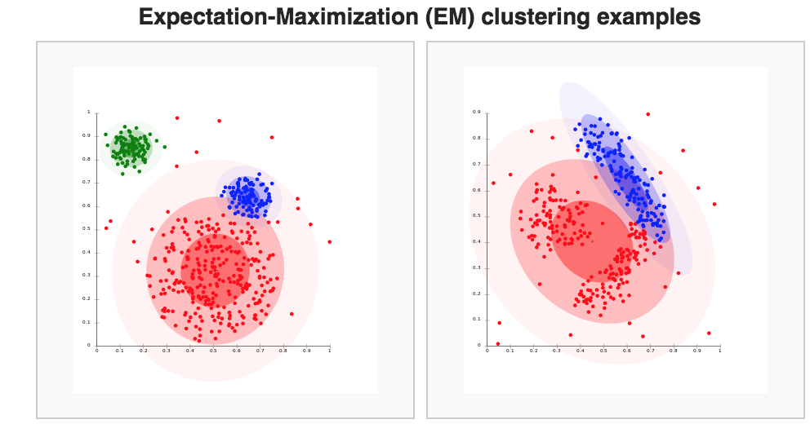
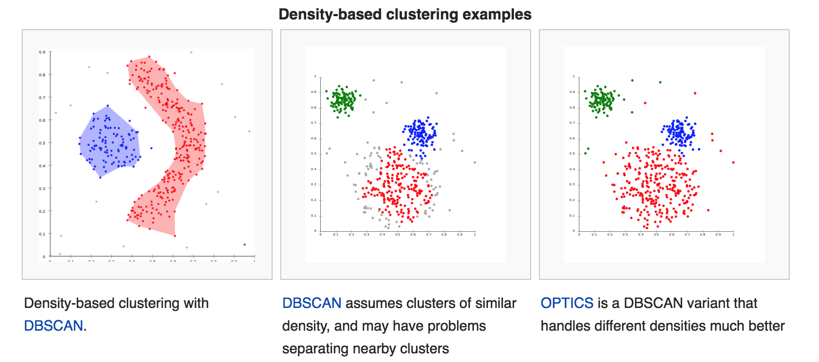
Introduction
Connectivity Models
Centroid Models
Distribution Models
Density Models

Slide 4
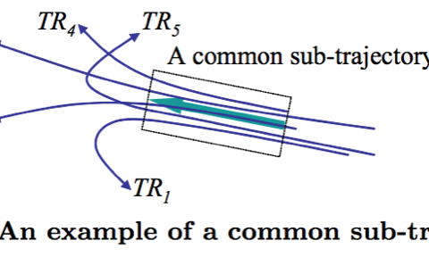
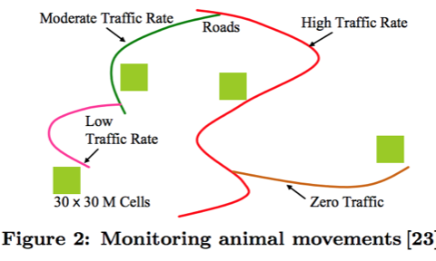
Introduction
Trajectory Clustering Algorithms
Sub-trajectories [Partition-and-group framework]

Slide 5
Applications - Hurricane Forecasting

Slide 6
Applications - Bird Migration in North America

Slide 7
Contents
Introduction
Design Overview
Trajectory Partition
Line Segment Clustering
Results and Conclusions

Slide 8
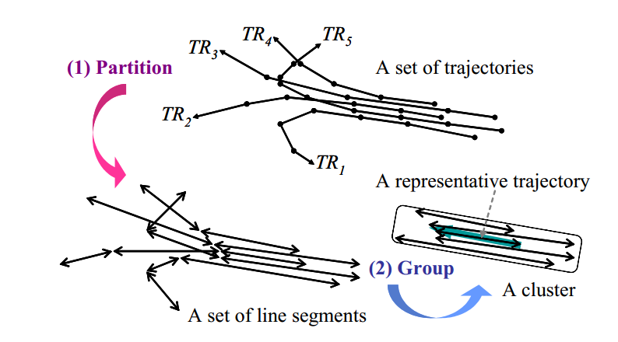
Partition-and-Group Framework

Slide 9
TRACLUS
Grouping Phase
MDL Cost
Approx. Trajectory Partitioning
Avg. Direction Vector
Avg. Coordinate
DBSCAN
Line Segment Clustering
Partitioning Phase
Representative Trajectory
Notes:
MDL – Min Description Length,

Slide 10
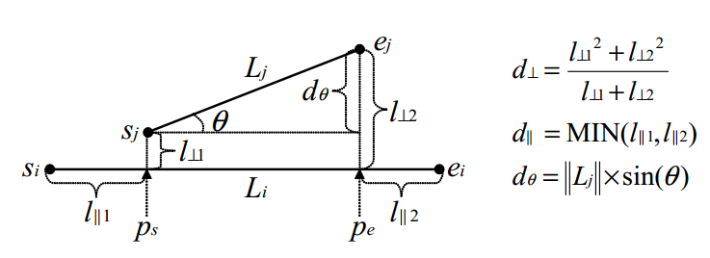
Distance Function
Notes:
The Lehmer mean of a set of n numbers

Slide 11
Contents
Introduction
Design Overview
Trajectory Partition
Line Segment Clustering
Results and Conclusions

Slide 12
Trajectory Partition
Two Properties
Preciseness
Conciseness
Method
MDL (Cost Function)
Approximate Algorithm
Local Optimal

Slide 13
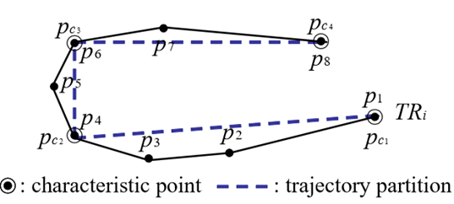
Two Properties
Preciseness
Difference between trajectory and its partition should be small
Select characteristic points where behavior changes rapidly
Conciseness:
The number of trajectories should be as small as possible
Contradictory to preciseness

Slide 14
Method: minimum description length (MDL)
The MDL cost consists of two components
L(H): length description of hypothesis
L(D|H): length description of data
The best of Hypothesis to explain D is the one that minimizes the sum of L(H) and L(D|H)
In our partition problem
L(H): represents the sum of the length of all trajectory partitions.
L(D|H): represents the sum of the difference between a trajectory and a set of its trajectory partitions

Slide 15
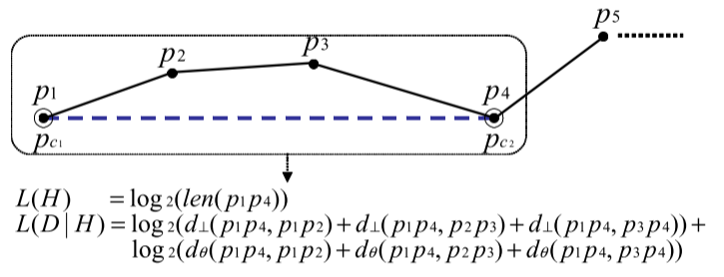
Method: minimum description length (MDL)
minimizes the sum of L(H) and L(D|H)

Slide 16
Approximate Solution: local minimum
Idea
MDLpar(Pi, Pj): MDL cost (= L(H) + L(D|H)), when Pi and Pj are only characteristic points.
MDLnopar(Pi, Pj): no characteristic point between Pi and Pj
Longest trajectory partition k. MDLpar(Pi, Pk) ≤ MDLnopar(Pi, Pk)
Approximate Trajectory Partitioning
If MDLpar is greater than MDLnopar, previous point as characteristics point
Local optimal not global; 80% accuracy on average.

Slide 17
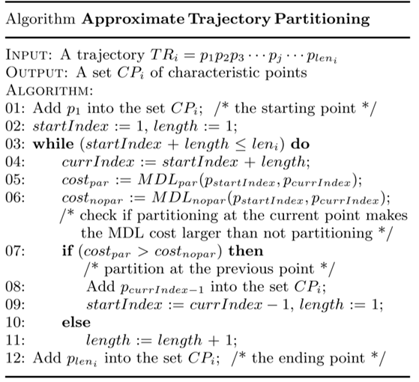
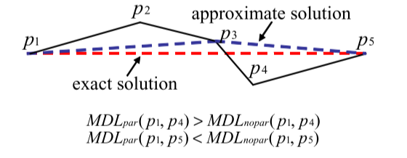
Approximate Solution: local minimum

Slide 18
Contents
Introduction
Design Overview
Trajectory Partition
Line Segment Clustering
Results and Conclusions

Slide 19
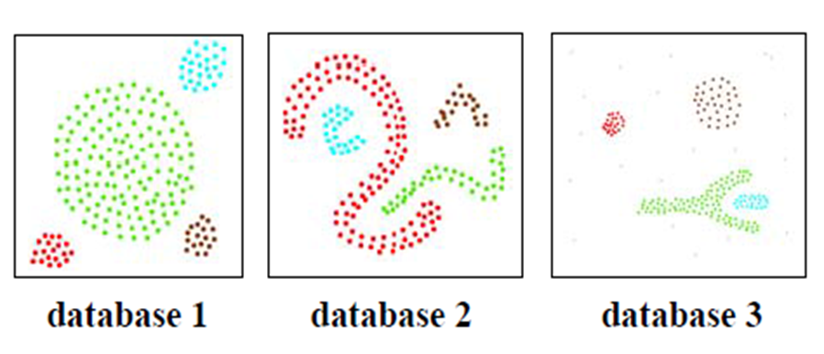
DBSCAN

Slide 20
DBSCAN
p
MinPoints: 3
Eps: 1
q
q: core point p: border point

Slide 21
DBSCAN
MinPoints: 3
Eps: 1
p
q
p is directly density-reachable from q, but not vice versa

Slide 22
DBSCAN
MinPoints: 3
Eps: 1
o
p
q
p is density-reachable from o, p is density-reachable from o
p and q are density-connected

Slide 23
DBSCAN-like Line Segment Clustering

Slide 24
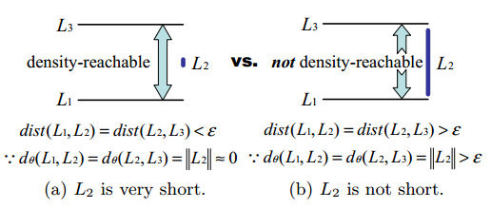
Modification (1)
Influence of a very short line segment on clustering
Increase the length of line segment!

Slide 25
Modification (2)
Trajectory cardinality
May only from one trajectory
Take trajectory cardinality into consideration when deciding a cluster

Slide 26
Representative Trajectory of a Cluster

Slide 27
Heuristic for Parameter Value Selection

Slide 28
Contents
Introduction
Design Overview
Trajectory Partition
Line Segment Clustering
Results and Conclusions

Slide 29
Two Datasets
The hurricane track data set
Contains the hurricane’s latitude, longitude, maximum sustained surface wind, and minimum sea-level pressure at 6-hourly intervals.
The animal movement data set
Contains the radio-telemetry locations (with other information) of elk, deer, and cattle from the years 1993 through 1996.

Slide 30
Result for parameter choosing
In figure 16, according to heuristic, the Eps = 31 and MinLns = 5-7, the real optimal Eps is 30 and MinLns is 6.
In figure 19, according to heuristic, the Eps = 21 and MinLns is about 8, the real optimal Eps is 27 and MinLns is 9.

Slide 31
Clustering quality Measure
Since there is no well-defined measure for density-based clustering method. In this paper, authors defined QMeasure, which consists of two parts. The first part is Sum of Squared Error(SSE). In addition to the SSE, they also considered the noise penalty to penalize incorrectly classified noises.

Slide 32
Result for QMeasure
Above figures shows the QMeasure as Eps and MinLns are varied. We can observe that QMeasure becomes nearly minimal when the optimal parameter values are used. The correlation between the actual clustering quality and QMeasure, is shown to be strong.

Slide 33
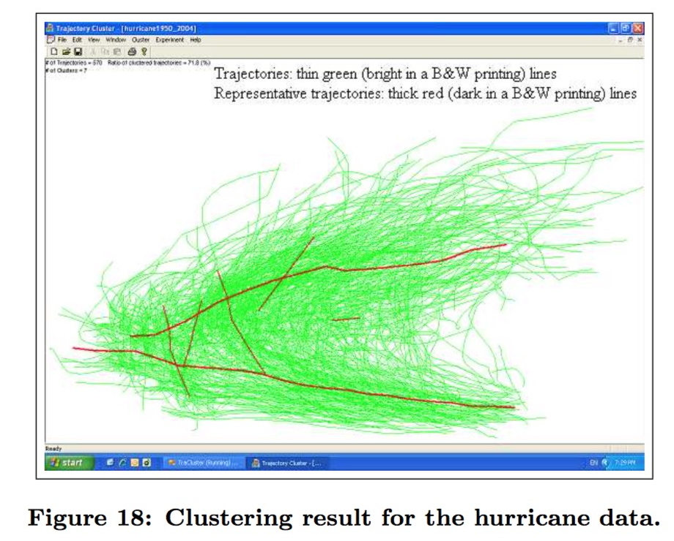
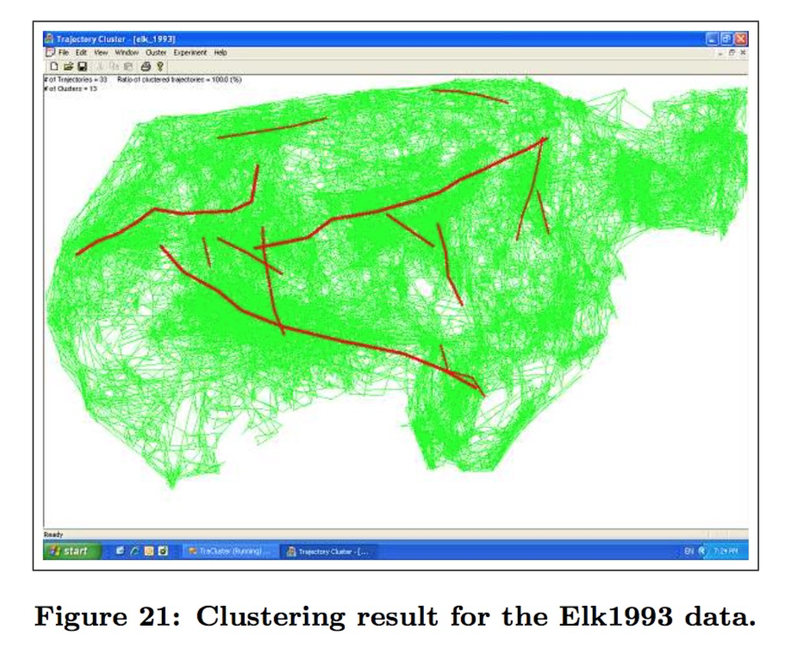
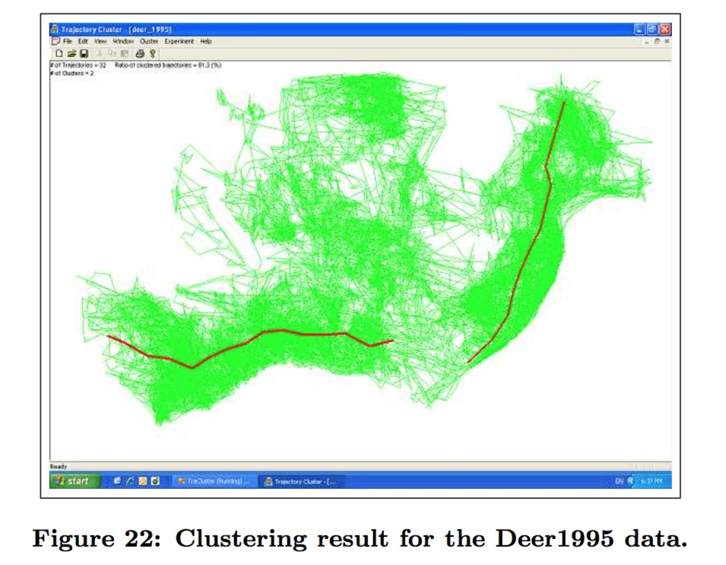
Clustering Results
Above figures shows the clustering result for the given dataset. The result is valid and reasonable according to visual inspection and domain knowledge.

Slide 34
Conclusions
Proposed a novel framework, the partition-and-group framework, for clustering trajectories.
Designed a formal trajectory partitioning algorithm using the minimum description length(MDL) principle.
Proposed a density-based line-segment clustering algorithm.
Investigated for parameter value selection and clustering quality measure.
Demonstrated, by using various real data sets, that TRACLUS algorithm is very effective.

Slide 35
Future Work
Extensibility: to support undirected or weighted trajectories.
Parameter Insensitivity: to make the algorithm more insensitive to parameter values.
Efficiency: to improve the clustering performance by using an index to execute an neighborhood query.
Movement Patterns:to extend the algorithm to support various types of movement patterns, especially circular motion, now only support straight motion.
Temporal Information: to extend the algorithm to take account of temporal information during clustering.

Slide 36
Thank you !
Q&A?

