Slide 1
Chapter 10
Refrigeration and Heat Pump Systems

Slide 2
Learning Outcomes
Demonstrate understanding of basic vapor-compression refrigeration and heat pump systems.
Develop and analyze thermodynamic models of vapor-compression systems and their modifications, including
  sketching schematic and accompanying T-s diagrams.
  evaluating property data at principal states of the systems.
  applying mass, energy, and entropy balances for the basic processes.
  determining refrigeration and heat pump system performance, coefficient of performance, and capacity.

Slide 3
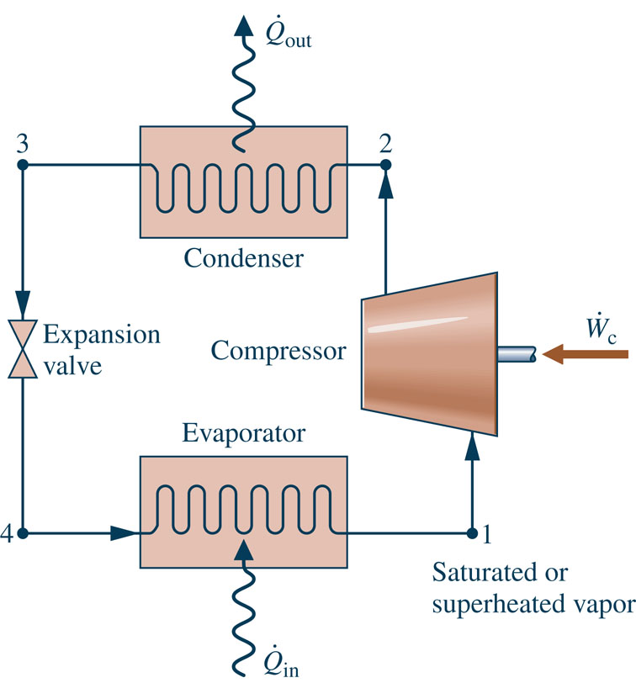
Vapor-Compression
Refrigeration Cycle
Most common refrigeration cycle in use today
There are four principal control volumes involving these components:
  Evaporator
  Compressor
  Condenser
  Expansion valve
Two-phase
liquid-vapor mixture
All energy transfers by work and heat are taken as positive in the directions of the arrows on the schematic and energy balances are written accordingly.
Notes:
Figure 10.3

Slide 4
The Vapor-Compression
Refrigeration Cycle
The processes of this cycle are
Process 4-1: two-phase liquid-vapor mixture of refrigerant is evaporated through heat transfer from the refrigerated space.
Process 1-2: vapor refrigerant is compressed to a relatively high temperature and pressure requiring work input.
Process 2-3: vapor refrigerant condenses to liquid through heat transfer to the cooler surroundings.
Process 3-4: liquid refrigerant expands to the evaporator pressure.
Two-phase
liquid-vapor mixture

Slide 5
The Vapor-Compression
Refrigeration Cycle
Engineering model:
  Each component is analyzed as a control volume at steady state.
  The compressor operates adiabatically.
  The refrigerant expanding through the valve undergoes a throttling process.
  Kinetic and potential energy changes are ignored.

Slide 6
The Vapor-Compression
Refrigeration Cycle
Applying mass and energy rate balances
Evaporator
(Eq. 10.3)
  The term is referred to as the refrigeration capacity, expressed in kW in the SI unit system or Btu/h in the English unit system.
  A common alternate unit is the ton of refrigeration which equals 200 Btu/min or about 211 kJ/min.

Slide 7
The Vapor-Compression
Refrigeration Cycle
Applying mass and energy rate balances
Compressor
  Assuming adiabatic compression
Condenser
Expansion valve
  Assuming a throttling process
(Eq. 10.4)
(Eq. 10.5)
(Eq. 10.6)

Slide 8
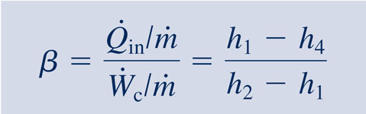
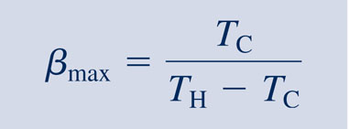
The Vapor-Compression
Refrigeration Cycle
Performance parameters
Coefficient of Performance (COP)
(Eq. 10.7)
Carnot Coefficient of Performance
(Eq. 10.1)
This equation represents the maximum theoretical coefficient of performance of any refrigeration cycle operating between cold and hot regions at T_{C} and T_{H}, respectively.

Slide 9
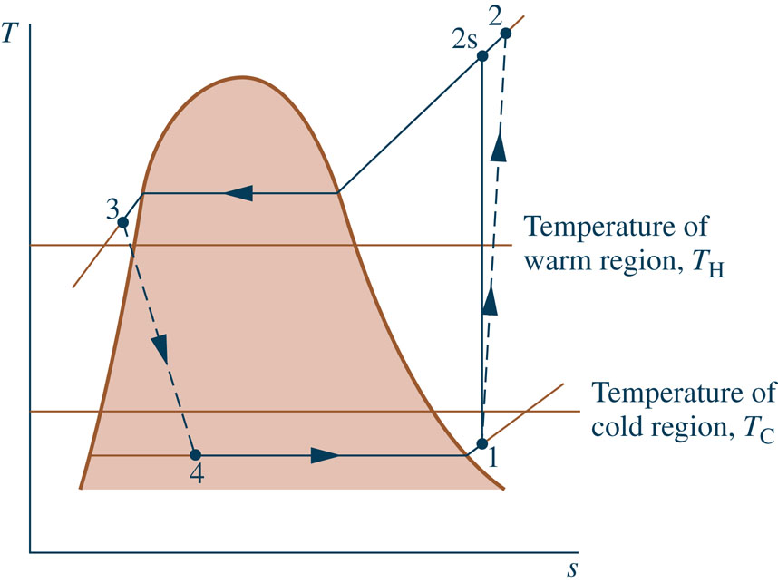
Features of
Actual Vapor-Compression Cycle
Heat transfers between refrigerant and cold and warm regions are not reversible.
  Refrigerant temperature in evaporator is less than T_{C}.
  Refrigerant temperature in condenser is greater than T_{H}.
  Irreversible heat transfers have negative effect on performance.
Back of Refrig.
Keep Ice Cream Cold

Slide 10
Features of
Actual Vapor-Compression Cycle
The COP decreases – primarily due to increasing compressor work input – as the
  temperature of the refrigerant passing through the evaporator is reduced relative to the temperature of the cold region, T_{C}.
  temperature of the refrigerant passing
T_{refrigerant} ↑
T_{refrigerant} ↓
through the condenser is increased relative to the temperature of the warm region, T_{H}.
Notes:
10

Slide 11
Features of
Actual Vapor-Compression Cycle
Irreversibilities during the compression process are suggested by dashed line from state 1 to state 2.
  An increase in specific entropy accompanies an adiabatic irreversible compression process. The work input for compression process 1-2 is greater than for the counterpart isentropic compression process 1-2s.
  Since process 4-1, and thus the refrigeration capacity, is the same for cycles 1-2-3-4-1 and 1-2s-3-4-1, cycle 1-2-3-4-1 has the lower COP.

Slide 12

Isentropic Compressor Efficiency
The isentropic compressor efficiency is the ratio of the minimum theoretical work input to the actual work input, each per unit of mass flowing:
work required in an isentropic compression from compressor inlet state to the exit pressure
(Eq. 6.48)
work required in an actual compression from compressor inlet state to exit pressure

Slide 13
Actual Vapor-Compression Cycle
Example: The table provides steady-state operating data for a vapor-compression refrigeration cycle using R-134a as the working fluid. For a refrigerant mass flow rate of 0.08 kg/s, determine the
(a) compressor power, in kW,
(b) refrigeration capacity, in tons,
(c) coefficient of performance,
(d) isentropic compressor efficiency.
State
h (kJ/kg)
1
241.35
2s
272.39
2
280.15
3
91.49
4
91.49
Notes:
13

Slide 14
Actual Vapor-Compression Cycle
State
h (kJ/kg)
1
241.35
2s
272.39
2
280.15
3
91.49
4
91.49
(a) The compressor power is
3.1 kW
(b) The refrigeration capacity is
3.41 tons
Notes:
14

Slide 15
Actual Vapor-Compression Cycle
State
h (kJ/kg)
1
241.35
2s
272.39
2
280.15
3
91.49
4
91.49
(c) The coefficient of performance is
3.86
Notes:
15

Slide 16
Actual Vapor-Compression Cycle
State
h (kJ/kg)
1
241.35
2s
272.39
2
280.15
3
91.49
4
91.49
(d) The isentropic compressor
efficiency is
0.8 = 80%
Notes:
16

Slide 17
p-h Diagram
The pressure-enthalpy (p-h) diagram is a thermodynamic property diagram commonly used in the refrigeration field.

Slide 18
Selecting Refrigerants
Refrigerant selection is based on several factors:
  Performance: provides adequate cooling capacity cost-effectively.
  Safety: avoids hazards (i.e., toxicity).
  Environmental impact: minimizes harm to stratospheric ozone layer and reduces negative impact to global climate change.

Slide 19
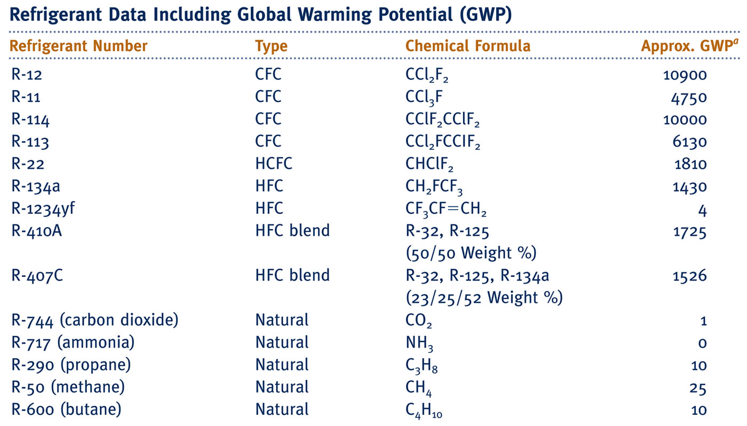
Refrigerant Types and Characteristics
Global Warming Potential (GWP) is a simplified index that estimates the potential future influence on global warming associated with different gases when released to the atmosphere.

Slide 20
Refrigerant Types and Characteristics
Chlorofluorocarbons (CFCs) and Hydrochlorofluorocarbons (HCFCs) are early synthetic refrigerants each containing chlorine. Because of the adverse effect of chlorine on Earth’s stratospheric ozone layer, use of these refrigerants is regulated by international agreement.
Hydrofluorocarbons (HFCs) and HFC blends are chlorine-free refrigerants. Blends combine two or more HFCs. While these chlorine-free refrigerants do not contribute to ozone depletion, with the exception of R-1234yf, they have high GWP levels.
Natural refrigerants are nonsynthetic, naturally occurring substances which serve as refrigerants. These include carbon dioxide, ammonia, and hydrocarbons. These refrigerants feature low GWP values; still, concerns have been raised over the toxicity of NH₃ and the safety of the hydrocarbons.

Slide 21
Ammonia-Water Absorption Refrigeration
Absorption refrigeration systems have important commercial and industrial applications.
The principal components of an ammonia-water absorption system are shown in the figure.
Absorber
coolant

Slide 22
Ammonia-Water Absorption Refrigeration
  The left-side of the schematic includes components familiar from the discussion of the vapor-compression system: evaporator, condenser, and expansion valve. Only ammonia flows through these components.
Absorber
coolant
Notes:
22

Slide 23
Ammonia-Water Absorption Refrigeration
  The right-side of the schematic includes components that replace the compressor of the vapor-compression refrigeration system: absorber, pump, and generator. These components involve liquid ammonia-water solutions.
Absorber
coolant
Notes:
23

Slide 24
Ammonia-Water Absorption Refrigeration
A principal advantage of the absorption system is that – for comparable refrigeration duty – the pump work input required is intrinsically much less than for the compressor of a vapor-compression system.
Absorber
coolant
Notes:
24

Slide 25
Ammonia-Water Absorption Refrigeration
Specifically, in the absorption system ammonia vapor coming from the evaporator is absorbed in liquid water to form a liquid ammonia-water solution.
The liquid solution is then pumped to the higher operating pressure. For the same pressure range, significantly less work is required to pump a liquid solution than to compress a vapor (see discussion of Eq. 6.51b).
Absorber
coolant
Notes:
25

Slide 26
Ammonia-Water Absorption Refrigeration
However, since only ammonia vapor is allowed to enter the condenser, a means must be provided to retrieve ammonia vapor from the liquid solution.
This is accomplished by the generator using heat transfer from a relatively high-temperature source.
Absorber
coolant
Notes:
26

Slide 27
Ammonia-Water Absorption Refrigeration
Steam or waste heat that otherwise might go unused can be a cost-effective choice for the heat transfer to the generator.
Alternatively, the heat transfer can be provided by solar thermal energy, burning natural gas or other combustibles, and in other ways.
Absorber
coolant
Notes:
27

Slide 28
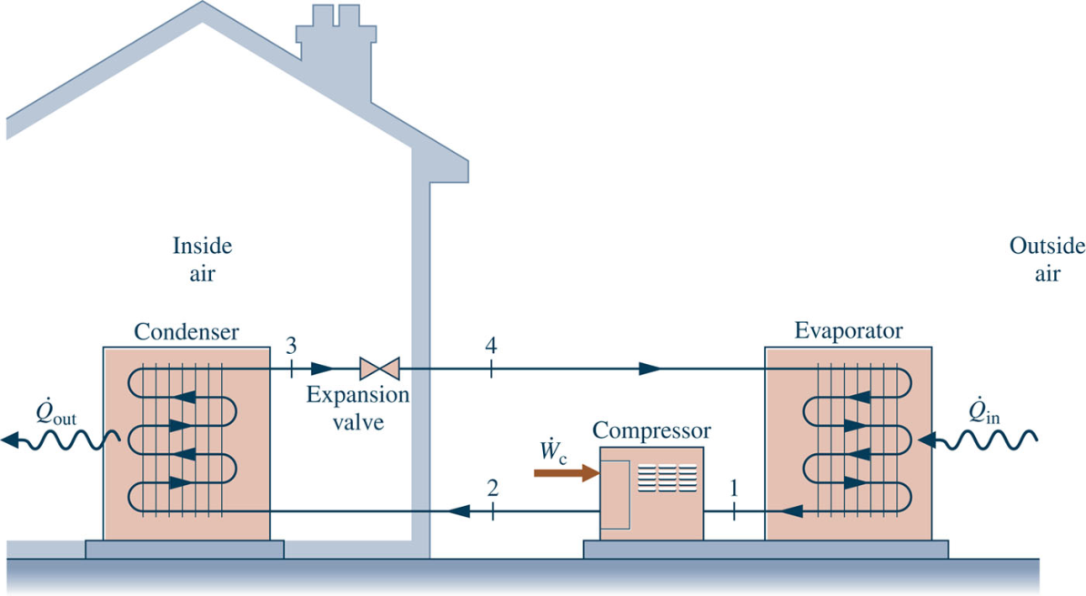
Vapor-Compression Heat Pump Systems
The objective of the heat pump is to maintain the temperature of a space or industrial process above the temperature of the surroundings.
Principal control volumes involve these components:
  Evaporator
  Compressor
  Condenser
  Expansion valve

Slide 29
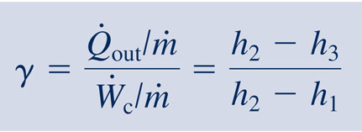
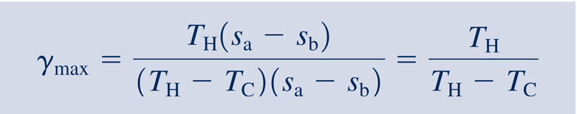
The Vapor-Compression Heat Pump Cycle
Performance parameters
Coefficient of Performance
(Eq. 10.10)
Carnot Coefficient of Performance
(Eq. 10.9)
This equation represents the maximum theoretical coefficient of performance of any heat pump cycle operating between cold and hot regions at T_{C} and T_{H}, respectively.

Slide 30
Vapor-Compression Heat Pump System
The method of analysis for vapor-compression heat pumps closely parallels that for vapor-compression refrigeration systems.
Example: A vapor-compression heat pump cycle with R-134a as the working fluid maintains a building at 20ºC when the outside temperature is 5ºC. The refrigerant mass flow rate is 0.086 kg/s. Additional steady state operating data are provided in the table. Determine the
(a) compressor power, in kW,
(b) heat transfer rate provided to the building, in kW,
(c) coefficient of performance.
State
h (kJ/kg)
1
244.1
2
272.0
3
93.4
Notes:
30

Slide 31
Vapor-Compression Heat Pump System
State
h (kJ/kg)
1
244.1
2
272.0
3
93.4
(a) The compressor power is
2.4 kW
(b) The heat transfer rate provided to the building is
15.4 kW
Notes:
31

Slide 32
Vapor-Compression Heat Pump System
State
h (kJ/kg)
1
244.1
2
272.0
3
93.4
(c) The coefficient of
performance is
6.4
Comment: Applying Eq. 10.9, the maximum theoretical coefficient of performance of any heat pump cycle operating between cold and hot regions at T_{C} and T_{H}, respectively is
19.5
Notes:
32

Slide 33
Brayton Refrigeration Cycle
The working fluids of vapor-compression systems undergo liquid-to-vapor phase change. In Brayton refrigeration systems the working fluid remains a gas throughout.
The Brayton refrigeration cycle is the reverse of the Brayton power cycle introduced in Sec. 9.6 as shown in the figure.

Slide 34
Brayton Refrigeration Cycle
The processes of this cycle are
Process 1-2: the refrigerant gas, which may be air, enters the compressor at state 1 and is compressed to state 2.
Process 2-3: The gas is cooled by heat transfer to the warm region at temperature T_{H}.
Process 3-4: The gas expands through the turbine to state 4, where the temperature, T₄, is well below T_{C}.
Process 4-1: Refrigeration of the cold region is achieved through heat transfer from the cold region to the gas as it
passes from state 4 to state 1, completing the cycle.
The work developed by the turbine assists in driving the compressor.

Slide 35
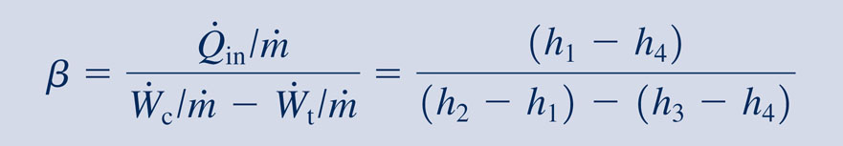
Brayton Refrigeration Cycle
The coefficient of performance of the cycle is
(Eq. 10.11)

Slide 36
Automotive Air Conditioning using Carbon Dioxide
Owing to its low GWP of 1, carbon dioxide, CO₂, is under consideration for use in automotive air-conditioning systems.
The schematic shows such a CO₂-charged air-conditioning system. It combines aspects of gas refrigeration with aspects of vapor-compression refrigeration.

Slide 37
Automotive Air Conditioning using Carbon Dioxide
The processes of this cycle are
Process 1-2: CO₂ vapor enters the compressor at state 1 and is compressed to state 2.
Process 2-3: The CO₂ vapor is then cooled to state 3 by heat transfer to the ambient at temperature T_{H}.
Process 3-4: The CO₂ next passes through the interconnecting heat exchanger, where it is further cooled to temperature T₄ < T_{H}.

Slide 38
Automotive Air Conditioning using Carbon Dioxide
Process 4-5: The CO₂ expands through the valve to state 5, where it is a two-phase liquid-vapor mixture at T₅ < T_{C}, the passenger cabin temperature, and then enters the evaporator.
Process 5-6: As the CO₂ passes through the evaporator, it is vaporized by heat transfer from the passenger cabin.
Process 6-1: Finally, CO₂ vapor passes through the heat exchanger, where its temperature is increased to T₁, completing the cycle.

Slide 39
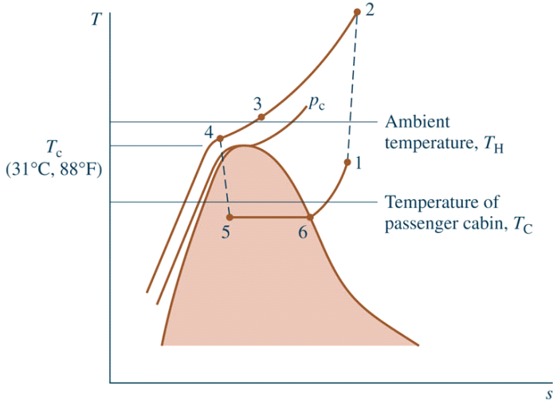
Automotive Air Conditioning using Carbon Dioxide
The states visited in the cycle are shown on the T-s diagram:
(Critical
Temperature
of CO₂)

Slide 40
Two-phase
liquid-vapor mixture

