Slide 1
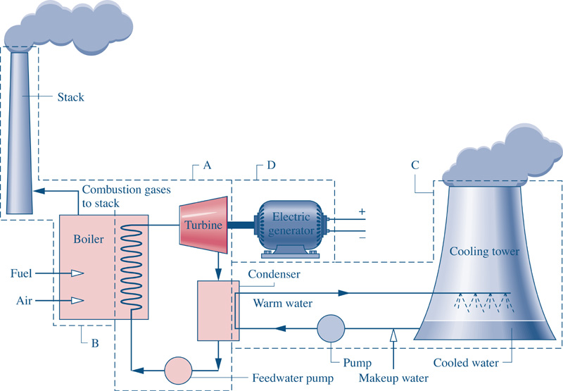
Fig08_01
Goal: Want to generate 1000 MW (1x10⁶ kJ/s) of Electricity.
Fig08_01

Slide 2
How much fuel is required to run a 1000 MW power plant?
What are the C02 and other emissions?

Slide 3
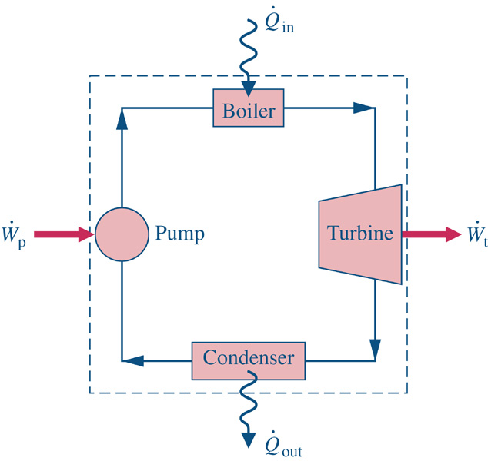
Consider a system similar to what the components that we’ve just analyzed in class.
1
2
Assume ideal conditions initially
Look up state properties
4
3

Slide 4
Consider a system similar to what the components that we’ve just analyzed in class.
1
2
How to address actual conditions?
Measure/observe any two independent
state properties and look up the rest.
B) Use reasonable efficiency estimates
for each device
4
3

Slide 5
How much fuel is required to run a 1000 MW power plant?
What are the C02 and other emissions?
1.) Given state variables, determine Ideal and Actual performances
Performance ?

Slide 6
How much fuel is required to run a 1000 MW power plant?
What are the C02 and other emissions?
1.) Given state variables, determine Ideal and Actual performances
2.) Determine the mass flow rate for 1000 MW generation

Slide 7
How much fuel is required to run a 1000 MW power plant?
What are the C02 and other emissions?
1.) Given state variables, determine Ideal and Actual performances
2.) Determine the mass flow rate for 1000 MW generation
3.) Determine Boiler fuel requirements

Slide 8
How much fuel is required to run a 1000 MW power plant?
What are the C02 and other emissions?
1.) Given state variables, determine Ideal and Actual performances
2.) Determine the mass flow rate for 1000 MW generation
3.) Determine Boiler fuel requirements
What about Boiler efficiency? Say 85% efficient implies:

Slide 9
How much fuel is required to run a 1000 MW power plant?
What are the C02 and other emissions?
1.) Given state variables, determine Ideal and Actual performances
2.) Determine the mass flow rate for 1000 MW generation
3.) Determine Boiler fuel requirements
4.) How much Fuel will be required?
Assume Coal (the dominant fuel source) is used with a heating
value of 5,500 kJ/kg coal.

Slide 10
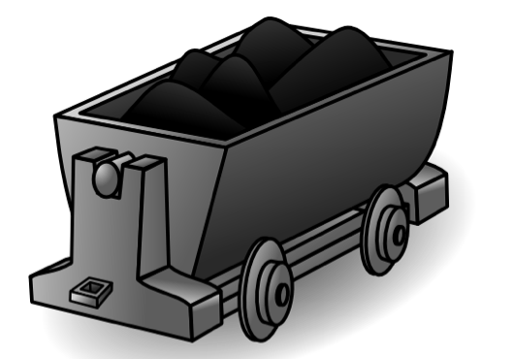
A coal train car has a carry capacity of
Approximately 100,000 kg/car
In 1999 the average train could pull 70 coal cars. Consequently, about 10 train
deliveries per day are required to run the power plant!

Slide 11
How much fuel is required to run a 1000 MW power plant?
What are the C02 and other emissions?
1.) Given state variables, determine Ideal and Actual performances
2.) Determine the mass flow rate for 1000 MW generation
3.) Determine Boiler fuel requirements
4.) Determine chemical balance
5.) Realistic chemical makeup of coal might be
(on a mass chemical analysis)

Slide 12
How much fuel is required to run a 1000 MW power plant?
What are the C02 and other emissions?
4.) Determine chemical balance
5.) Realistic chemical makeup of coal might be
(on a mass chemical analysis)
6.) Consider 100 kg fuel and 125% theoretical air (realistic)

Slide 13
6.) Consider 100 kg fuel and 125% theoretical air (realistic)
Theoretical O₂ Requirements:
= 7.102+6.994/2 + 0.0156)=10.614 moles=“X”

Slide 14
Theoretical O₂ Requirements:
= 7.102+6.994/2 + 0.0156)=10.614 moles=“X”
Determine the mass of CO₂ emitted:

Slide 15
Theoretical O₂ Requirements:
= 7.102+6.994/2 + 0.0156)=10.614 moles=“X”
Determine the mass of CO₂ emitted:
How much do things weigh?

Slide 16
Theoretical O₂ Requirements:
= 7.102+6.994/2 + 0.0156)=10.614 moles=“X”
Determine the mass of CO₂ emitted:
How much do things weigh? ~ 650 Blue Whales per Day!

Slide 17
Theoretical O₂ Requirements:
= 7.102+6.994/2 + 0.0156)=10.614 moles=“X”
Determine the mass of Sulfurous Acid H₂SO₃ emitted: (acid rain)

Slide 18
Determine the mass of Sulfurous Acid H₂SO₃ emitted: (acid rain)
For our 1000 MW Power Plant using 67.65x10⁶ kg fuel/day

Slide 19
Determine the mass of Sulfurous Acid H₂SO₃ emitted: (acid rain)
For our 1000 MW Power Plant using 67.65x10⁶ kg fuel/day
Or, about 3 Blue Whales per day!

