Slide 1
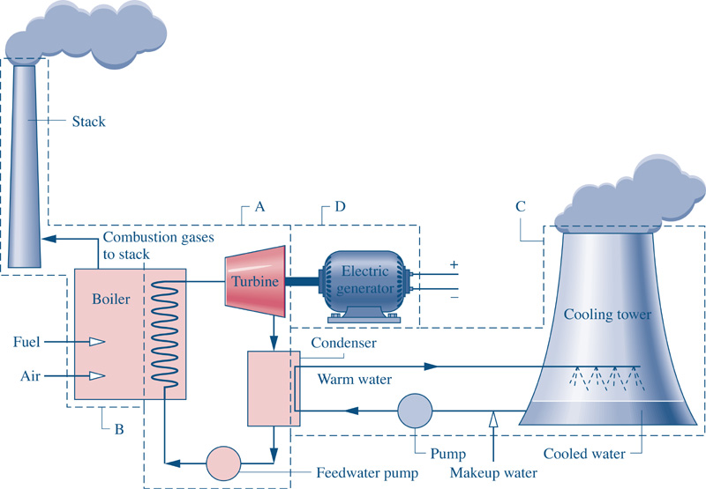
Fig08_01
Goal: Want to generate 1000 MW (1x10⁶ kJ/s) of Electricity.
Fig08_01

Slide 2
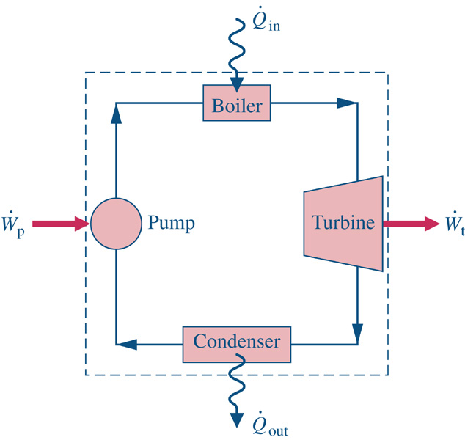
Consider a system similar to what the components that we’ve just analyzed in class.
1
2
Assume ideal conditions initially
Look up state 2 properties
4
3

Slide 3
Consider a system similar to what the components that we’ve just analyzed in class.
1
2
Assume ideal conditions initially
Look up state properties
4
3

Slide 4
Consider a system similar to what the components that we’ve just analyzed in class.
1
2
How to address actual conditions?
Measure/observe any two independent
state properties and look up the rest.
B) Use reasonable efficiency estimates
for each device
4
3

Slide 5
Consider a system similar to what the components that we’ve just analyzed in class.
1
2
How to address actual conditions?
Measure/observe any two independent
state properties and look up the rest.
B) Use reasonable efficiency estimates
for each device
4
3

Slide 6
Performance ?

Slide 7
Fig08_01
Goal: Want to generate 1000 MW (1x10⁶ kJ/s) of Electricity.
Fig08_01

Slide 8
How much fuel is required to run a 1000 MW power plant?
What are the C02 and other emissions?

Slide 9
How much fuel is required to run a 1000 MW power plant?
What are the C02 and other emissions?
1.) Given state variables, determine Ideal and Actual performances
Performance ?

Slide 10
How much fuel is required to run a 1000 MW power plant?
What are the C02 and other emissions?
1.) Given state variables, determine Ideal and Actual performances
2.) Determine the mass flow rate for 1000 MW generation

Slide 12
How much fuel is required to run a 1000 MW power plant?
What are the C02 and other emissions?
1.) Given state variables, determine Ideal and Actual performances
2.) Determine the mass flow rate for 1000 MW generation

Slide 13
How much fuel is required to run a 1000 MW power plant?
What are the C02 and other emissions?
1.) Given state variables, determine Ideal and Actual performances
2.) Determine the mass flow rate for 1000 MW generation
3.) Determine Boiler fuel requirements

Slide 15
How much fuel is required to run a 1000 MW power plant?
What are the C02 and other emissions?
1.) Given state variables, determine Ideal and Actual performances
2.) Determine the mass flow rate for 1000 MW generation
3.) Determine Boiler fuel requirements

Slide 16
How much fuel is required to run a 1000 MW power plant?
What are the C02 and other emissions?
1.) Given state variables, determine Ideal and Actual performances
2.) Determine the mass flow rate for 1000 MW generation
3.) Determine Boiler fuel requirements
What about Boiler efficiency? Say 85% efficient implies:

Slide 17
How much fuel is required to run a 1000 MW power plant?
What are the C02 and other emissions?
1.) Given state variables, determine Ideal and Actual performances
2.) Determine the mass flow rate for 1000 MW generation
3.) Determine Boiler fuel requirements
4.) Determine chemical balance

Slide 18
How much fuel is required to run a 1000 MW power plant?
What are the C02 and other emissions?
1.) Given state variables, determine Ideal and Actual performances
2.) Determine the mass flow rate for 1000 MW generation
3.) Determine Boiler fuel requirements
4.) Determine chemical balance
Assume Coal (the dominant fuel source) is used with a heating
value of 5,500 kJ/kg coal.

Slide 20
How much fuel is required to run a 1000 MW power plant?
What are the C02 and other emissions?
1.) Given state variables, determine Ideal and Actual performances
2.) Determine the mass flow rate for 1000 MW generation
3.) Determine Boiler fuel requirements
4.) Determine chemical balance
Assume Coal (the dominant fuel source) is used with a heating
value of 5,500 kJ/kg coal.

Slide 21
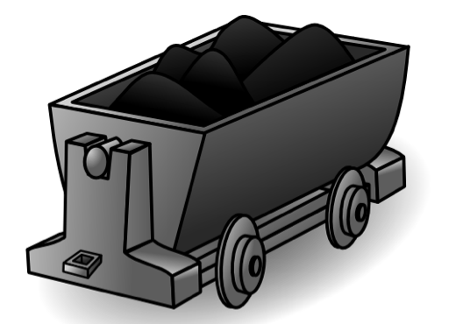
A coal train car has a carry capacity of
Approximately 100,000 kg/car

Slide 22
A coal train car has a carry capacity of
Approximately 100,000 kg/car
In 1999 the average train could pull 70 coal cars. Consequently, about 10 train
deliveries per day are required to run the power plant!

