Slide 1
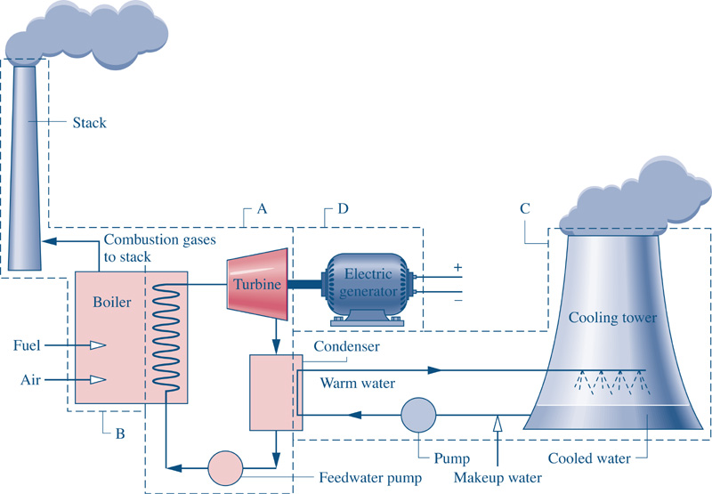
Fig08_01
Goal: Want to generate 1000 MW (1x10⁶ kJ/s) of Electricity.
Fig08_01

Slide 2
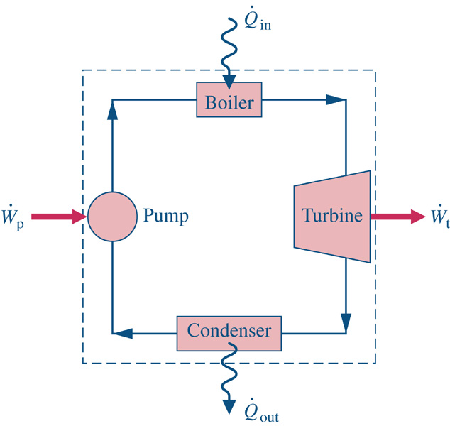
Consider a system similar to what the components that we’ve just analyzed in class.
1
2
Assume ideal conditions initially
Look up state 2 properties
4
3

Slide 3
Consider a system similar to what the components that we’ve just analyzed in class.
1
2
Assume ideal conditions initially
Look up state properties
4
3

Slide 4
Consider a system similar to what the components that we’ve just analyzed in class.
1
2
How to address actual conditions?
Measure/observe any two independent
state properties and look up the rest.
B) Use reasonable efficiency estimates
for each device
4
3

Slide 5
Consider a system similar to what the components that we’ve just analyzed in class.
1
2
How to address actual conditions?
Measure/observe any two independent
state properties and look up the rest.
B) Use reasonable efficiency estimates
for each device
4
3

Slide 6
What is h_{(3-Ideal)} ?

Slide 7
What is h_{(3-Ideal)} ?

Slide 9
Consider a system similar to what the components that we’ve just analyzed in class.
1
2
4
3

Slide 10
Consider a system similar to what the components that we’ve just analyzed in class.
1
2
4
3

Slide 11
Consider a system similar to what the components that we’ve just analyzed in class.
1
2
4
3

Slide 13
Consider a system similar to what the components that we’ve just analyzed in class.
1
2
4
3

Slide 14
Performance ?

