Slide 1
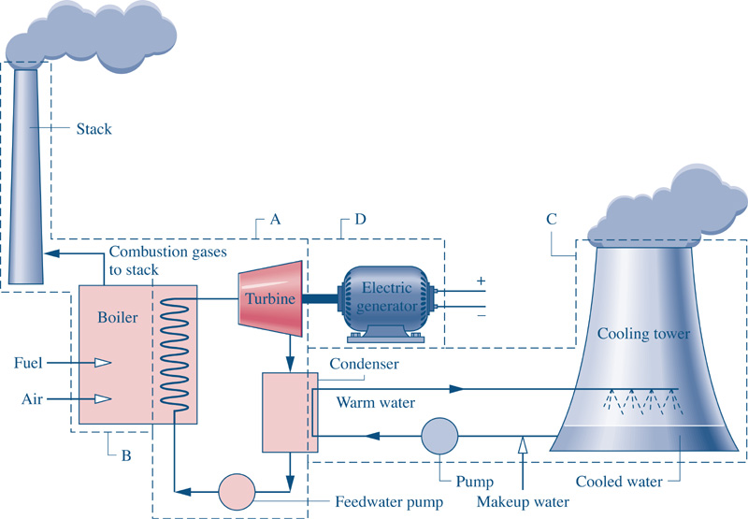
Fig08_01
Goal: Want to generate 1000 MW (1x10⁶ kJ/s) of Electricity.
Fig08_01

Slide 2
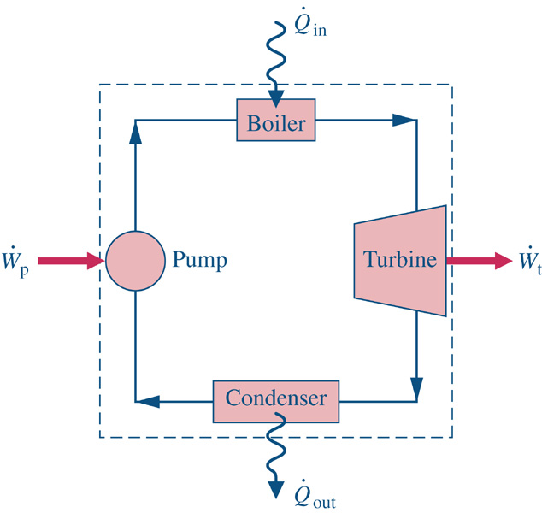
Consider a system similar to what the components that we’ve just analyzed in class.
1
2
Assume ideal conditions initially
Look up state 2 properties
4
3

Slide 5
Consider a system similar to what the components that we’ve just analyzed in class.
1
2
Assume ideal conditions initially
Look up state 2 properties
4
3

Slide 6
Consider a system similar to what the components that we’ve just analyzed in class.
1
2
Assume ideal conditions initially
Look up state 2 properties
4
3

Slide 8
Consider a system similar to what the components that we’ve just analyzed in class.
1
2
Assume ideal conditions initially
Look up state 2 properties
4
3

