Slide 1
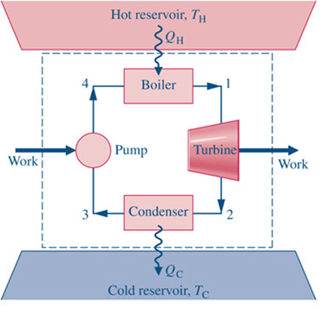
 | P (bar) | T (deg C) | v | h | s | x
1 | 100 | 600
2 | .7 |  |  |  |  | .90
3 | .7 |  |  |  |  | 0.0
4 | 100 |  | 1.0797 x10⁻³
Draw P-v and T-s
Diagrams

Slide 2
 | P (bar) | T (deg C) | v | h | s | x
1 | 100 | 600 | ^{.03837} | 3625.3 | 6.903 | NA
2 | .7 | 89.95 | 2.1286 | 2431.7 | 6.8509 | .90
3 | .7 | 89.95 | .001306 | 376.7 | 1.1919 | 0.0
4 | 100 | 140 | 1.0797 x10⁻³ | 589.13 | 1.7391 | NA
Draw P-v and T-s
Diagrams

Slide 3
 | P (bar) | T (deg C) | v | h | s | x
1 | 100 | 600
2 | .7 | 120 | 2.571 | 2719.6 | 7.6375
3 | .7 |  |  |  |  | 0.0
4 | 100 | 150 | ^{.00109} | 632.2 | 1.8418
Draw P-v and T-s
Diagrams

Slide 4
 | P (bar) | T (deg C) | v | h | s | x
1 | 100 | 600 | ^{.03837} | 3625.3 | 6.903 | NA
2 | .7 | 120 | 2.571 | 2719.6 | 7.6375
3 | .7 | 89.95 | .001306 | 376.7 | 1.1919 | 0.0
4 | 100 | 150 | ^{.00109} | 632.2 | 1.8418
Draw P-v and T-s
Diagrams

