Slide 1
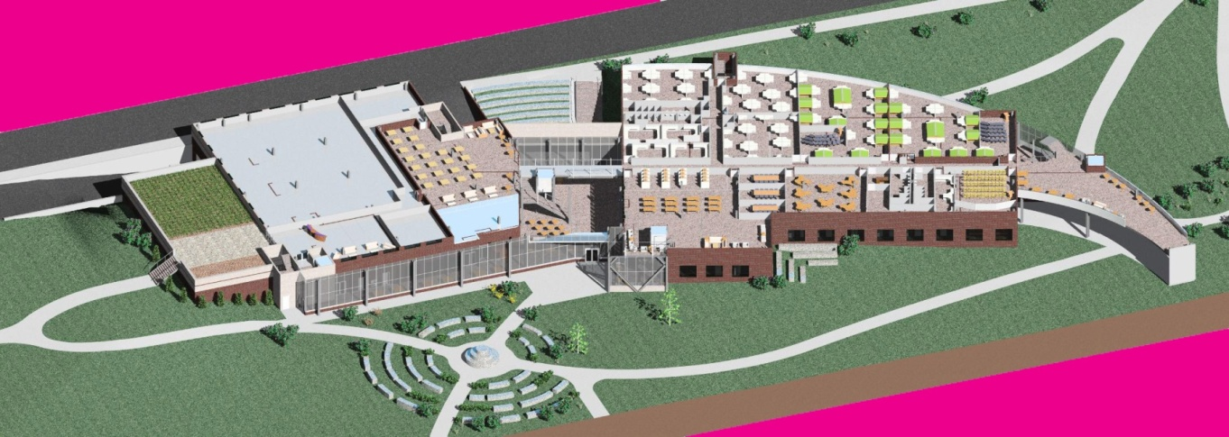
Building Information Modeling Adoption at Penn State
John I. Messner, Ph.D.
Associate Professor of Architectural Engineering
Director of the Computer Integrated Construction Research Program
The Pennsylvania State University
jmessner@engr.psu.edu
Notes:
Note to ID: Use this slide to introduce each section within a session.

Slide 2

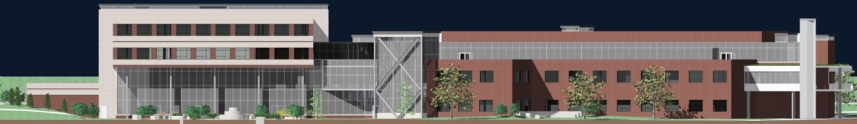
Architectural Engineering
Established in 1910
Graduate 100 students each year
Focus on engineered systems in buildings
5 year program, ABET accredited program
4 option areas
  Construction
  Structural
  Mechanical
  Lighting / Electrical
Upon graduation, most students work for:
  Engineering consulting firms,
  Large integrated architectural practices, or
  Large construction companies

Slide 3
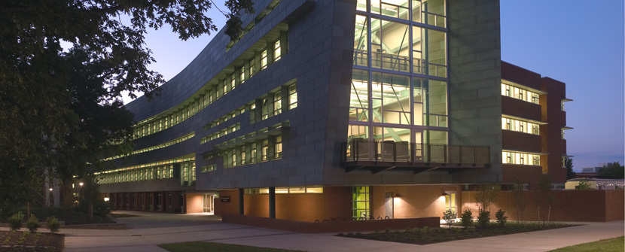
Architecture
5 year, National Architectural Accrediting Board (NAAB) accredited program
Graduate 40 students each year
Educational priorities:
  The practice of architecture: drawing, model-making, service learning, and hands-on construction activities with non-traditional means of building delivery (such as design-build and digital fabrication)
  Visualization & Fabrication: advanced visualization methods, with the study of building delivery and fabrication processes.
  Sustainability: research agendas in the area of sustainability and “green architecture.”
One semester study abroad in Rome, Italy

Slide 4
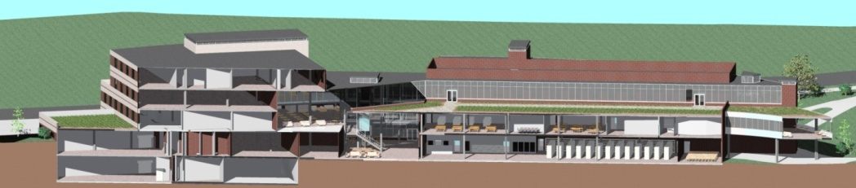
Evolution of BIM Implementation
2004:
2005:
2006:
2007:
  Started a 1 credit BIM Seminar course with Autodesk’s assistance
  Started integrating Revit Architecture into 2nd year CAD course
  4D Modeling in undergraduate curriculum
  Students started to use Revit for architecture projects
  Expanded BIM into earlier courses
    Workshop addressing Revit, 3DsMax and
    Integrated Environmental Solutions IES<VE>

Slide 5
Current & Future Courses with BIM in AE
Current
Future
Engr Design
Working Drawings
Architecture
Architecture Studio
Architecture Studio
Mechanical Engr for Bldg
Senior Thesis
Engineering
Lighting / Elec Engr for Bldg
Structural
Engr for Bldg
Intro to Construction
Precon
Services
Project Controls
Construction
Year 1
Year 2
Year 3
Year 4
Year 5

Slide 6
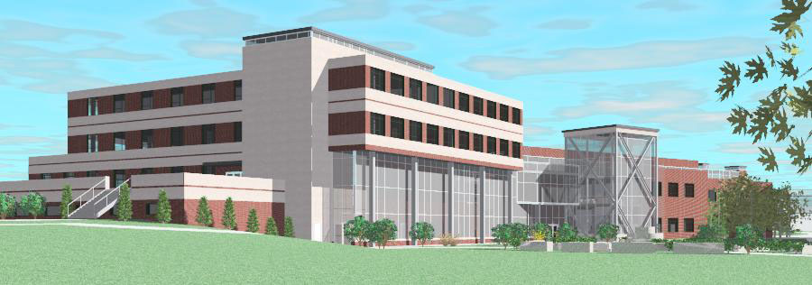
Current Status in Architectural Engineering
Architectural BIM
  Starts in 2nd Year for all students (some see Revit in 1st year)
  Used throughout architectural studio courses (2nd & 4th Yr)
Engineering Analysis
  Structural, lighting and mechanical analysis tools used
  Limited interoperability, but under development
Construction Analysis
  Automated takeoffs and 4D CAD taught in 3rd year
  Advanced 4D CAD and design coordination in 5th year

Slide 7
Courses with BIM in Architecture
Current
Future
Architecture
Arch Studio
Arch Studio
Arch Studio
Arch Studio
Professional
Practice
Engineering
Environmental control systems
Tech System
Integration
Year 1
Year 2
Year 3
Year 4
Year 5

Slide 8
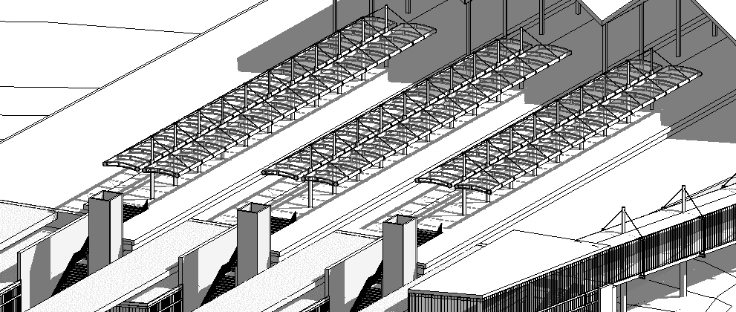
Current Status in Architecture
Architectural BIM
  Starts in 2nd Year
  Used in architectural studio courses (2nd to 5th Yr)
Engineering Analysis
  Daylighting and energy analysis tools used
Professional Practice
  Teaching the advantages of BIM for collaboration and integrated practice

Slide 9
And we are just getting started…
Future tasks that we are pursuing
Integrated design studios with integrated design tools
  Architecture and Architectural Engineering students working together in groups to design and plan the construction of a project
Earlier education on BIM concepts and foundational tools
  BIM Boot Camp for students
Common repository of learning content for self guided learning
  BIMwiki initiative
Integrated course assignments enabled by common models
  An integrated 3rd year course series around a common building project (Mechanical, electrical, lighting, structural, acoustical and construction system design)

Slide 10
Student Examples

Slide 11
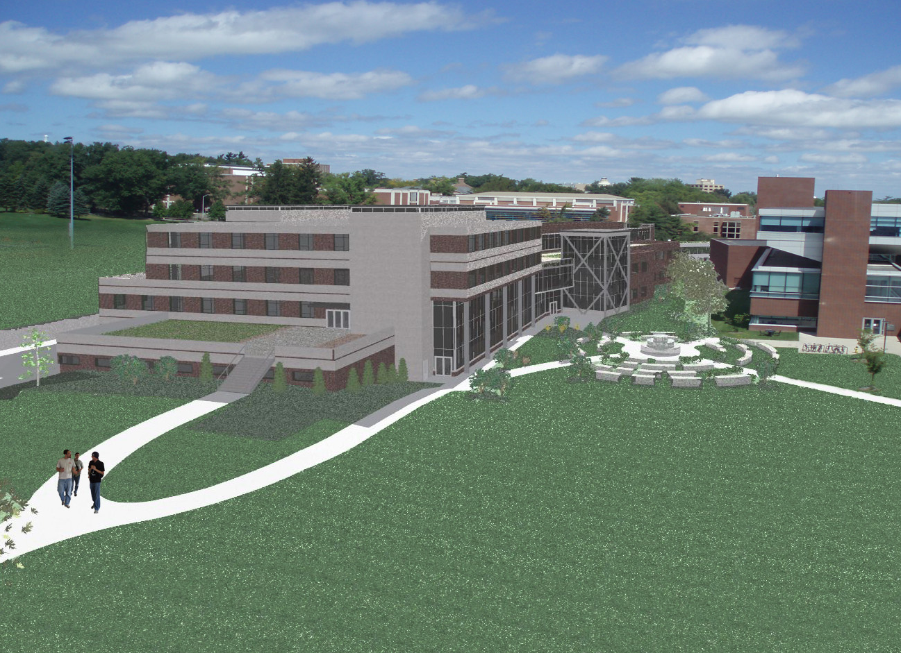
Signature Engineering Building
AE Associates
Group #17 Jim Gawthrop
Sonja Hinish Lindsay Lynch
Charlie Miller Ralph Kreider

Slide 12
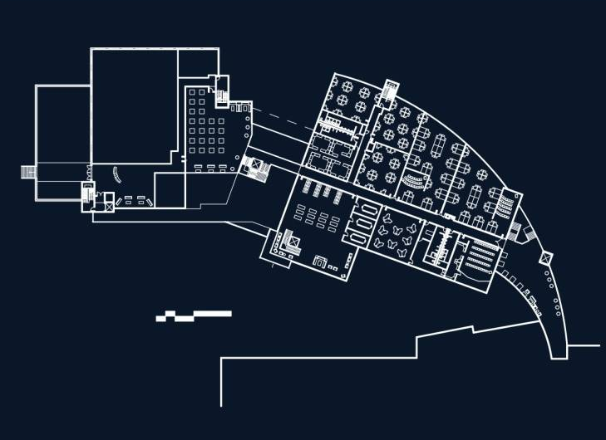

Second Floor Plan
Dean’s Office
AE Spaces
Library

Slide 13
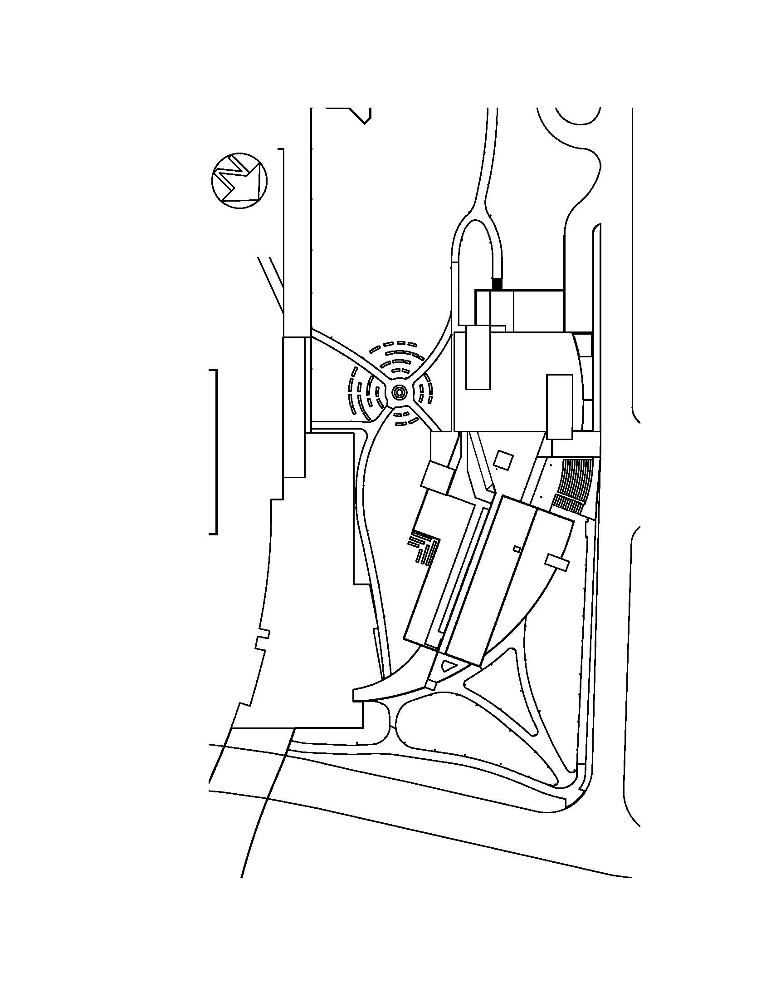
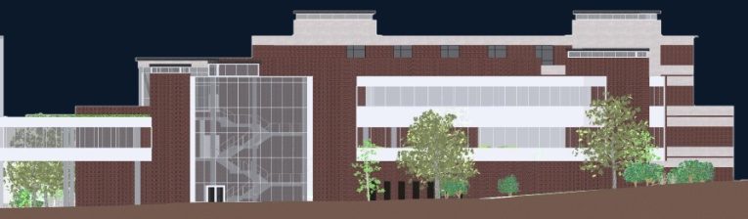
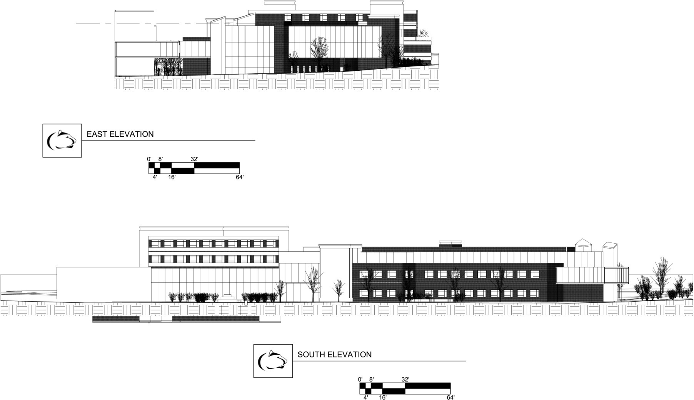
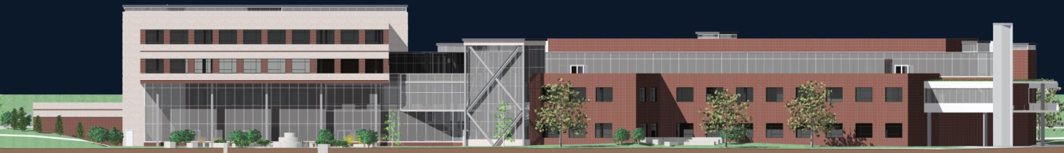
Elevations
East Elevation
South Elevation

Slide 14
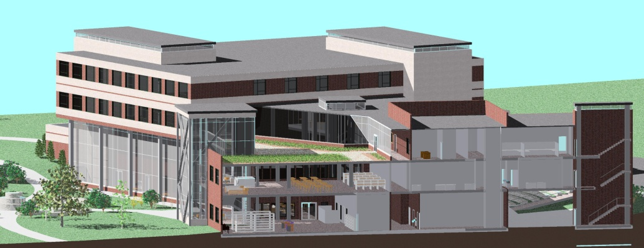

Building Sections
North – South Section
East – West Section

Slide 15
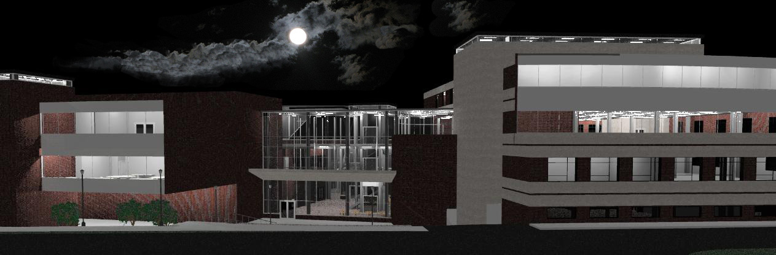
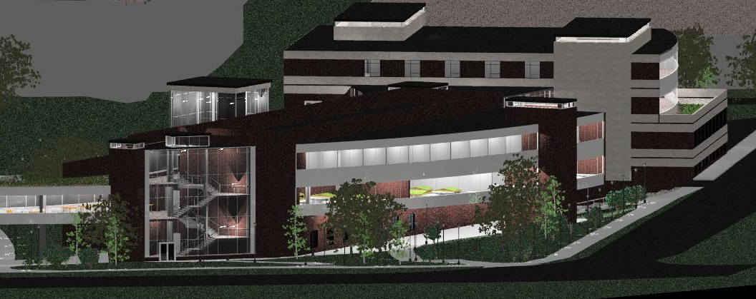
Night Exterior Perspectives
View of the North Entrance
Aerial View From Rec Hall

Slide 16

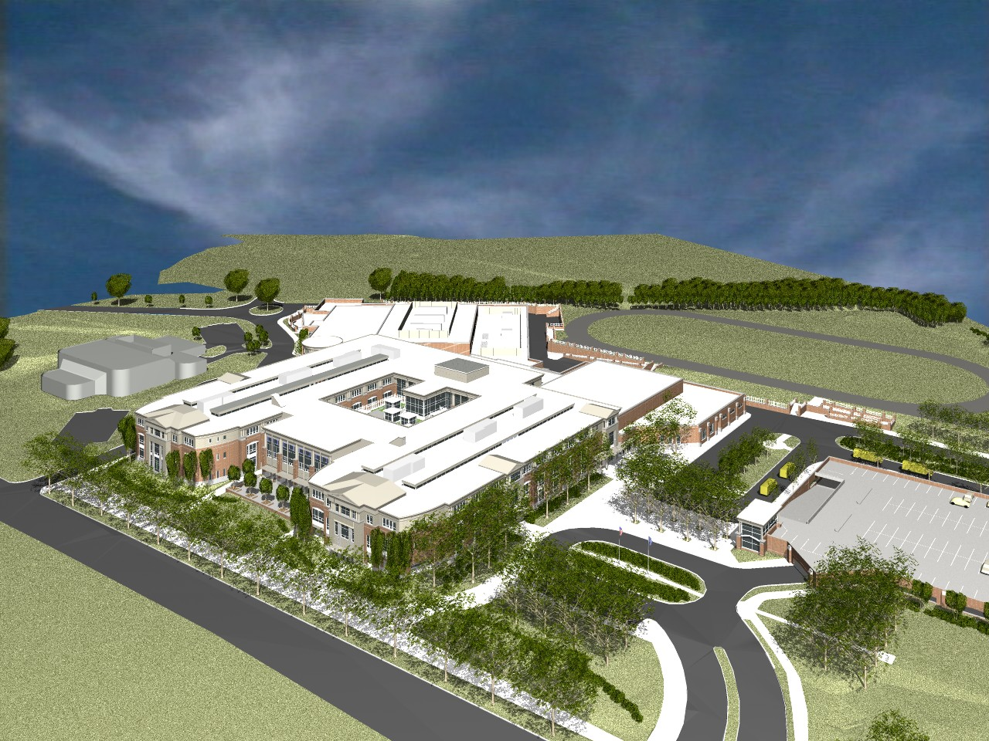
Effectiveness of Building Information Modeling in Value Engineering, Sequencing, & Site Logistics
T.C. Williams High School Replacement Project
Kyle Conrad
AE Senior Project
– Spring 2007
Construction Management

Slide 17
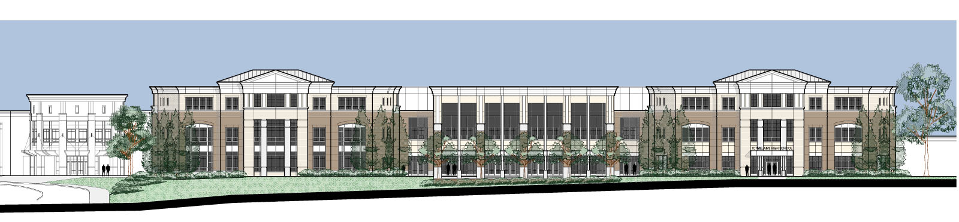
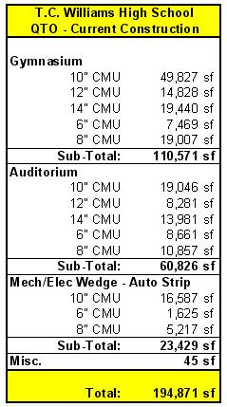
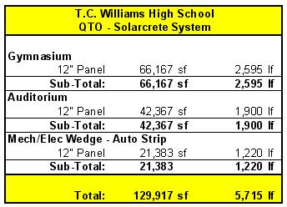
Building Information Model [ BIM ]
Project Background
BIM
Alternative Building Materials
Gymnasium
Acoustics
Heat Transfer
Structural
Frame
Work Sequencing
Site Logistics
Conclusions / Recommendations
Q & A
Kyle Conrad – Construction Management

Slide 18
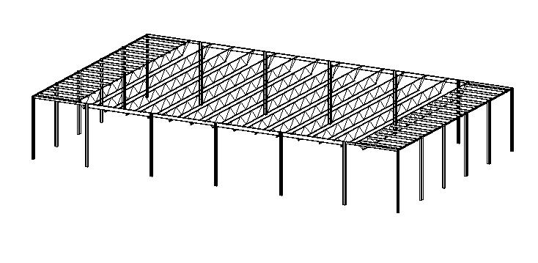
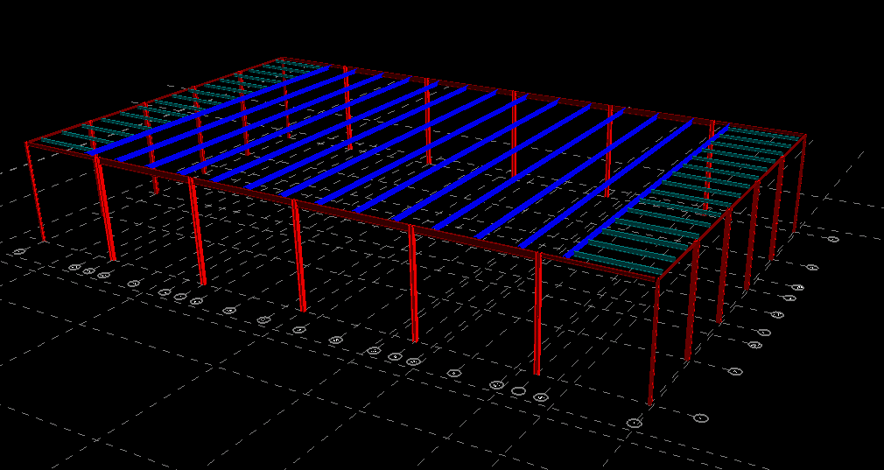
Structural Moment Frame
Autodesk Revit Structure 4
  Register with RAM International to obtain link for exporting Revit Structure 4 files to RAM
  Install Link
  Reopen Revit Structure 4 to export model to RAM
Project Background
BIM
Alternative Building Materials
Gymnasium
Acoustics
Heat Transfer
Structural
Frame
Work Sequencing
Site Logistics
Conclusions / Recommendations
Q & A
  Apply Loads per contract drawings
  Basic Wind Speed
    90 mph
    Exposure B
  Importance Factor of 1.15 applied to loading per structural engineer’s direction
RAM Structural Systems
Kyle Conrad – Construction Management

Slide 19
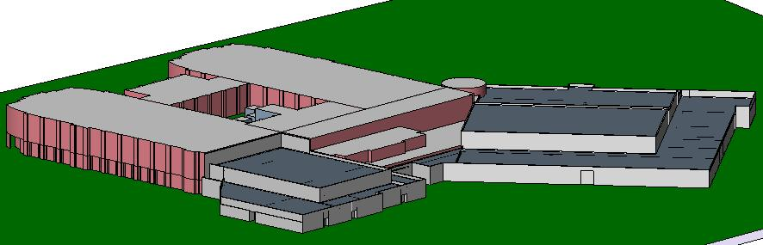
Work Sequencing / Site Logistics
Using NavisWorks Timeliner
Project Background
BIM
Alternative Building Materials
Gymnasium
Acoustics
Heat Transfer
Structural
Frame
Work Sequencing
Site Logistics
Conclusions / Recommendations
Q & A
Current CMU Construction Simulation
395 day structural system construction duration
Resequenced CMU Construction Simulation
695 day structural system construction duration
252 day project schedule extension
Proposed Solarcrete System Construction Simulation
158.5 day structural system construction duration
17 day project schedule reduction
Kyle Conrad – Construction Management

Slide 20
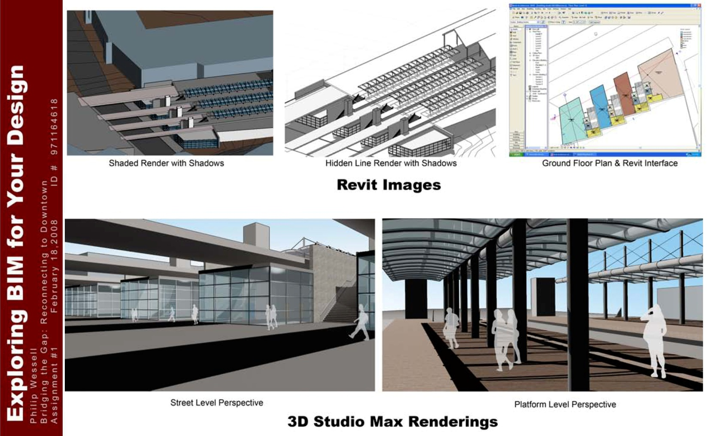
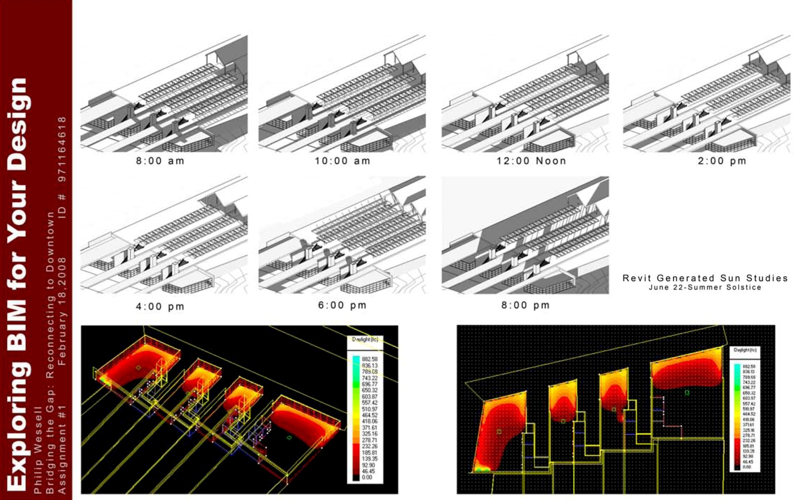
Student Examples
5th year Technical Systems Integration
student Philip Wessell, using Revit, 3dsMax and IES<VE>

Slide 21
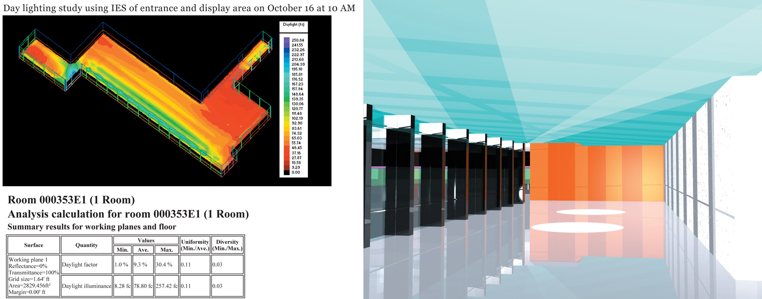
Student Examples
5th year Technical Systems Integration
student Nathan Derr, using Revit, 3dsMax and IES<VE>

Slide 22
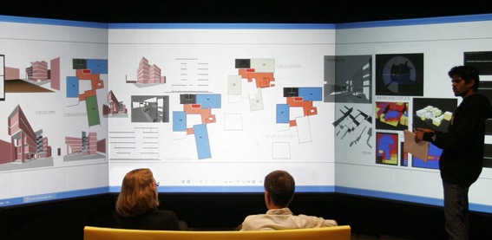
Student Examples graduate design studio
presentation of student Suhas Bambardeka using
BIM, program analysis, day-lighting analysis
(image from Immersive Environments Lab)

Slide 23
Display Systems and Digital Fabrication

Slide 24
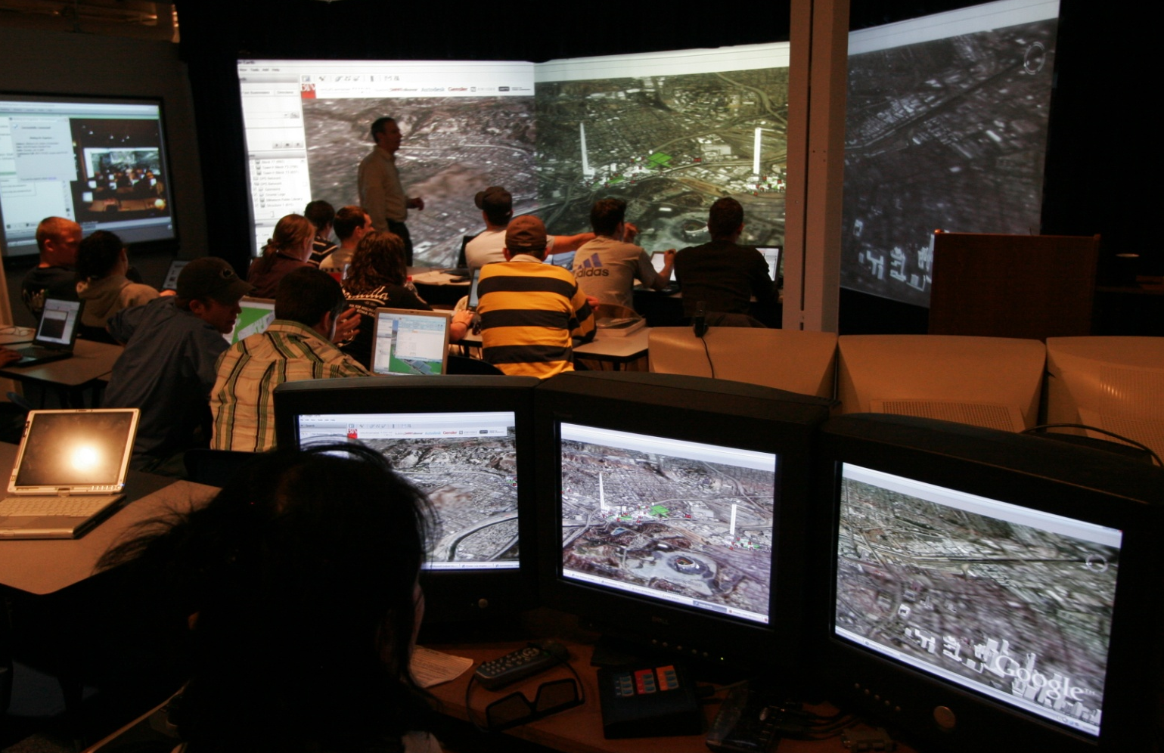
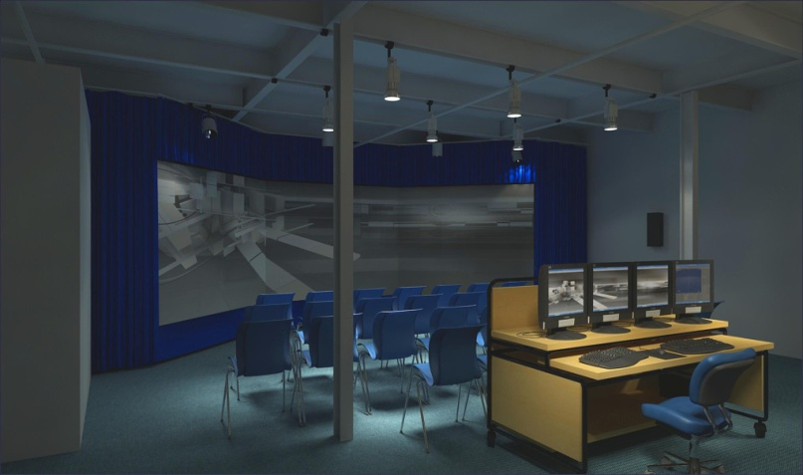
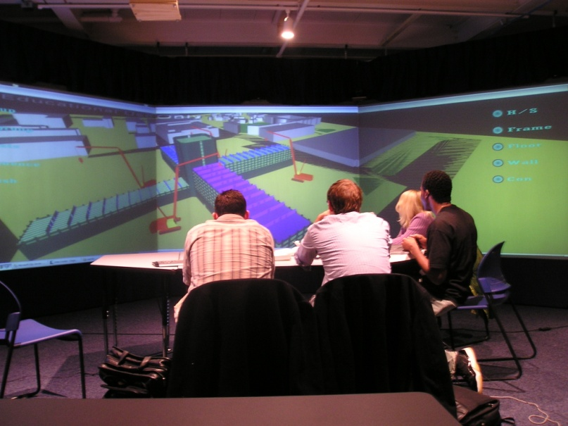
Immersive Construction (ICon) Lab
An affordable virtual environment and interactive workspace
ICon Lab Rendering
BIMStorm LAX in the ICon Lab
Characteristics:
  3 large backlit screens
  3D stereoscopic visualization
  Interactive SMARTBoard display
  20 tablet PCs
  Surround sound
  VNC nodes for each screen
Virtual Construction Simulator activity in the ICon Lab

Slide 25
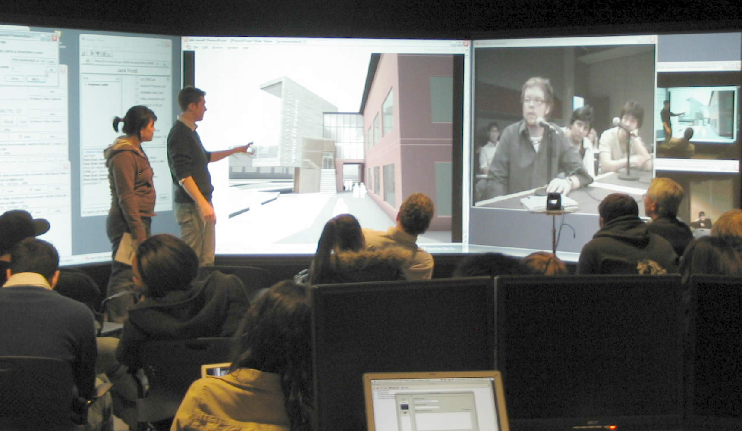
Immersive Environments Lab (IEL)

Slide 26
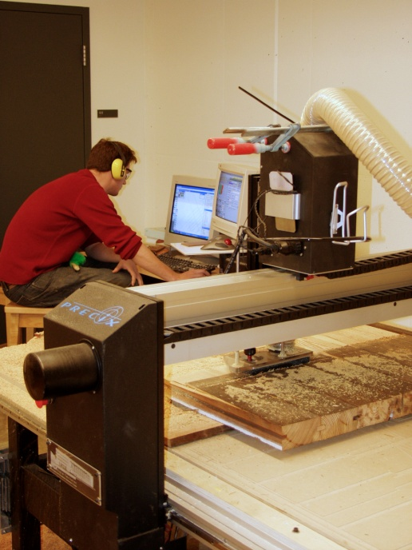
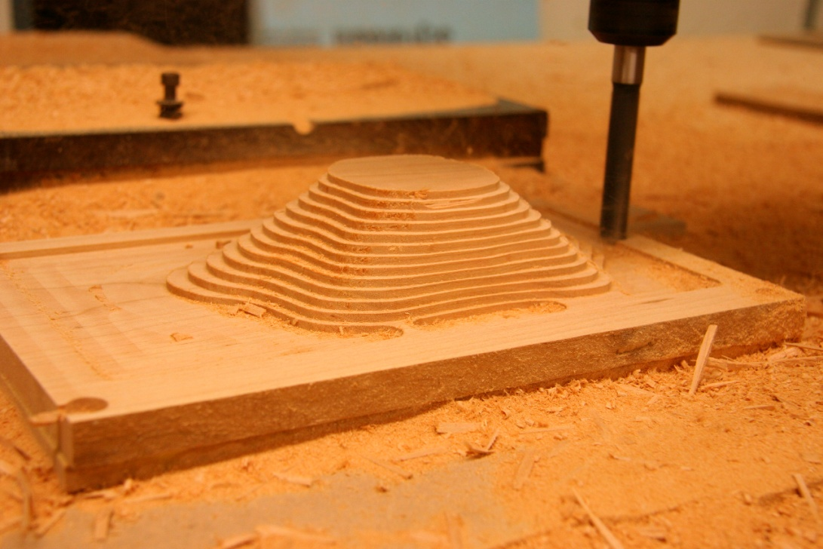
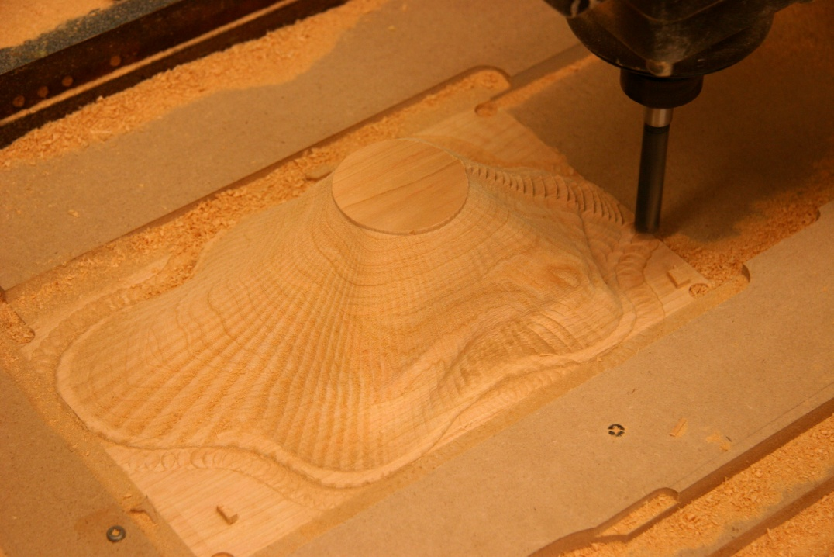
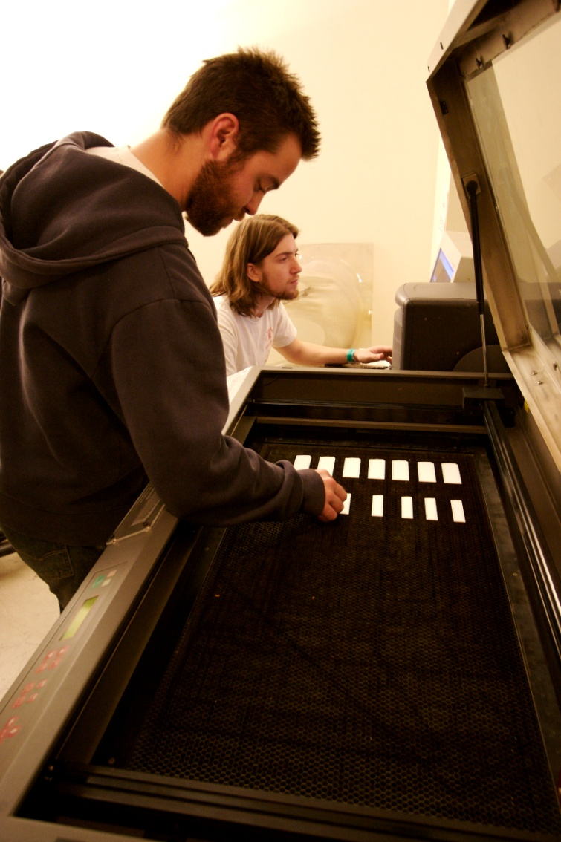
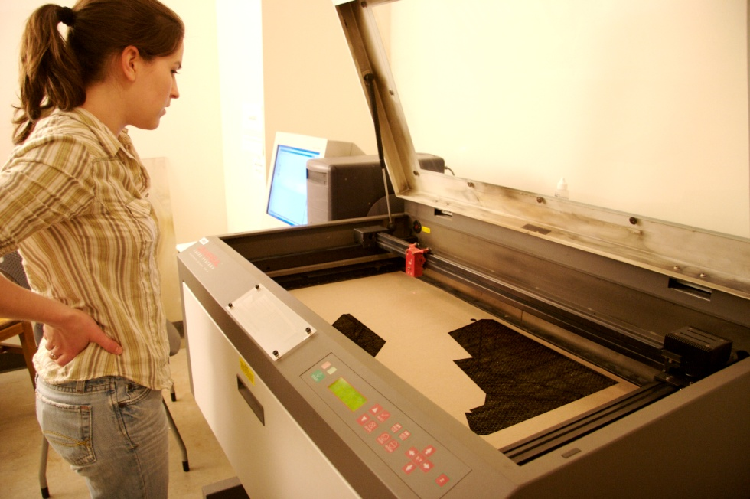
Digital Fabrication
3-axis CNC Router
Lasercutter

Slide 27
Views of the Faculty

Slide 28
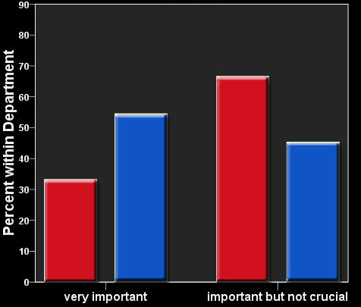
How important is it for students to use (or learn to use) different analysis applications ?
Department
Architectural Engineering
Architecture
66.7%
54.5%
45.5%
33.3%

Slide 29
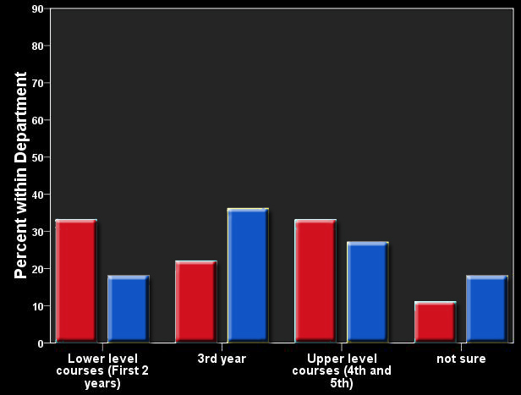
When should students be introduced to BIM?
Department
Architectural Engineering
Architecture
36.4%
33.3%
33.3%
27.3%
22.2%
18.2%
18.2%
11.1%
Spring 2008 – Departments of Architectural Engineering and Architecture

Slide 30
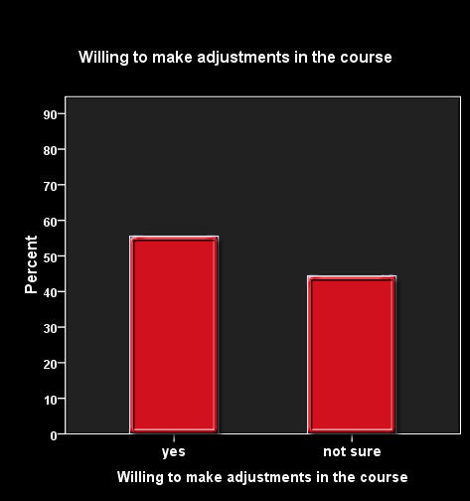
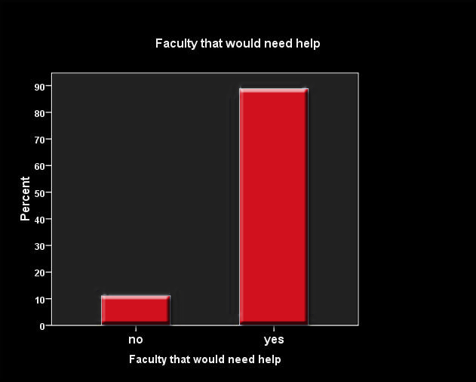
AE faculty willing to make
adjustments in their courses
AE faculty that would need
assistance to implement changes
88.9%
55.6%
44.4%
11.1%

Slide 31
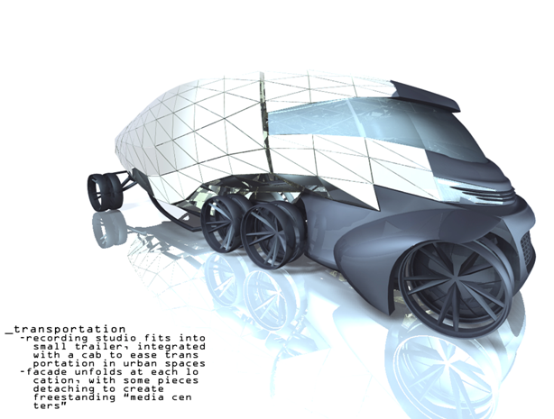
The Path Forward
Hoffman – 3rd Year Architecture Student

Slide 32
Challenges to overcome
Faculty training
  One day seminars
  Teaching assistants with application knowledge
Student training in applications while achieving educational objectives
  Application tutorials
  Autodesk training sessions
  Lower level course implementation
Institutional knowledge transfer on interoperability
  BIMwiki Initiative underway to capture standard workflows
  (www.coe.psu.edu/BIMwiki/)

Slide 33
Lessons Learned
Acknowledge faculty concerns and address them
Take every opportunity to inform and train
Students can effectively push the technology into the classroom if
  they are allowed,
  they have access to the software, and
  they are aware of the capabilities and benefits
Knowledge sharing is important, and difficult…
  We tend to relearn continuously
A good computing infrastructure and manager is critical

Slide 34
Acknowledgements
Raymond A. Bowers Program
Colleagues in Architectural Engineering and Architecture
Computer Integrated Construction Research Program members
ACSA
The many vendors who support the program
The National Science Foundation

Slide 35
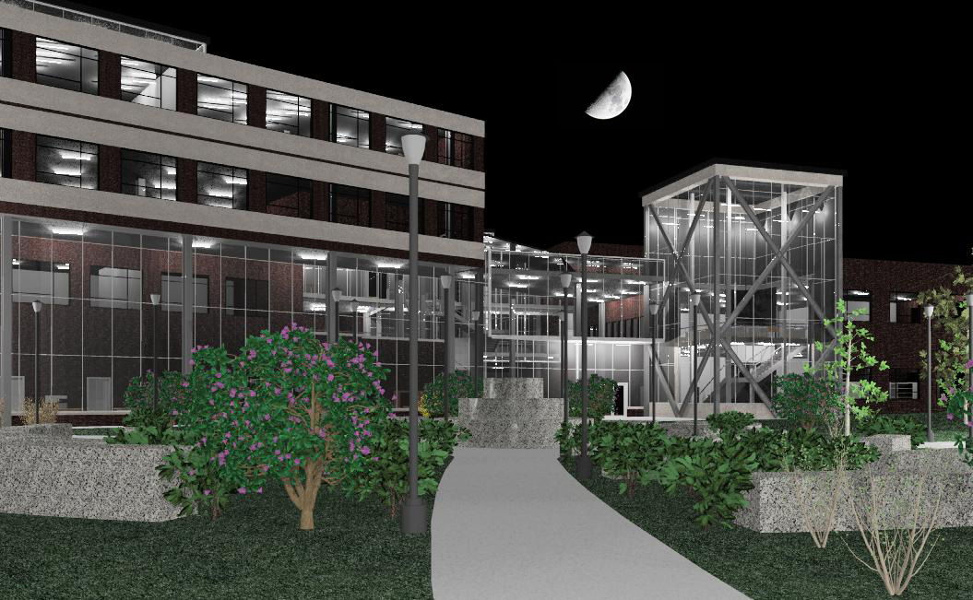
"You never change something by fighting the existing reality. To change something, build a new model that makes the existing model obsolete."
- Buckminster Fuller

