Slide 1

Autonomous Mapping Robot
Worcester Polytechnic Institute
Department of Electrical and Computer Engineering
Advisor:
R. James Duckworth
Co-Advisor:
David Cyganski
Jason Ogasian
Jonathan Hayden
Hiroshi Mita

Slide 2
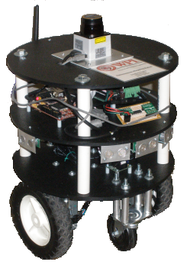
Overview
Project motivation
Background material
Robot functional overview
  Design requirements
  The chassis
  System electronics
  Onboard sensors
  Software implementation
Video demonstration of robot
Results and Recommendations

Slide 3
Project Motivation
Establish a need: search and rescue
How will the project fill this need?
Time and budget constraints
Leave room for future expansion
  Allow room for additional functionality
  Provide recommendations for future work

Slide 4
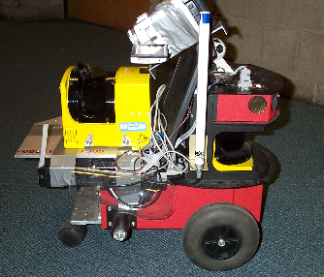
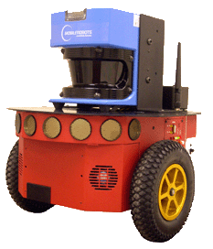
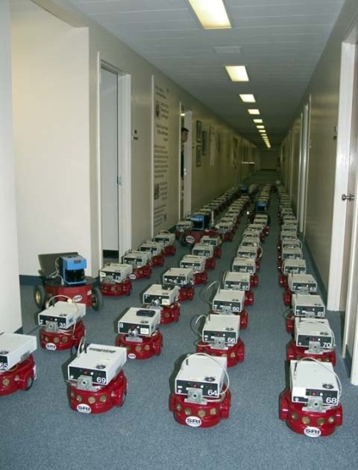
Background
Existing mapping robots
  CMU 3D texture mapping
  MobileRobots’ Mapperbot
  Centibots
Commonalities
with our design
3D texture mapping robot
Mapperbot
Centibots project

Slide 5
Robot Functional Overview
- System Requirements -
Project goal: Atwater Kent 3rd floor
Autonomous operation
Sufficient battery life/efficiency
Capable microprocessor
Wireless communication
Host software: Mapping GUI

Slide 6
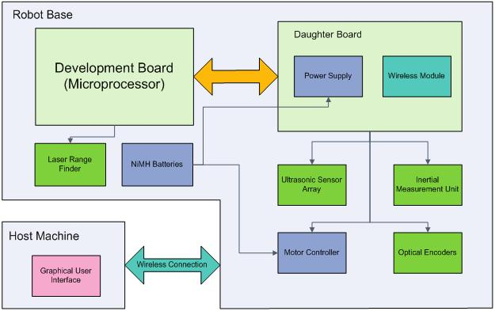
Robot Functional Overview
- High-level Diagram -

Slide 7
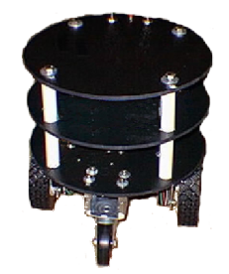
Robot Functional Overview
- Robot Chassis -
Requirements
  Size
  Wheels
  Motors
Purchasing vs. building
  Focus on ECE aspects of design
Zagros Robotics:
Max ’99 Mobile Robot Base.

Slide 8
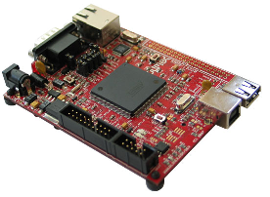
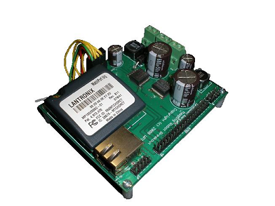
Robot Functional Overview
- System Electronics -
Development board
  Microprocessor (Linux)
  USB and Ethernet
Custom PCB
  Power circuitry
  Wireless module
  Interface sensors with
  development board
Olimex SAM9-L9260
Custom PCB

Slide 9
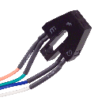
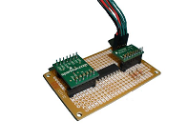

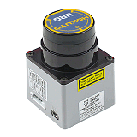
Robot Functional Overview
- Onboard Sensors-
Onboard Sensors
  Optical encoders
    Dead reckoning
  Inertial Measurement Unit
    Accelerometer and Gyroscope
  Ultrasonic sensors
    Short-range navigation
  Laser Rangefinder
    Mapping
Fairchild QRB1134
Custom IMU
Devantech SRF05
Hokuyo URG-04LX Laser

Slide 10
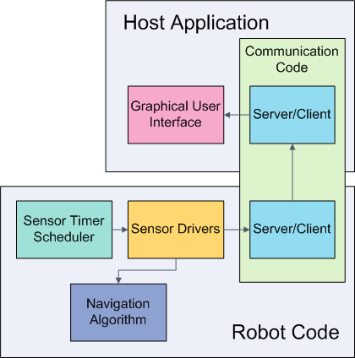
Robot Functional Overview
- Software Implementation -
Communication code
  Socket API
Robot code
  Sensor scheduling
  Sensor drivers
  Navigation algorithm
Host application
  Graphical user interface
Real-time Operation

Slide 11
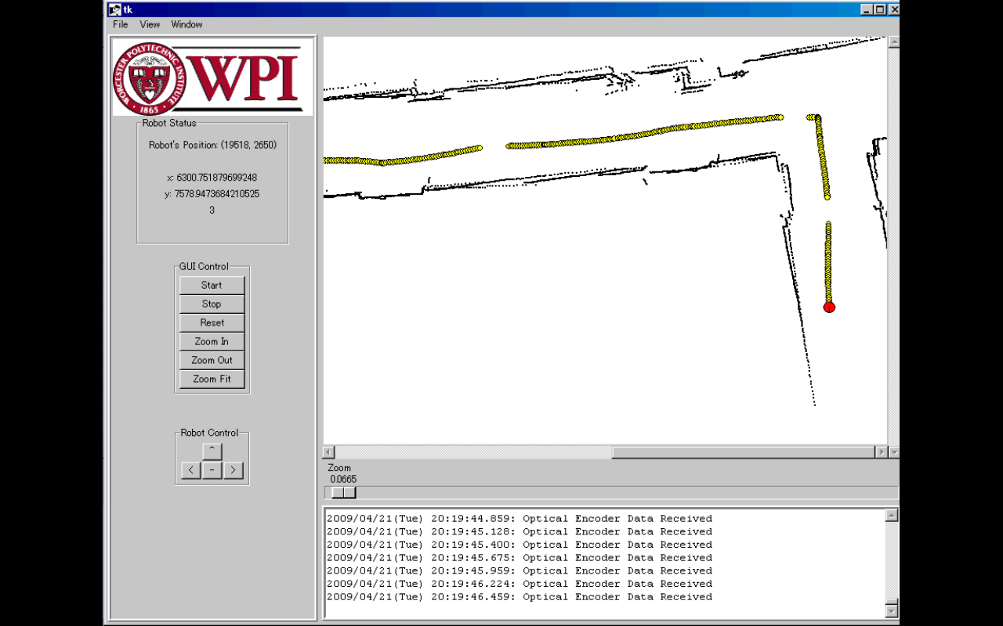
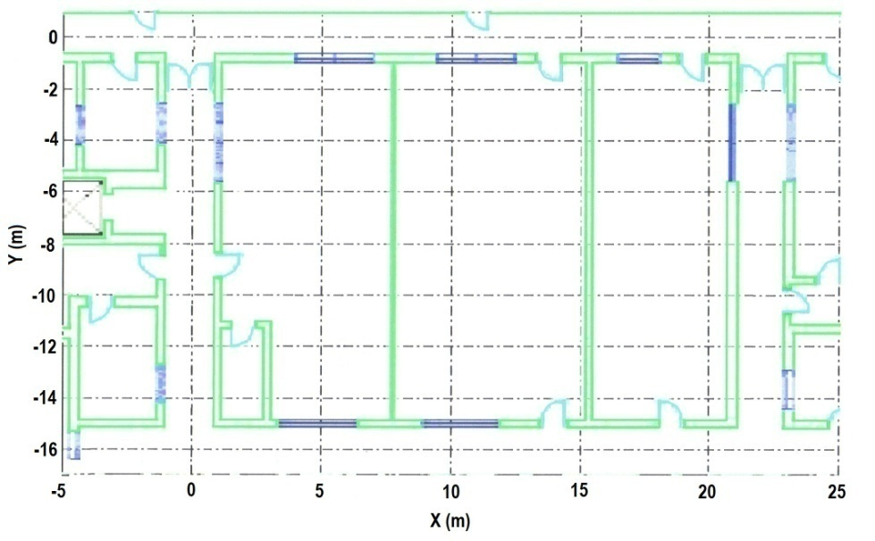
Graphical Map Display

Slide 12
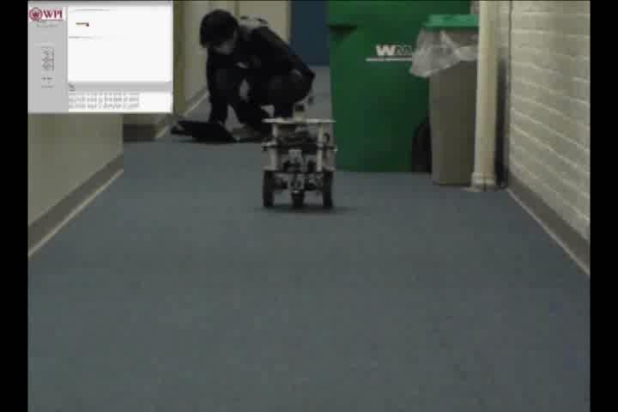
Video Demonstration

Slide 13
Results and Recommendations
Final product capabilities
  Autonomous operation
  Wireless data transfer
  GUI map displayed to user
  Systems working together to generate a map
  Positional data error of 5.6%
Suggestions for future work
  Human detection capability
  More robust chassis
  Improved navigation algorithm

Slide 14
Acknowledgements
Thanks to:
Professors Duckworth and Cyganski
ECE Shop
WPI Department of Electrical and Computer Engineering

Slide 15
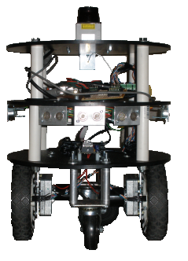
Questions?

