Slide 1
Firefighter Indoor Navigation using Distributed SLAM (FINDS)
Major Qualifying Project
Matthew Zubiel
Nick Long
Advisers:
Prof. Duckworth, Prof. Cyganski

Slide 2
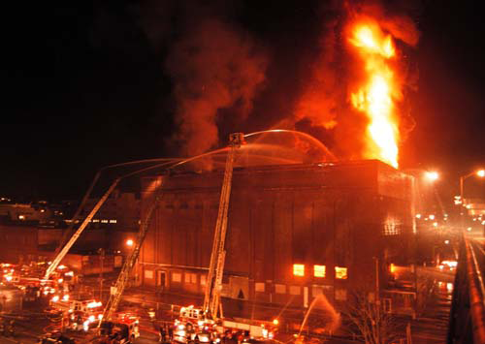
Need for Firefighter Location
Worcester Cold Storage Fire, December 1999
In total, 6 firefighters died after becoming lost
Need for outside personnel to keep track of responders indoors
Photo Credit :Worcester Telegram and Gazette
Incident Commanders need current location of each first responder
Communicate directions to firefighters
Direct rescue teams to downed firefighter

Slide 3
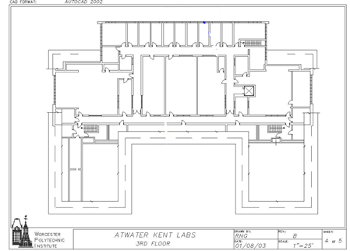
Technologies of Indoor Navigation and Tracking
GPS cannot be used indoors
Alternative ways to track:
RF-Based Localization and Tracking
Inertial Based Tracking
Dead Reckoning
Simultaneous Localization and Mapping (SLAM)
Build a map of the environment with no prior knowledge of surroundings
Build a track of the location of a user

Slide 4
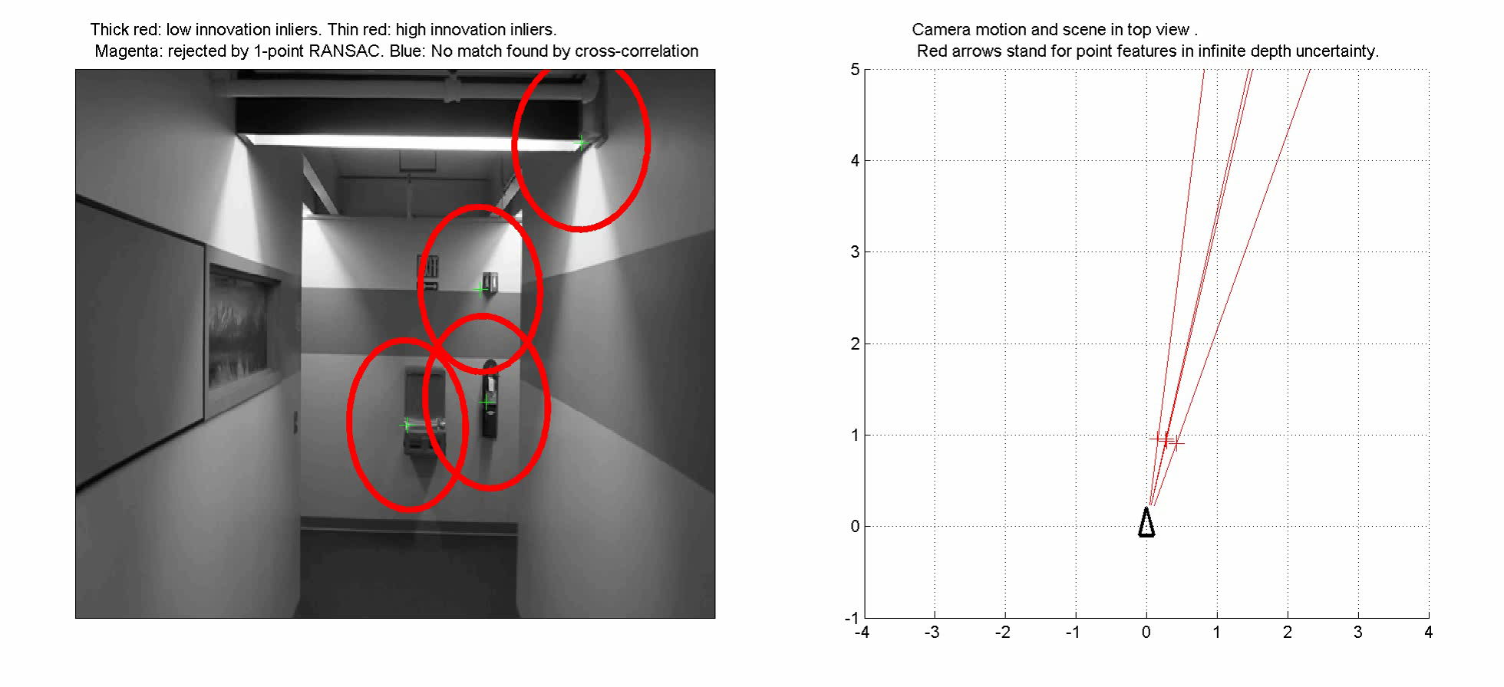
Simultaneous Localization and Mapping
EKFMonoSLAM [1]
Requires an image set for input
Detects features (corners) in images, and correlates detected corners from frame to frame
Produces predictions for both feature location and track
Sample EKFMonoSLAM Output
[1] Javier Civera, Oscar G. Grasa, Andrew J. Davison, J. M. M. Montiel, 1-Point RANSAC for EKF Filtering: Application to Real-Time Structure from Motion and Visual dometry, to appear in Journal of Field Robotics, October 2010.

Slide 5
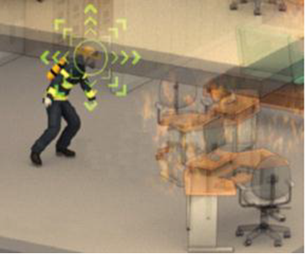
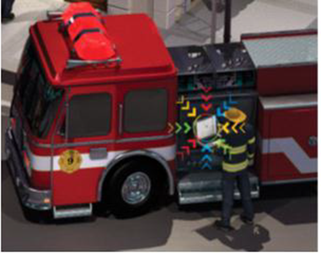

Our Approach
Initially attempted to develop a “real-time” tracking system
Processing time was very long
We attempted to take responsibility off EKFMonoSLAM by implementing functionality remotely
Video capture and corner detection were moved to a mobile unit
Mobile unit sent coordinates of detected corners to base station (laptop)
Mobile Unit
Base Station
Photo Courtesy Popular Science

Slide 6
Project Goals
Capture and process images in real time
Send resulting data to base station
Develop method to provide EKFMonoSLAM algorithm with input
Configure EKFMonoSLAM algorithm to accurately track motion using corner-only input
Run 2 scenario based tests, and compare experimental results with expected results
A. Straight Line Test
B. 90-Degree Turn

Slide 7
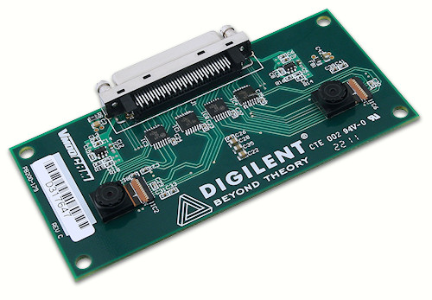
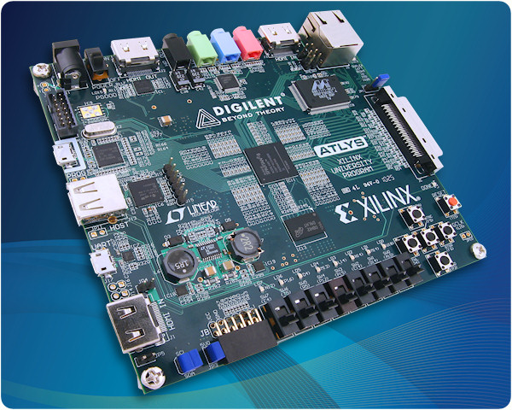
Mobile Unit Hardware Components
2 Components
VmodCAM Stereo Camera Module
Atlys FPGA

Slide 8

Mobile Unit Implementation
3 HDL Components:
1. Image Capture – Data from VmodCAM to rest of design
2. Corner Detection Module – Detect corners in images from camera.
3. Communications Module – Transmit corners to base station

Slide 9
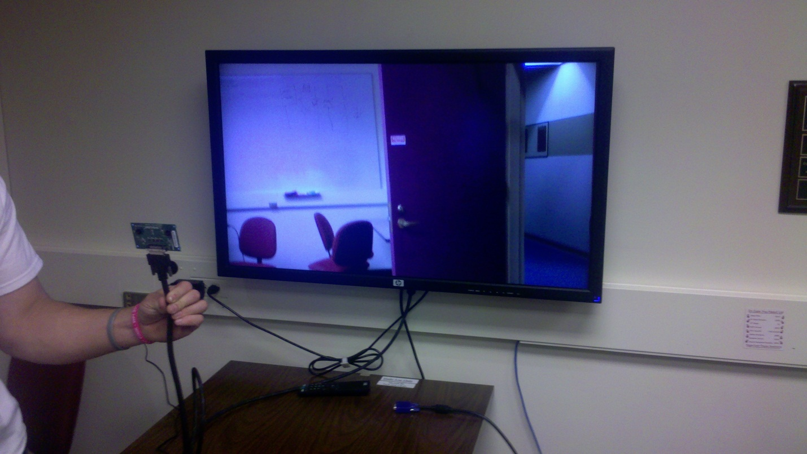
VmodCAM Module
Gather data from VmodCAM to the rest of design
I²C Communication for RGB 565 color images
Initial Testing using HDMI Display and DDR2 Memory from Digilent Provided Code
VmodCAM

Slide 10

Corner Detection Approach
Harris Corner Detection Algorithm
Corners found by determining a Harris value for every pixel
$H\left(x,y\right)=detC_{str}− α{\left(traceC_{str}\right)}^{2}$
Initial Simulations performed using MATLAB
Sample Harris Output using MATLAB

Slide 11
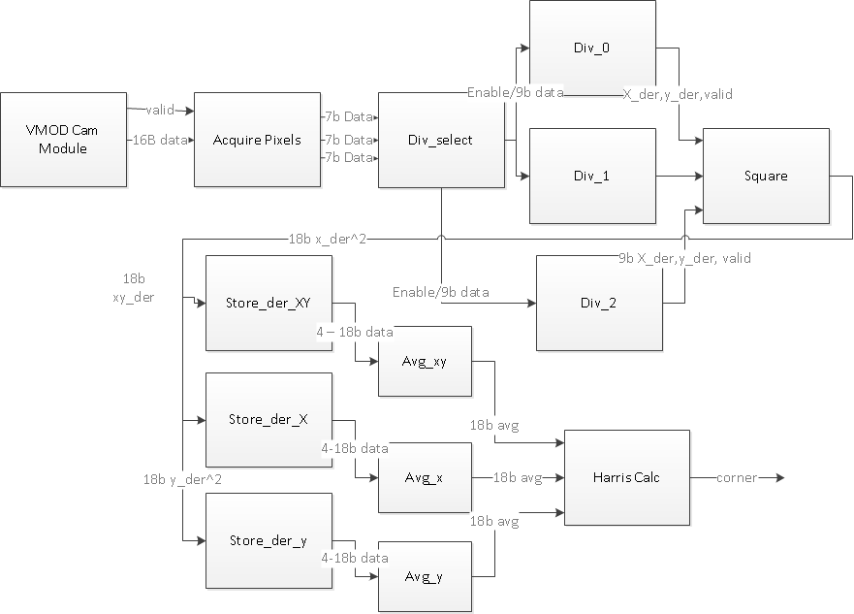
VHDL Corner Detection Implementation
Pipelined Approach
Operate on each pixel as it arrives

Slide 12
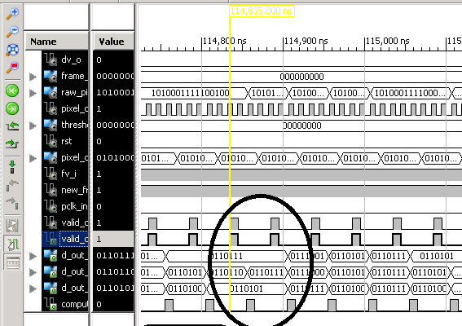
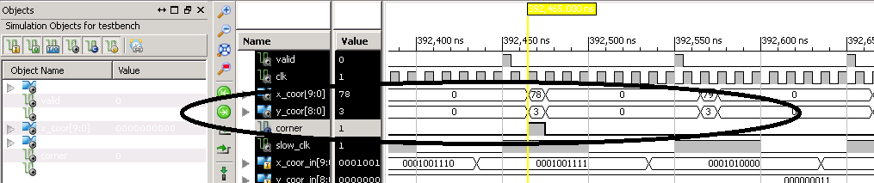
VHDL Test Bench
Simulated Input from Camera
Corner Detection Output

Slide 13
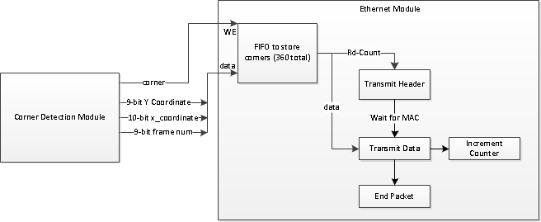
Ethernet Module
Utilizes Atlys Gigabit Ethernet capabilities and UDP protocol
Sends corners in the format:
Valid, Y-Coordinate, X-Coordinate, Frame Number
Sends 360 Corners at a time for data considerations

Slide 14
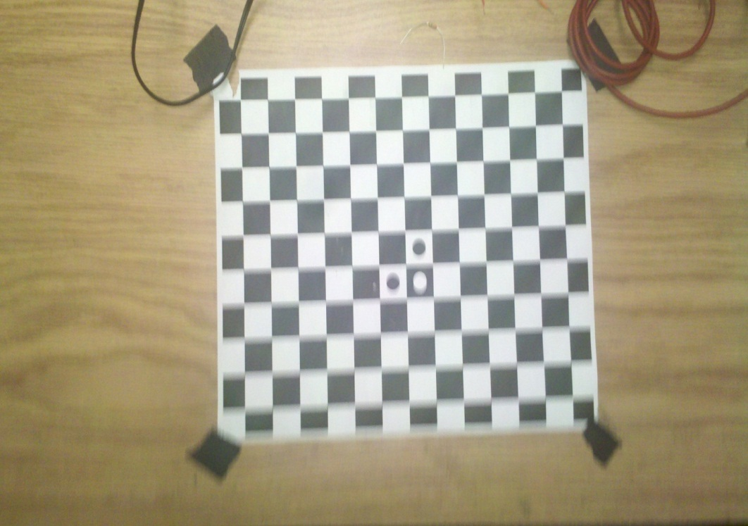

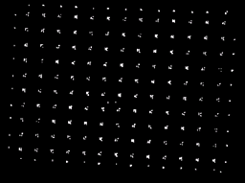
Results: Corner Detection
Corner Detection Completed on Atlys FPGA
Original Image
FPGA Output

Slide 15
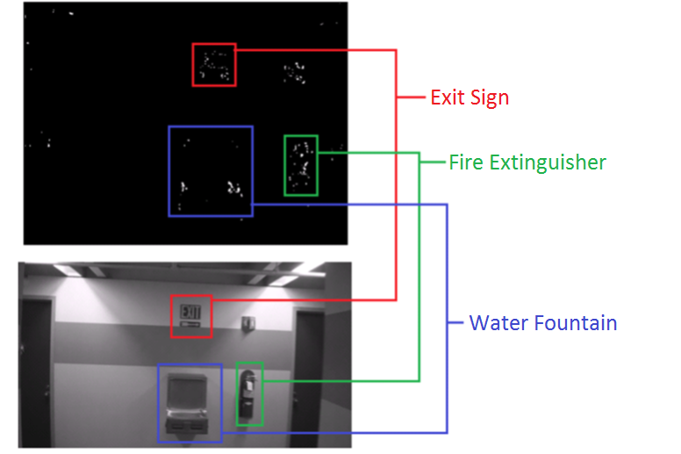
Results: Corner Detection (cont)

Slide 16
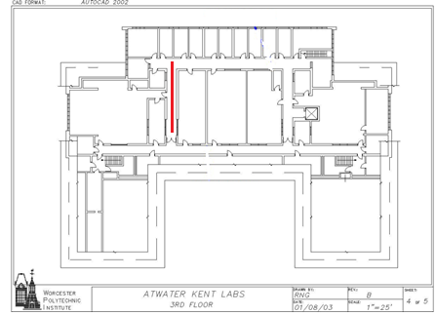
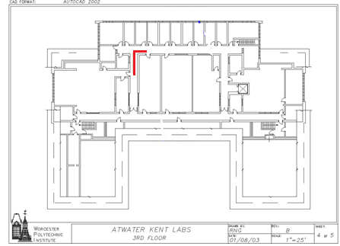
Complete System Testing
2 Scenario Tests Performed
Straight Line and 90-Degree Turn

Slide 17
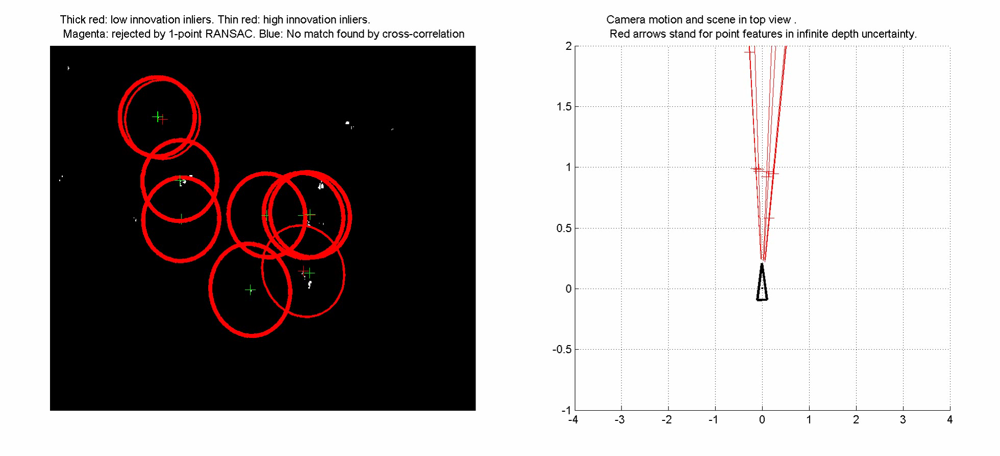
Scenario Test – Straight Line

Slide 18
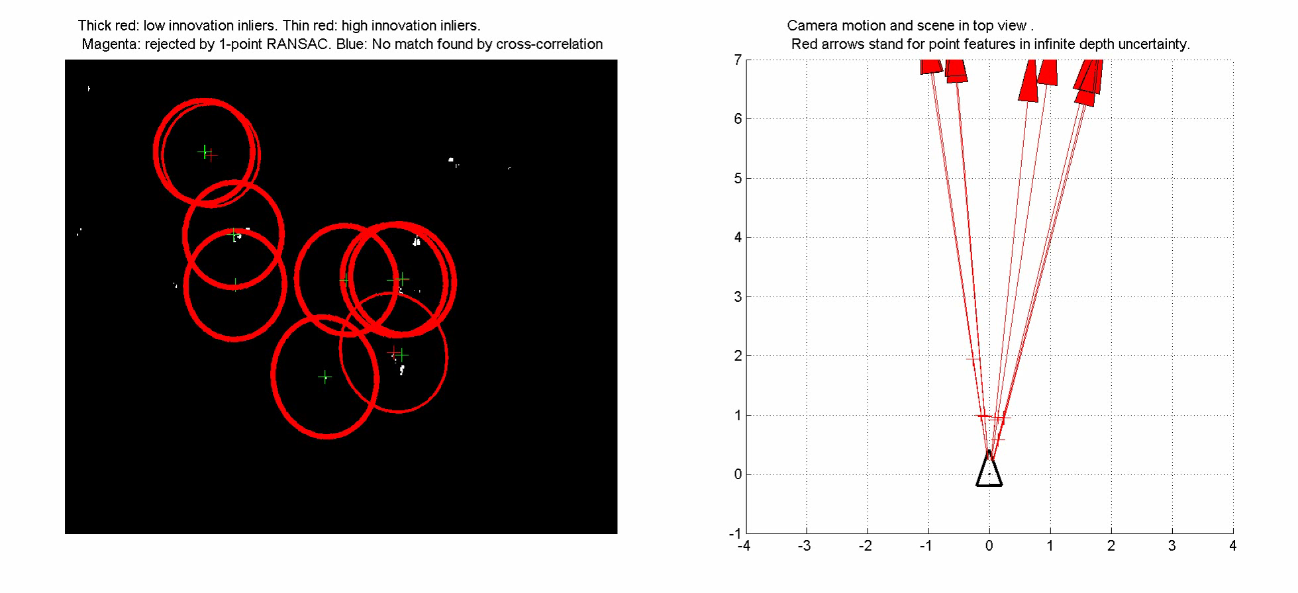
Scenario Test – 90 Degree Turn

Slide 19
Conclusions
Goal | Implementation
Capture and process images in real time | VModCAM Stereo Camera Module with FPGA Processing
Send resulting data to base station | Ethernet Module on FPGA with Base Station Receiver
Develop method to provide SLAM algorithm with input | Corner Detection on FPGA to base station receiver (black and white images)
Configure SLAM algorithm to accurately track motion using corner-only input | Modified settings in EKFMonoSLAM to reflect corner-only input
Run 2 scenario based tests, and compare experimental results with expected results | Video results
Successfully tracked the path of a person walking down a corridor

Slide 20
Suggestions for Future Work
Before deployment, many improvements are required
Power consumption must be analyzed for mobile power implementation
Ethernet module must be replaced by wireless component
Hardware must be ruggedized and form-factor must be minimized
Base station (namely EKFMonoSLAM) needs to be optimized for real-time processing
Possible research into alternate SLAM algorithms
Additional, more comprehensive scenario testing
Thermal Camera Expansion

