Slide 1
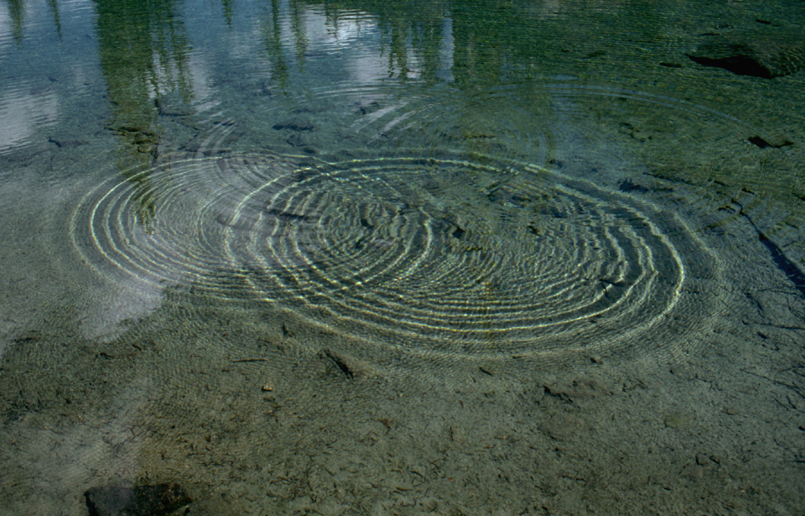
PH1140
Oscillations and Waves
Term D 2009
Frank Dick
508-831-6766
fdick@wpi.edu
www.wpi.edu/Academics/Depts/Physics/Courses/ph1140d09

Slide 2
Oscillations and Waves
Oscs &Wavs OSWAs
I signed up for a course on oswas?
First, let me ask you a couple of questions…
What’s an oscillator? What is oscillation?
  A mass that goes to and fro.
  Periodic motion of a mass.
What’s a wave?
  A shape that moves thru a continuous medium.
Notes:
Demo mass/spring, rpoe pulse. Wad up the rope and throw at volunteer, then make wave. Shape is state.

Slide 3
Today we will do three things…
take a field trip ☺
  I lied! How about videos and demos instead?
talk about organization & logistics, plugh ☹
  when to do what, and how to go about doing it
babble on about circular motion (huh?)
  what does circmo have to do with oswas?
  What do you want to do first?
Notes:
oz-wahz. 15 min demos, 10 min org&log, 25 min circmo

Slide 4
Oscillations
you can have oscillations of:
  masses on springs
  tuning forks
  guitar strings
  vocal cords
  bobbing boats
  pendulums, …the list is sort of long…
twins on playground swings, wee!
Notes:
Put osc parameters on board, along with EOM and soln: xva, EKU, ωγφA, mkb, Q

Slide 5
Oscillations
What kinds of oscillations are there?
  free
  damped
  forced
  superimposed
  coupled
  linear and non-linear
  mechanical and electrical
Notes:
Put osc parameters on board, along with EOM and soln: xva, EKU, ωγφA, mkb, Q

Slide 6
Waves
you can have waves:
  on ropes and slinkys
  on membranes and surfaces
  in matter (sound)
  in empty space (light)
A pebble tossed in a pond makes waves
Notes:
WAVs: lon, lat, ωλkvφA, P,E,p,L

Slide 7
Waves
What kinds of waves are there?
  1D, 2D and 3D waves
  mechanical and electromagnetic
  longitudinal, transverse and circular
  periodic and packet (non-periodic)
  traveling and standing
Notes:
WAVs: lon, lat, ωλkvφA, P,E,p,L

Slide 8
Interactions
“how the world works”
you can have interactions between:
  oscillators and oscillators
  oscillators and waves
  waves and waves
- this makes that, or that makes this
- resonance works the magic!
how do we describe an oswa interaction? hmm…
Notes:
Resonance! shake rope with large A but wrong f, then small A but right f

Slide 9
Interactions
What interactions are occuring in this room?
Sound!
  vocal cord oscillators stimulate sound waves
  sound waves stimulate ear drum oscillators
Light!
  atomic oscillators in bulbs stimulate light waves
  light waves stimulate atomic oscillators in retinas
Notes:
Resonance! Examples: guitar strings and tuning forks and sound waves

Slide 10
Organization & Logistics (plugh)
Go to
www.wpi.edu\+physics and click on
→ Student Resources
→ Physics Course Online
→ PH1140 D09
and cruise !
--- book mark this puppy.

Slide 11
Labs Rule !
hands-on learning is a big deal
labs are worth 20% of your grade, hello
“not familiar with Logger Pro and Vernier”?
  team with someone who is
read the General Lab Procedure
read lab procedures ahead of time (why?)
  because… bring your equations to lab
Submit worksheet in lab and you’re done.

Slide 12
Go to myWPI for…
grades
announcements
link to course webpage
Ah, myWPI, my home away from home!

Slide 13
Read these or else… !
Syllabus !
Schedule !
General Lab Procedure !
Lab Procedures !
Study Guides !
See schedule for due dateS
SGs are one-stop-shop for exam preP
Find everything at the course webpage
Notes:
Syllabus, game rules. Schedule points to labs, HWs, SGs. Gen Lab Proc, must read! SGs tell you what I will test you on.

Slide 14
Exams will cover…
homework & labs
Do these,
review these,
and you are good to go !
3 exams · 3 study guides · you do the math

Slide 15
Introducing the staff…
Frank Dick, Lecturer and Conference Instructor
fdick@wpi.edu
Fred Hutson, Lab Instructor and Coordinator
flh@wpi.edu
Ken Osborne, Lab Instructor
duck@wpi.edu

Slide 16
This course has been…
…completely redesigned
  if you see any inconsistencies…
  let us know
  if you have any suggestions…
  let us know
  if something does not work…
  let us know
  if the workload is too much…
  go ahead, whine and snivel !

Slide 17
Seriously, my philosophy is…
For my part:
  assign gobs of work…
    “average 17 hours per week per course”
  …but, give fair exams
    you have seen it before in labs and homework
    by the way, exams are worth 50% of your grade
For your part:
  show up…!
  …put in time at home, there is no substitute

Slide 18
Any questions?
I have a question for you…

Slide 19
What
does circular motion
have to do with
anything
in this course?
huh?

Slide 20

circmo is the key…
that reveals the nature of
  simple
  harmonic
  motion

