Slide 1
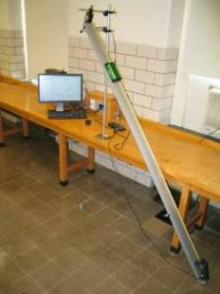
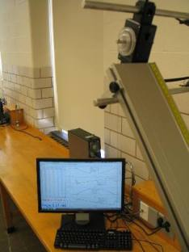
Lab 9 – Translational and Rotational Kinematics
Pulley with rotary motion sensor
Cart
Masses and hanger
Motion sensors
Objectives:
Predict the translational acceleration of the mass-hanger-cart system.
Measure the translational and rotational accelerations, each in two different ways.
Convert the rotational accelerations to translational accelerations.
Determine whether your five accelerations agree.
Notes:
Introduce setup and objectives. A string connects the cart with the masses on a hanger.

Slide 2
Experimental set-up
Pulley with rotary motion sensor
+x direction
Cart
Motion
sensor
Track
Masses on hanger
Set up the equipment as shown here, with a cart connected to a hanger with masses on it by a string that runs over a pulley. After bringing the system to equilibrium by adjusting the masses on the hanger, add 20 g to the hanger, such that its acceleration is down.
Notes:
Describe how to get started. First put enough mass on the hanger such that the system is in equilibrium. Then add 20 g to the hanger.

Slide 3
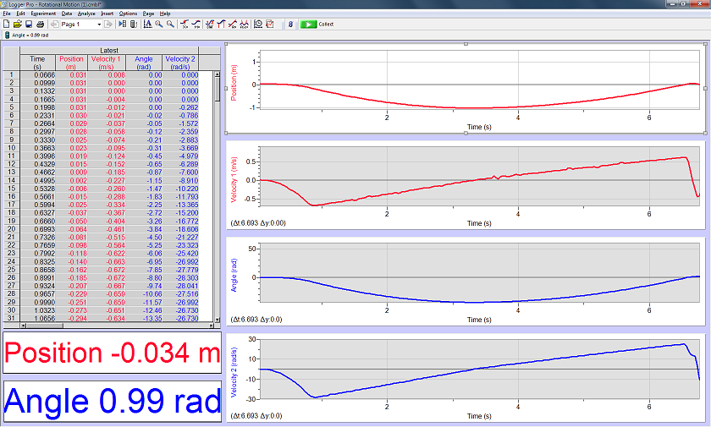
Experimental procedure
x
t
v_{x}
t
θ_{z}
t
ω_{z}
t
Give the cart a push down the slope, enough to make curves like these as the cart returns to the top of the track, but not enough to crash it into the motion sensor at the bottom of the track. Follow the online instructions.
Notes:
At some point the students must measure the mass of the cart and of the masses plus hanger. The expected analysis is given in the instructions online.

Slide 4
Central concept
Translational and rotational motion are very similar.
Notes:
Despite having different symbols to represent differently named variables, the behavior of the two types of motion is the same. (Straight lines for velocity as a function of time, parabolas for position as a function of time.)

