Slide 1
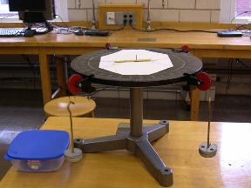
Lab 8 – Static Equilibrium
Pin
Pulleys
Extended object
Masses and hangers
Objectives:
Determine the forces and torques acting on an extended object (a wooden stick) by means of masses attached to strings and where the strings are attached to the stick.
Calculate if the 1) the torques sum to zero (rotational equilibrium) and 2) if the forces and torques sum to zero (rotational and translational equilibrium).
Notes:
Introduce setup and objectives.

Slide 2
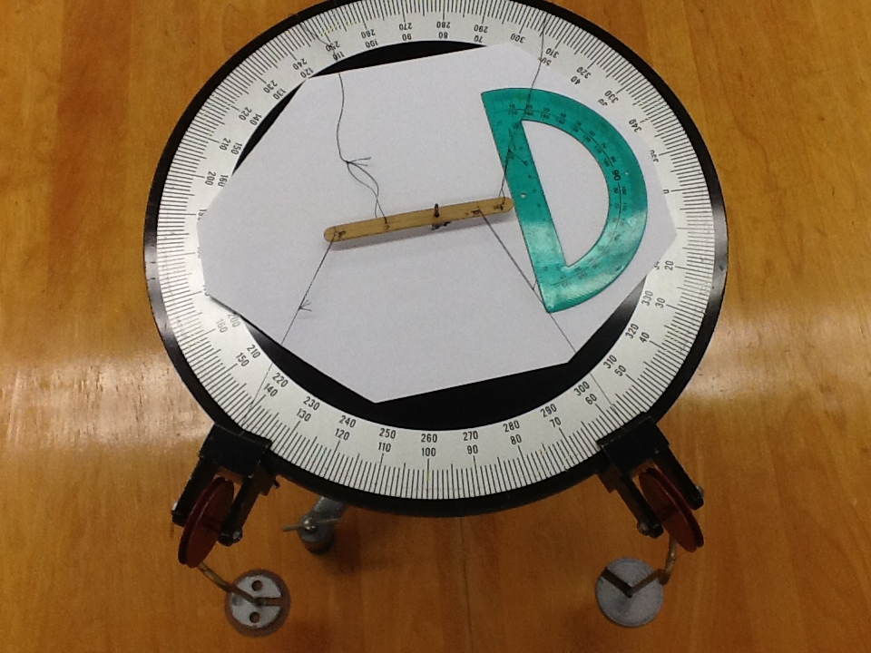
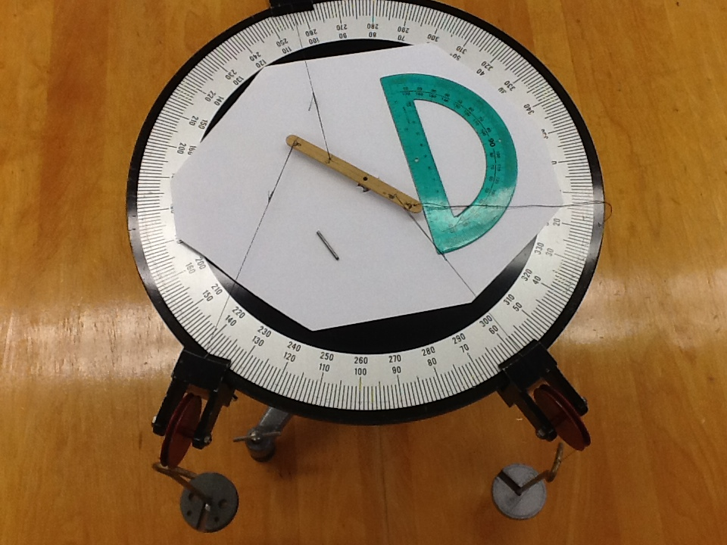
Experimental set-up
Case 1, with two taut strings Case 2, with three taut strings
v_{x}
t
Set up the equipment as shown here, with the pin in use for your check of rotational equilibrium (left image), but not in use for your validation of both rotational and translational equilibrium (right image). Follow the online instructions.
Notes:
Describe how to get started.

Slide 3
Central concept
The word equilibrium applies to both translation and rotation.
In this lab, you will verify equilibrium for a static extended object.
Notes:
Equilibrium means that both forces and torques sum to zero.

