Slide 1
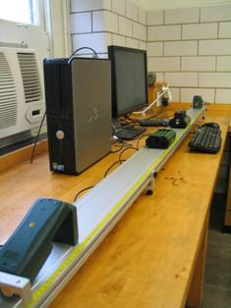
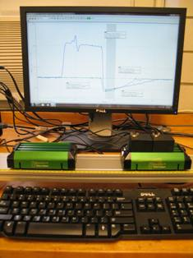
Lab 7 – Work-Energy and Momentum
Carts
v_{x}(t) curves
Motion sensors
Objectives:
Measure x-velocities of two carts before and after two kinds of collisions.
Calculate the total kinetic energies and momenta and their fractional changes.
Demonstrate if kinetic energy and momentum are conserved.
Notes:
Introduce setup and objectives.

Slide 2
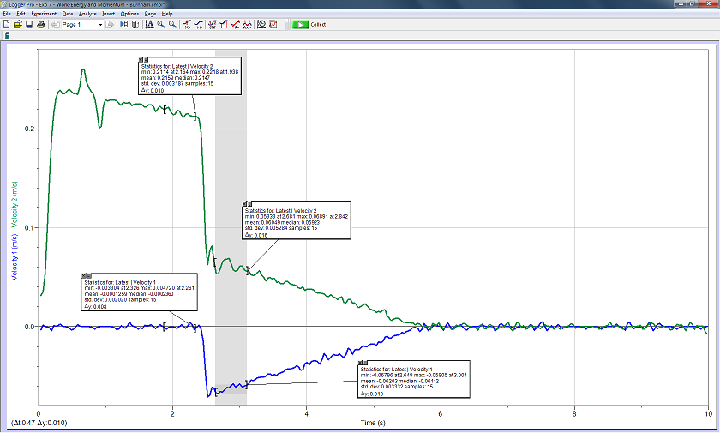
Experimental set-up
v_{x}
t
+x direction
Motion
sensor
Cart B, with extra mass
Motion
sensor
Cart A
Track
Set up the equipment as shown here, with two motion sensors and two carts and a level track. Cart B has extra mass attached. Give Cart A a gentle push up the track and collect data. Follow the online instructions.
Notes:
Describe how to get started. As a challenge question, you might ask them why the blue line, associated with the right-hand motion sensor, is negative. Yet the defined coordinate system is positive to the right. Thus in their worksheets they should enter the momentum of Cart B as positive.

Slide 3
Central concept
It is possible to measure whether kinetic energy and momentum are conserved.
Notes:
Ideally what they predict will match their experimental results.

