Slide 1

How Not to Be Evil
(By Accident)
Or:
Baking Consent in from the Beginning
By Local Word Monkey Kat Crighton

Slide 2



FIRST
1.Question
Ask yourself WHY you want to remove your audience’s ability to choose your work. INTERROGATE your MOTIVES.

Slide 3

FIRST
2.Reality
What is the worst-case scenario?
Are you prepared for the consequences?
Can you live with yourself if it happens?

Slide 4



DRAFT
3.Trust
People WANT to become an audience. Trapping isn’t necessary. Give them a door and they’ll enter it.

Slide 5

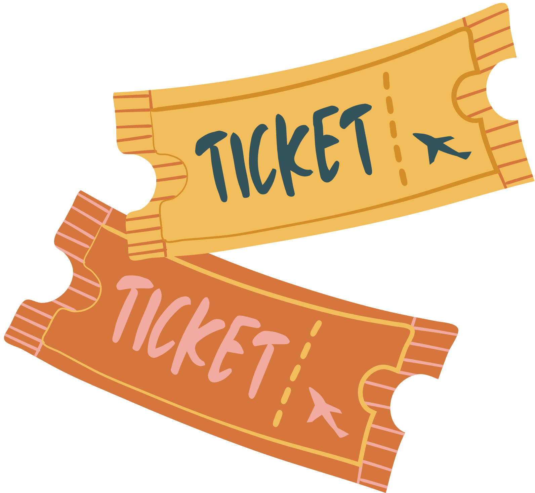
DRAFT
4.Context
Use the choices your audience has ALREADY MADE to create doors into your work.

Slide 6




DRAFT
5.Temptation
People are curious. Open the door to audiences by giving them the chance to find ANSWERS.

Slide 7


BUILD
6.Signs
Humans are pattern-loving, community-mirroring monkeys. Layer in signs and signals to metacommunicate entrances and exits.

Slide 8


BUILD
7.Teach
Assume every audience is learning how to interact with your work for the first time. Create chances to learn, discover, and unveil.

Slide 9
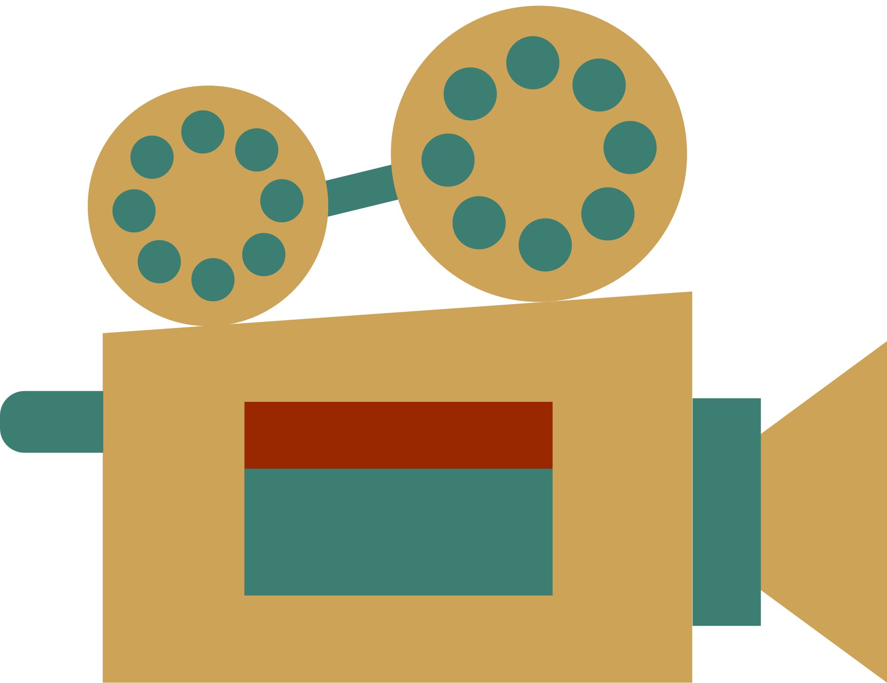
BUILD
8.Expectation
Your audience lives in a world of blurred realities and permissions. Use what they know and already accept
(and challenge it).

Slide 10


REVIEW
9.Commonsense
Rules are different in the magic circle... but not all of them. Make scripts and mechanics to help keep everyone safe.

Slide 11

REVIEW
10.Question
(Again.)
Have you made ways for an audience to enter? Do you allow for people who are not your audience to get out? INTERROGATE your WORK.

Slide 12
How Not to Be Evil (By Accident)
Or: Baking Consent in from the Beginning
First
1.
2.
Question (Yourself)
Reality check
Trust your audience
Context is a useful shortcut
Temptation can be a powerful tool
Signs can be embedded
Teach your audience how to play
Expectation is another useful shortcut
Commonsense: not all that common
Question (Your Work)
Draft
3.
4.
5.
Build
6.
7.
8.
By Local Word Monkey Kat Crighton
Review
9.
10.

