Slide 1
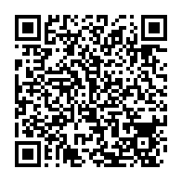
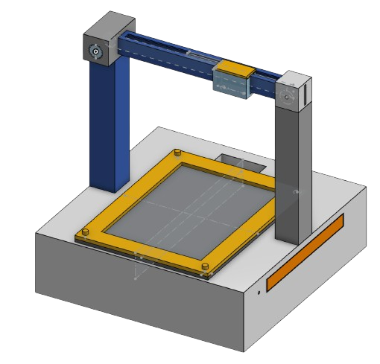
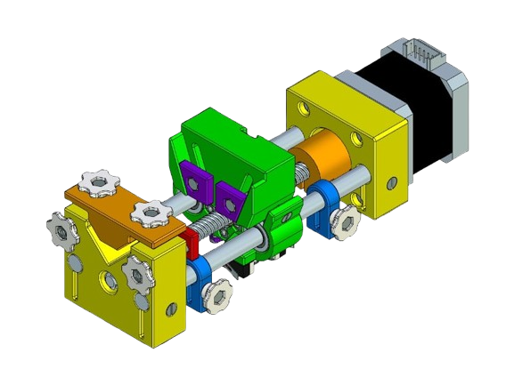
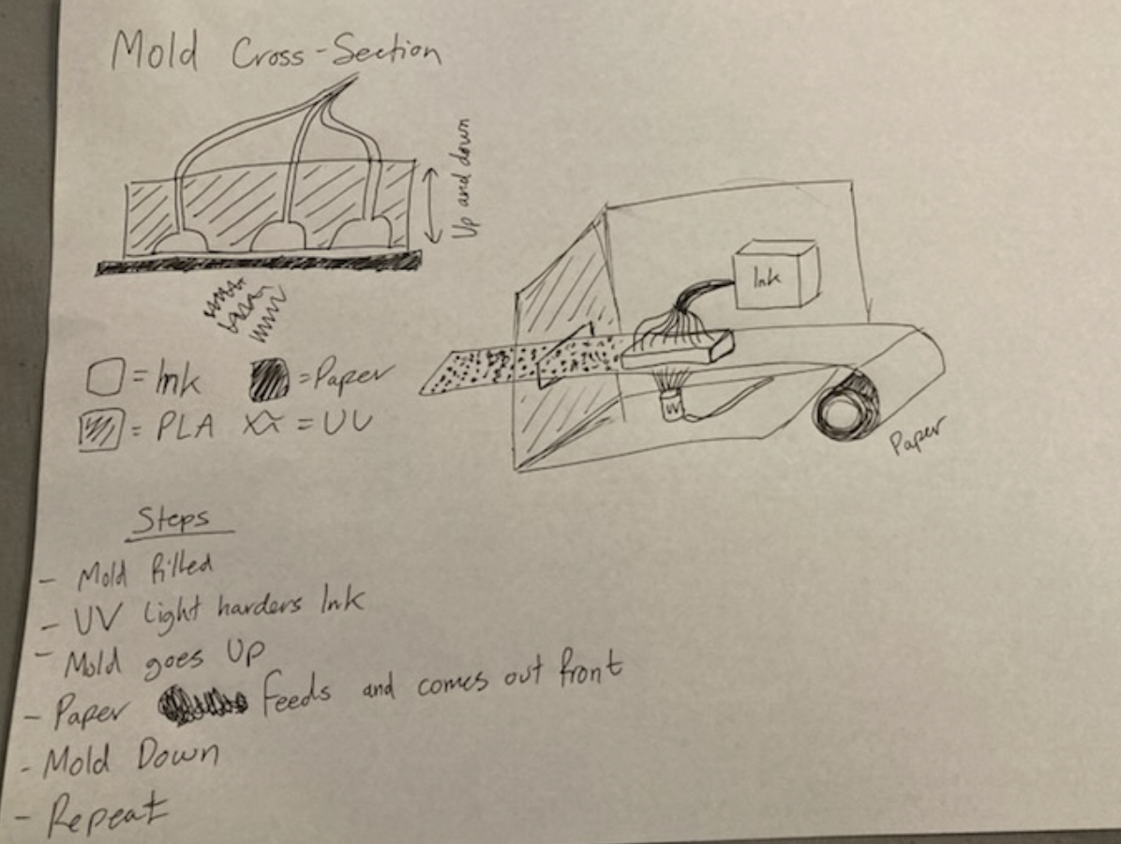
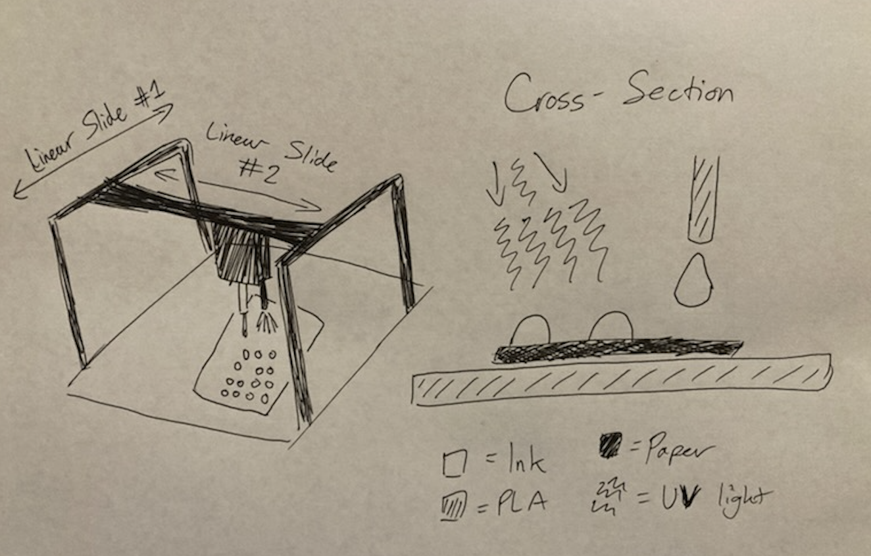
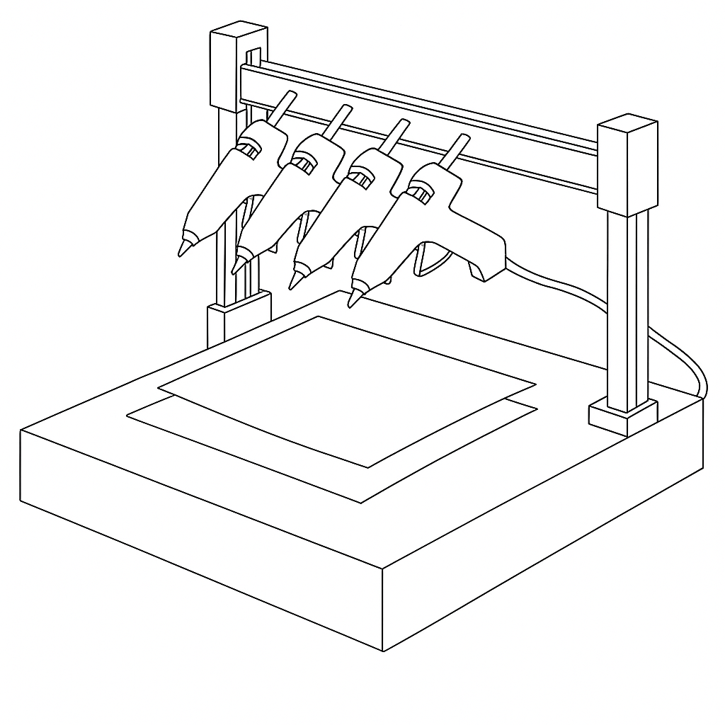
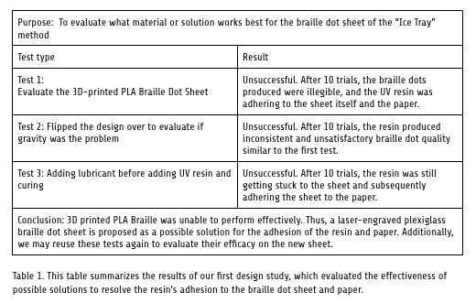
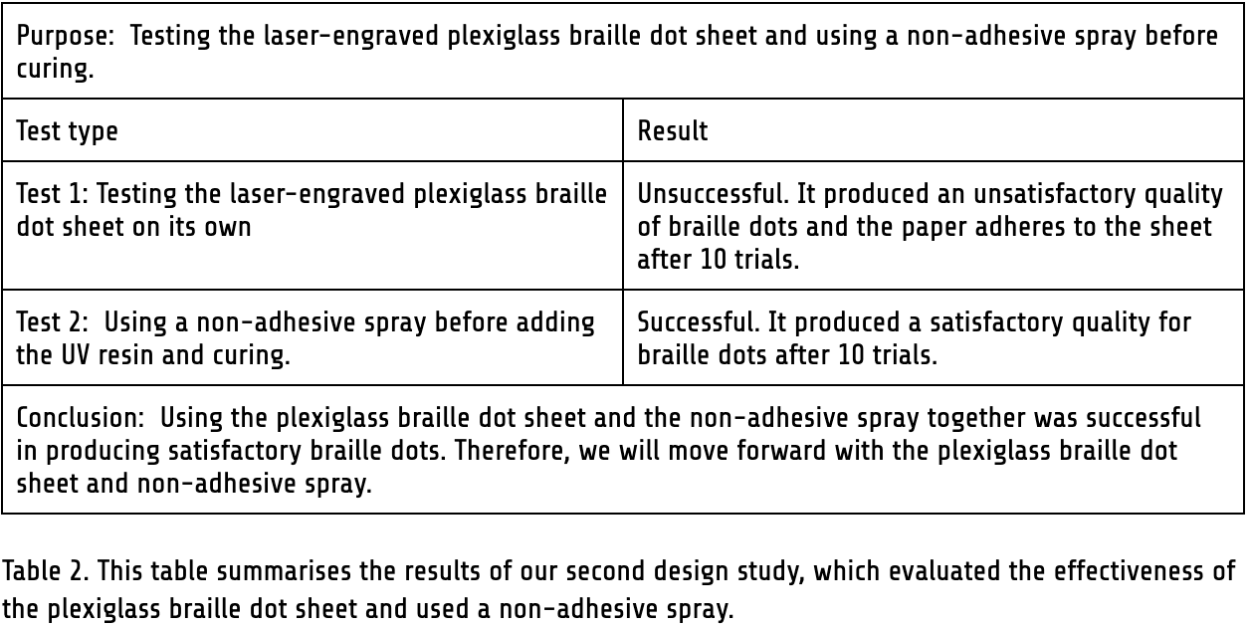
Affordable Braille Printer Using Ultraviolet Resin
Team Banana Bros
CEO Nhat Nguyen Anh Dao, CMO Daniel Harn, CTO Adam Yanco, CIO Evan Cheng
Advisor: Kevin Crowthers, Ph.D.
Problem Statement
Engineering Goal
For smaller businesses, providing access to braille literature for people with visual impairments can be difficult due to the cost and lack of durability of the most common forms of braille.
We aim to create an affordable Braille printer that produces conventionally-sized and durable Braille Dots onto paper.
Level 1 Requirements
Our Current Design
Printed Braille shall follow standard Braille conventions
Manufacturing costs shall be less than $500
Ink shall not be damaged by water
The dots shall not be scratched easily
The design uses Ultraviolet Resin
The design shall be safe to use
The design shall use USB printing
The design shall convert text to Braille
Motor mount
Braille sheet
Why We Chose This Design:
Manufacturing costs are <$500
Dots do not get damaged by water
Dots do not get scratched easily
Testing individual parts of its functionality proved successful:
Braille Molds can be cured onto paper
UV light can cure through the paper
The ‘Ice Tray’
Pump mount
X-axis mover
Y-axis mover
Motor
Z-axis mover
Design II
Design III
Design IV
The ‘Stamper’
3D Printer Attachment
Glue Gun
Pros
Potential to print Braille quickly
Cons
Inconsistent Braille Dot sizes and quality
Requires a lot of UV ink valves
Pros
Cheaper than other alternative designs
Relatively easy to install
Cons
Relies on user owning a 3D printer
Poor braille dot quality
Pros
Accessible
Easy to implement and build
Cons
Unable to adjust the size of Braille
Size of Braille is inconsistent
Design Studies
Methods
Testing the efficacy of the braille dot sheet
Sketch the design
Resolve issues arised from testing
Adding electrical components with suitable coding
Fig 1.
Paper adheres to the Braille sheet
Discussion of the design
Manually perform preliminary testing with the materials
Attach motors for automation
Fig 2.
Braille dots produced by the final test
Research for materials or CAD on Onshape
Obtain the physical design
Finished product!
Conclusions & Future Work
The Braille Printer allows the user to create durable Braille dots
The Braille Printer is significantly cheaper to produce than current market options
Incorporating the Braille sheet was difficult
Disallow the paper to attach itself to the Braille sheet for easier removal
Increase the speed at which the printer create Braille with a more efficient design
Automate the entire process of the 3D printer

