Slide 1
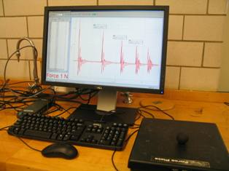
Lab 6 – The Impulse-Momentum Theorem
F(t) curve
Ball on force plate
Objectives:
Calculate the change in momentum from the time between bounces.
Use the force plate to measure the impulse.
Verify whether or not they agree.
Notes:
Introduce setup and objectives. Impulse equals change in momentum.

Slide 2
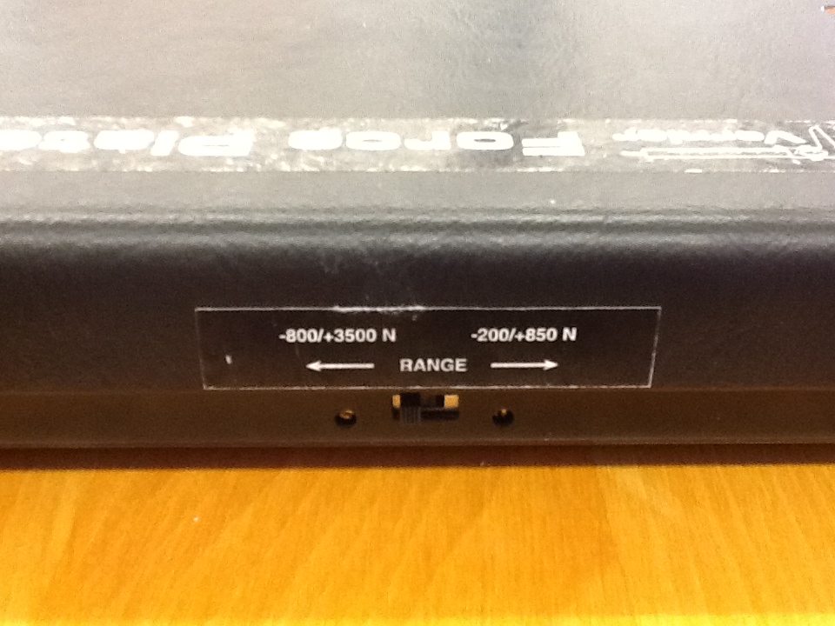
Experimental set-up
This time, set the switch at -200/+850 N.
Notes:
This time, the switch is for the lower range of force, which will lead to better force resolution.

Slide 3
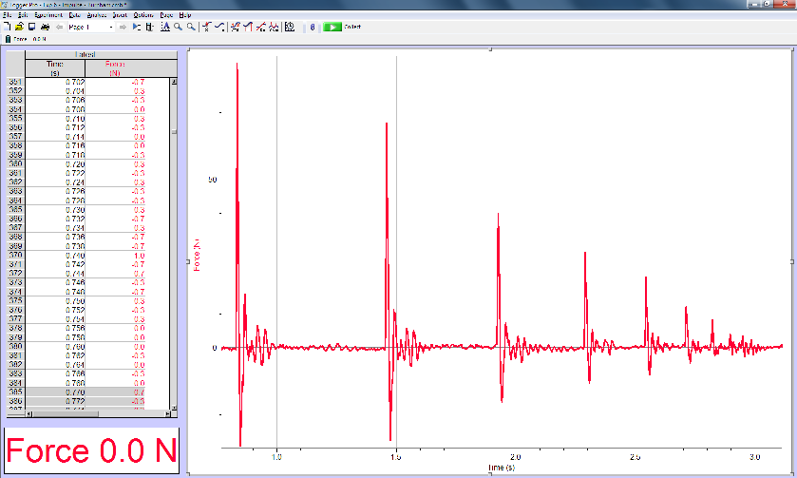
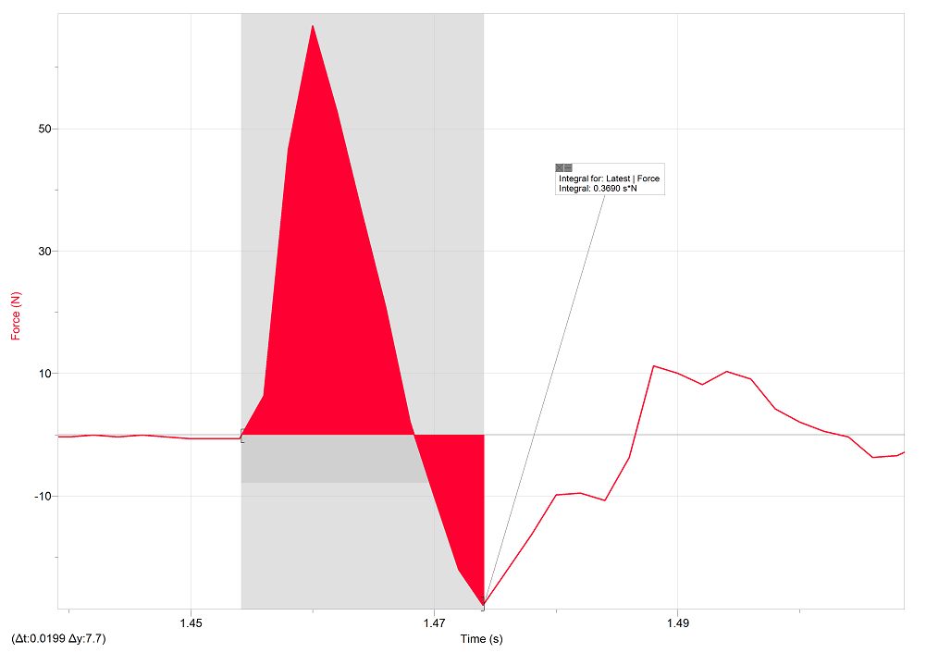
Experimental procedure
t₁ t₂ t₃ t₄ t₅
F
t
Drop the ball on the force plate and record F(t). It must bounce at least five times.
Measure the times of the first five major peaks.
Measure the second, third, and fourth impulses.
J = ∫ F(t)
Notes:
The difference in time gives the speed. The integral of the force gives the impulse. Most common mistake – not getting the signs right in the calculation of momentum.

Slide 4
Central concept
The impulse – the force integrated over time – should equal the change in momentum of a ball just before and just after a bounce.
Notes:
Ideally what they predict will match their experimental results.

