Slide 1
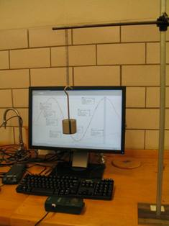
Lab 5 – Conservation of Energy
x(t) curve
Mass on hanger
Motion sensor
Objectives:
Work with the equations for energy
Verify if energy is conserved for a mass oscillating on a spring in a gravitational field
Notes:
Introduce setup and objectives.

Slide 2
Experimental set-up
Spring
Hanger
Mass
+y direction
Motion
sensor
Set up the equipment as shown here. Zero the sensor when the mass is off the hanger.
Notes:
Describe how to get started: the motion sensor is beneath the mass, which is suspended by a hanger and a spring. It’s important to zero the sensor when the mass is not on the hanger. Be careful not to drop the mass on the motion sensor!

Slide 3
Central concept
The gravitational, spring, and kinetic energies should all add up to the same value at any instant in time as the mass bobs up and down.
Notes:
Ideally what they predict will match their experimental results.

