Slide 1
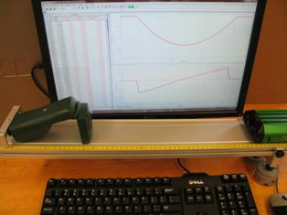
Lab 4 – The Mass-Dependence of Friction
x(t) curve
v_{x}(t) curve
Motion sensor
Track
Cart
Objectives:
Derive equations for N, f, µ.
Acquire data and calculate N, f, µ.
Determine which of N, f, µ are dependent on mass, both theoretically and experimentally.
Notes:
Introduce setup and objectives. N = normal force, f = friction force, µ = friction coefficient

Slide 2
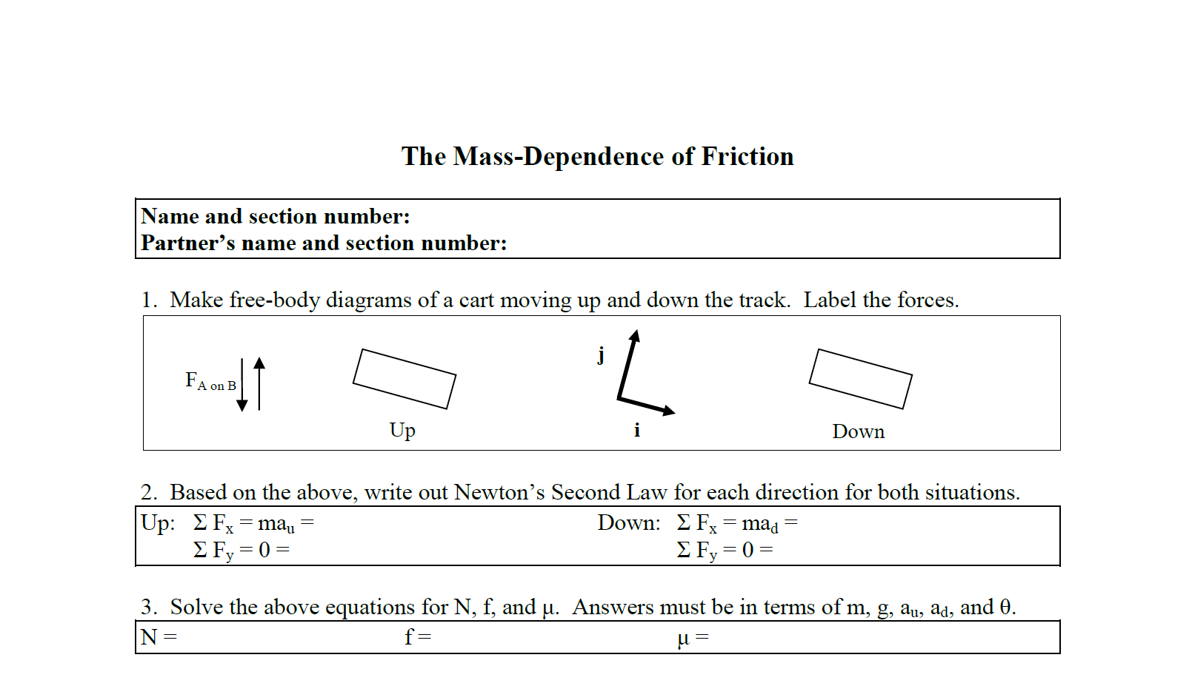
Prep questions
These prep questions are challenging.
Notes:
The students should do the prep questions ahead of time, in particular for this worksheet. If they don’t, they should first collect their experimental data during their lab session.

Slide 3
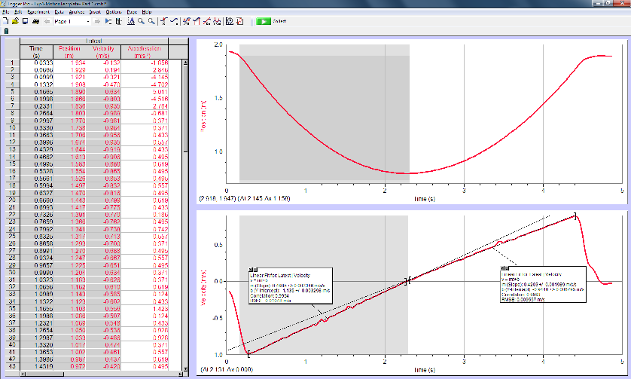
Experimental set-up
x
t
v_{x}
t
Motion
sensor
+x direction
Cart
Track
Masses
Set up the equipment as shown here, with the track slightly sloped by masses beneath the left-hand side of the track. Give the cart a gentle push up the track and collect data.
Notes:
Describe how to get started: the motion sensor on the left of the track, the cart to its right, the motion sensor connected to the computer, which is connected to the computer. As for Experiment 2, the track is slightly sloped by masses beneath the left-hand feet.

Slide 4
Central concept
It is possible to both predict and verify behavior, as you will do in this experiment.
Notes:
Ideally what they predict will match their experimental results.

