Slide 1
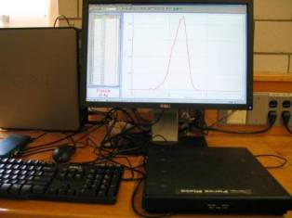
Lab 3 – Free-Body Diagrams
F(t)
Force plate
Objectives:
Measure force for different situations
Practice free-body diagrams
Notes:
Introduce setup and objectives.

Slide 2
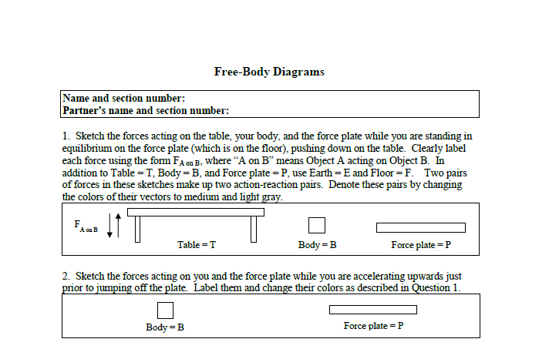
Prep questions
Do the first questions of the worksheet ahead of time. If you do, you’ll have plenty of time to collect data during your lab session.
Notes:
Tell the students that it’s in their best interest to do the prep questions ahead of time. This week they are to sketch some free-body diagrams. Later labs will have more challenging questions. If they are not able to do the prep questions before going to lab, they should first collect their experimental data, then return to the prep questions.

Slide 3
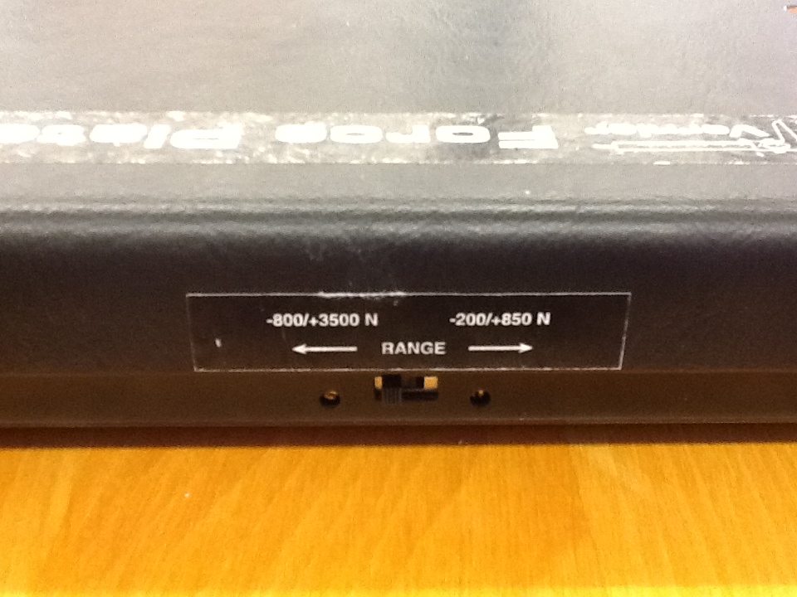
Part I – Preparation
There is a switch on the side of the force plate, just under the sticker. It should be at the setting marked -800/+3500 N. Please check!
Notes:
If the switch is in the wrong position and they step on it, the force plate will break.

Slide 4
Part I – Preparation
Masses
Force plate
Set up the equipment as shown, with the force plate on the floor and the masses on the table. The force plate should be connected to the interface box. Zero the force with the Zero function, to the left of the Start button on the toolbar.
Notes:
They will stand on the force plate and pick up objects and push down on the table.

Slide 5
Central concept
A free-body diagram, or force diagram, is a sketch of all the forces acting on a body that originate from other objects. It is important to the proper application of Newton’s Second Law to the body, which we shall study next.
Notes:
We are building skills now, such that later problems will be easier.

