Slide 1
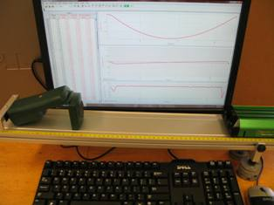
Lab 2 – One-Dimensional Kinematics
x(t)
v_{x}(t)
a_{x}(t)
Motion sensor
Track
Cart
Objectives:
Understand the graphs and equations of 1D motion
Learn more about the data acquisition software
Notes:
Introduce setup and objectives.

Slide 2
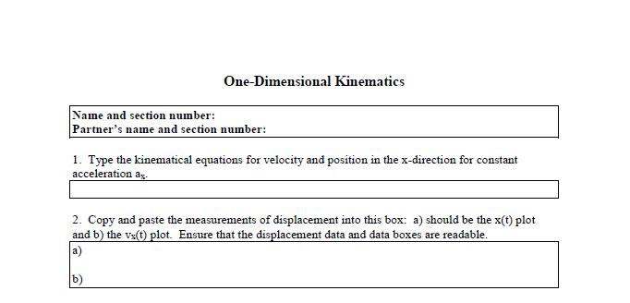
Prep questions
For this and subsequent labs, do the first questions of the worksheet ahead of time. If you do, you’ll have plenty of time to collect data during your lab session.
Notes:
Tell the students that it’s in their best interest to do the prep questions ahead of time. This week it’s very easy…just the kinematics equations for constant acceleration in one dimension. Later labs will have more challenging prep questions.

Slide 3
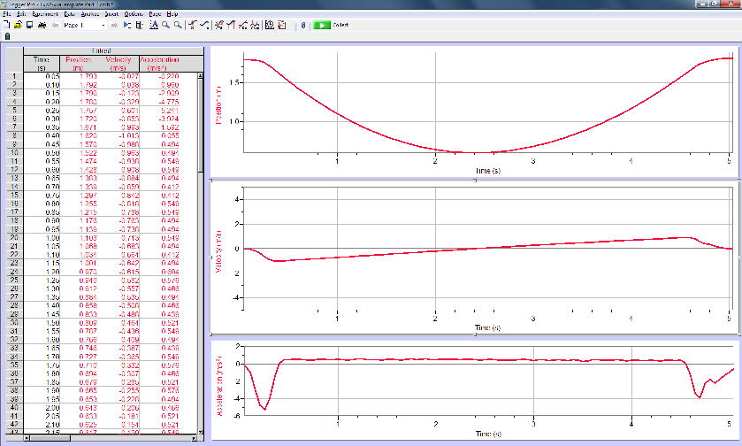
Part I – Preparations
x
t
v_{x}
t
a_{x}
t
Motion
sensor
+x direction
Cart
Track
Masses
Set up the equipment as shown here, with the track slightly sloped by masses beneath the left-hand side of the track. Give the cart a gentle push up the track and collect data.
Notes:
Describe how to get started: the motion sensor on the left of the track, the cart to its right, the motion sensor connected to the computer, which is connected to the computer. This time, the track is slightly sloped by masses beneath the left-hand feet.

Slide 4
Parts II and III – Analysis
x
t
v_{x}
t
a_{x}
t
You’ll use the analysis functions on the toolbar. Follow the online instructions.
Notes:
In this experiment, the students will use the Integrate, Examine, Tangent, Linear Fit, and Curve Fit functions. The Autoscale and Zoom functions are handy.

Slide 5
Central concept
Derivatives (slopes)
x v_{x} a_{x}
Integrals (areas)
Notes:
By doing Experiment 2, we hope that the students better understand the relationships between position and velocity, and velocity and acceleration.

