Slide 1
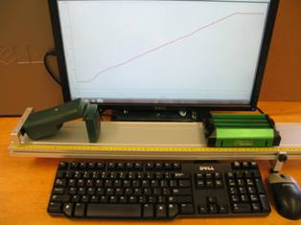
Lab 1 – Understanding Graphs of Motion
x(t) or v_{x}(t) curve
Motion sensor
Track
Cart
Objectives:
Learn how to operate the data acquisition system
Become familiar with x(t) and v_{x}(t) graphs
Improve your understanding of the variables x, v_{x}, a_{x}
Notes:
Introduce setup and objectives.

Slide 2
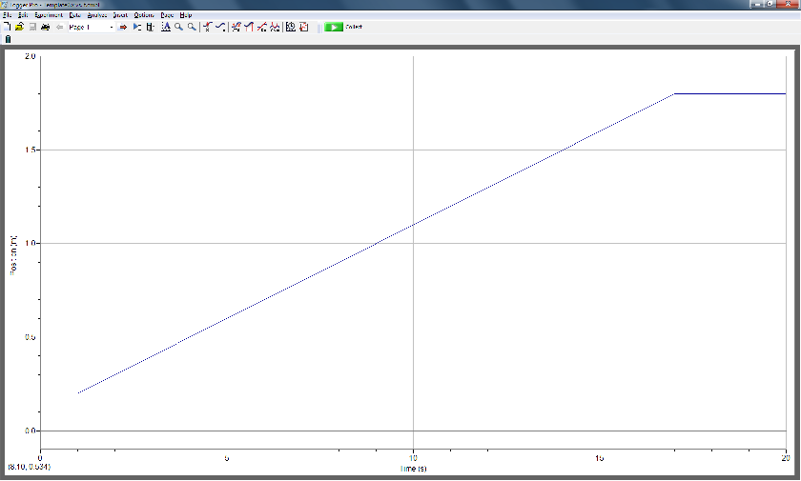
Part I – Experimental Set-up
Start
x
t
Motion
sensor
+x direction
Cart
Track
Set up the equipment as shown here. The motion sensor should be connected to the interface box, which in turn should be connected to the computer.
Notes:
Describe how to get started: the motion sensor on the left of the track, the cart to its right, the motion sensor connected to the computer, which is connected to the computer. To start data acquisition, press the green start button or the space bar, which toggles the acquisition on and off.

Slide 3
Part I – Experimental Set-up
Start
x
t
Motion
sensor
+x direction
Cart
Track
Move the cart so as to try to match the template.
Detailed instructions are given online.
Notes:
Their data won’t be perfect. That’s ok. They need to stay within the time limit for their lab session.

Slide 4
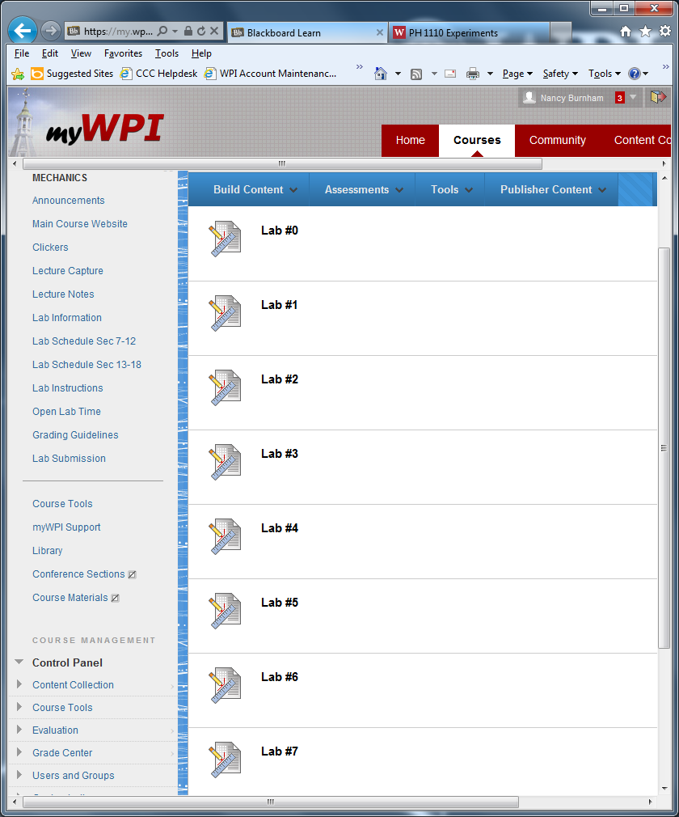
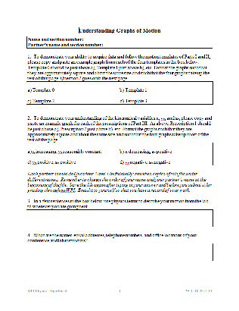
Lab 1 submission
Make sure to submit the Lab 1 worksheet at the right link.
Notes:
To finish, they must submit their worksheets via myWPI → Lab Submission, just as for Exp 0. Emphasize the importance of submitting the right worksheet to the right lab.

Slide 5
Reminders
Objectives:
Learn how to operate the data acquisition system
Become familiar with x(t) and v_{x}(t) graphs
Improve your understanding of the variables x, v_{x}, a_{x}
Notes:
The data acquisition system that the students will use for Experiment 1 will be the same as for most future experiments.

