Slide 1
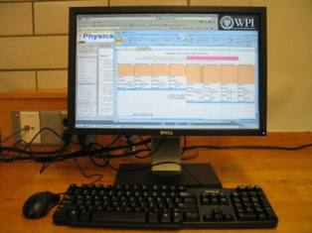
Lab 0 – Uncertainties of Experimental Data
Objectives:
Learn how to find the lab instructions
Learn how to express uncertainty in standard form
Learn how to submit your lab worksheets
Notes:
Introduce objectives.

Slide 2
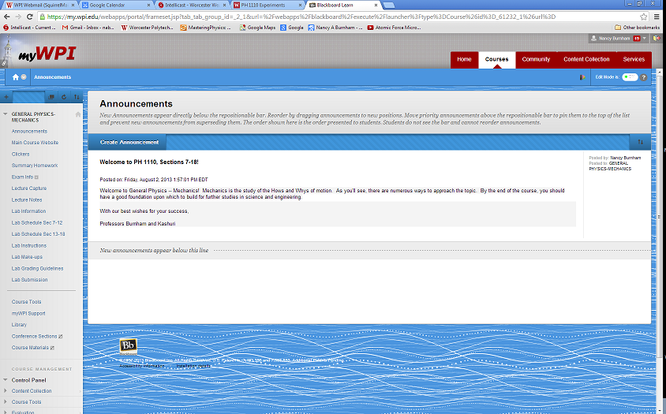
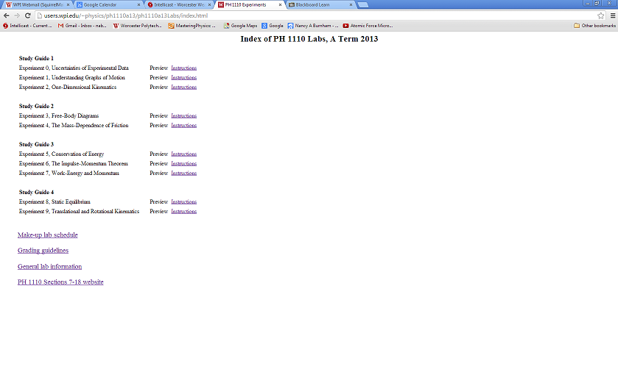
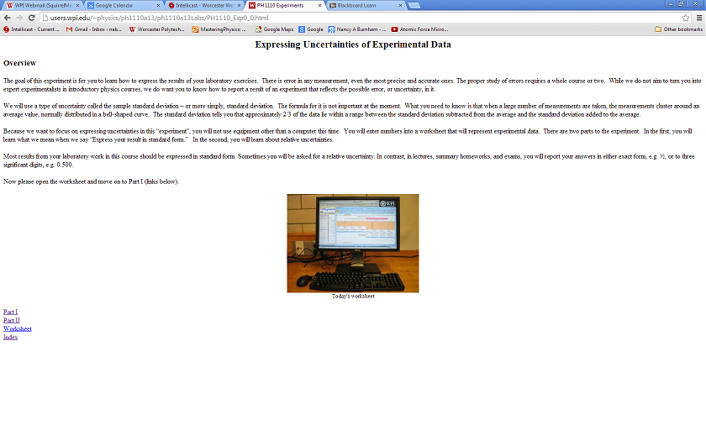
Find the instructions
Log into myWPI and open the page for PH 1110. There is a link to the index of lab instructions on the left-hand panel. Follow the instructions for Experiment 0.
Notes:
There are ten experiments this term.

Slide 3
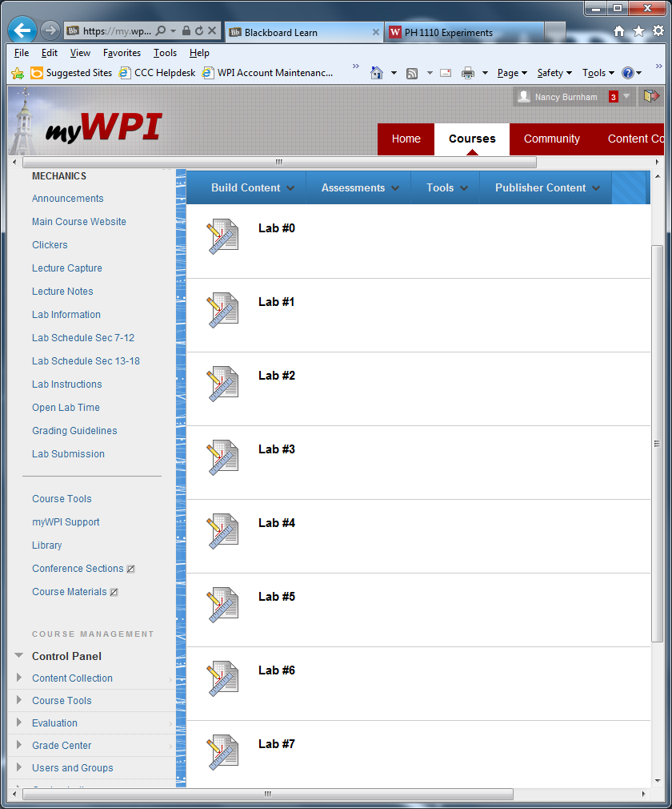
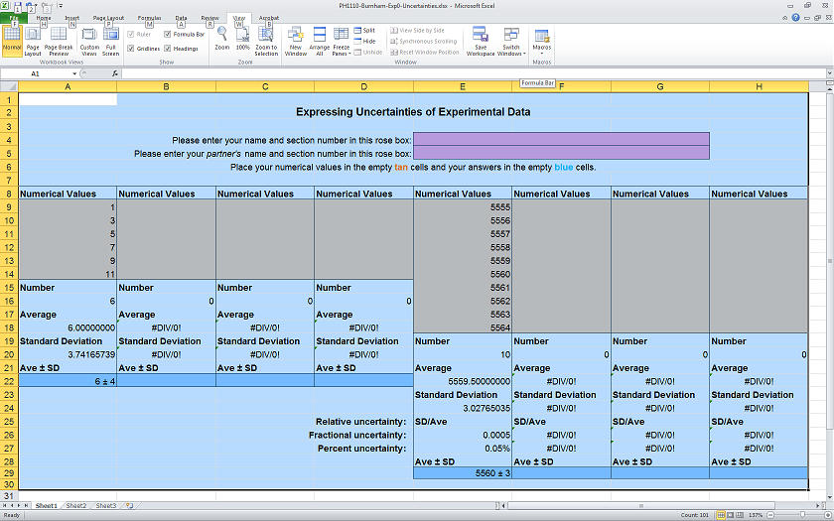
Lab 0 submission
Make sure to submit the Lab 0 worksheet at the correct link.
Internet Explorer tends to give the fewest submission errors.
Notes:
To finish, students must submit their worksheets via myWPI → Lab Submission. Emphasize the importance of submitting the right worksheet to the right lab. Occasionally students have trouble with submission. Submission is most reliable with Internet Explorer.

Slide 4
Welcome to mechanics labs!

