Slide 1
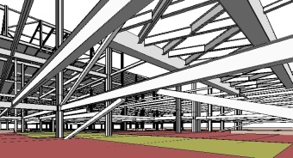
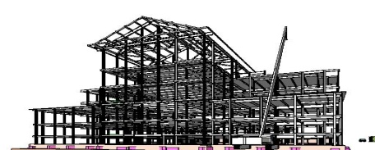
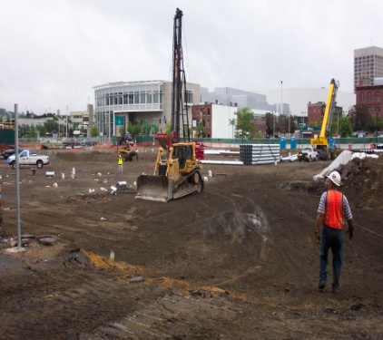
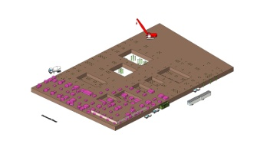
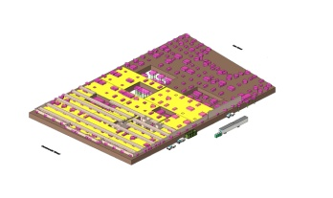
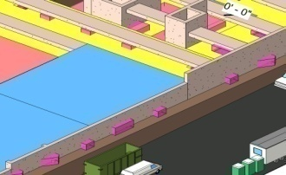
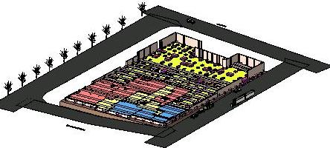
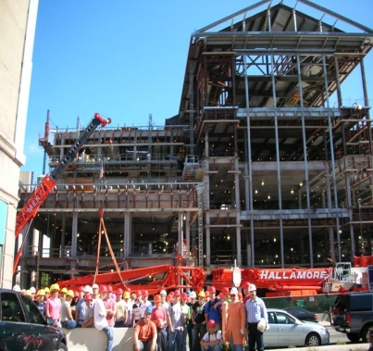
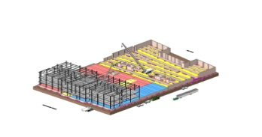
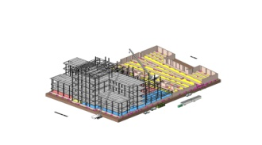
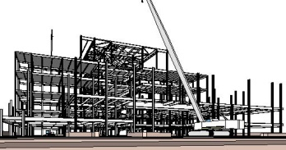
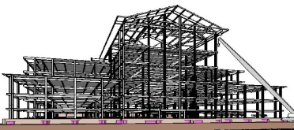

Guillermo Salazar, Ph.D, DBIA
Worcester Polytechnic Institute
Department of Civil and Environmental Engineering
EDUCATIONAL EXPERIENCES WITH BIM AT WPI

Slide 2
Educational Objectives
To assess, test, and understand the capabilities of BIM concepts in improving coordination and communications among multidisciplinary design and construction teams
To assess, test, and understand the impact of BIM technology on educational models and to make recommendations for implementation into the civil engineering curricula.
To prepare the students to function in the current practice of engineering and to become leaders in an industry gradually transformed by BIM.

Slide 3
Levels of Cognitive Ability & Skills
Knowledge. 1. Familiarity
Comprehension. 2. Beginner
Application. 3.Intermediate
Analysis. 4. Advanced
Synthesis. 5. Expert
Evaluation.
Reference: Bloom. (1956)
Taxonomy of Educational Objectives:
The Classification of Educational Goals
Increasing intellectual
challenge & practice

Slide 4
Basic Elements for BIM Curricula
(AGC-BIM Forum Educational Group)
Learn the use of BIM-related software
Develop a thorough understanding of the lifecycle project development process and the role of owner, designer, builder, users & other parties associated with the project
Incorporate multidisciplinary elements
  Within academic units
  With the Industry
Teach & practice integrated behavior
  Team members relationships & respect
  Teamwork (trust, communication, share information)
  Ethics
Teach how to effectively deal with change

Slide 5
How has WPI done it?
Graduate Research & Publications
Graduate Courses
Undergraduate Courses
Undergraduate Projects
Industry Penetration
Industry Penetration
Industry Penetration
2000
2008
2000 – to-date
2001
2003 – to-date
2006
2003 - to-date

Slide 6
How is Teaching Modeling impacting our Educational Program?
 |  | Civil 3D | Revit
1030 | Civil Eng & Comp Fund. | X | X
2000 | Analytical Mechanics I |  | X
2001 | Analytical Mechanics II |  | X
2002 | Intro to Anal and Design |  | X
2020 | Surveying | X
3006 | Steel Structures |  | X
3008 | Reinf. Conc. Structures |  | X
3010 | Structural Eng |  | X
3020 | Project Mangement | X | X
3021 | Cost Est, Sch, & Proj | X | X
3022 | Legal Aspects of Des
3023 | Arch Eng Sys |  | X
3024 | Control Surveying | X
3026 | Mat of Const
3030 | Fund of Civ Eng AutoCAD |  | *
 |  | Civil 3D cont’d | Revit cont’d
3041 | Soil Mech | X
3044 | Found. Eng
3050 | Intro to Transp Eng | X
3051 | Into to Pave Mat
3059 | Envir Eng | X
3060 | Water Treat
3061 | Waste Water Treat
3062 | Hydraulics | X
3070 | Urban and Envir Planning | X
3074 | Envir Analysis | X
4007 | Matrix Analysis of Struc
4017 | Prestressed Concrete
4046 | Experimental Soil Mech | X
4054 | Soil & Bit Materials
4060 | Envir Eng Lab
4061 | Hydrology | X
4071 | Land use Devel & Control | X
406X | Haz & Indus Waste Mang | X
Qualifying Projects

Slide 7
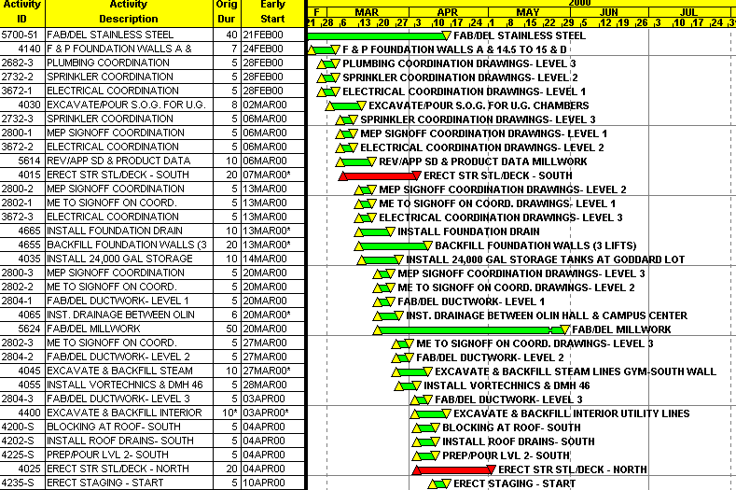
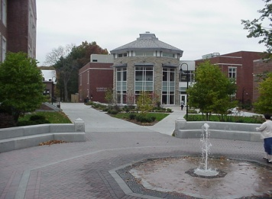
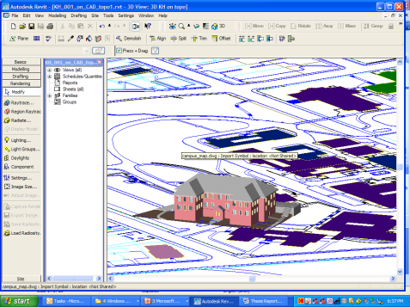
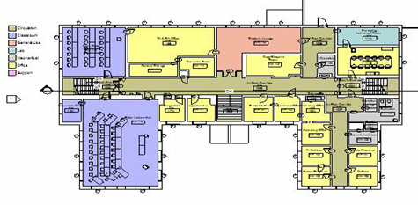
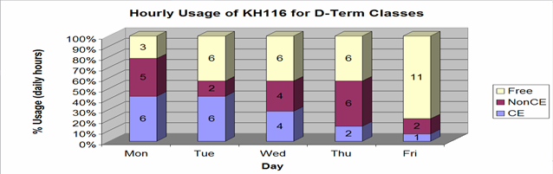
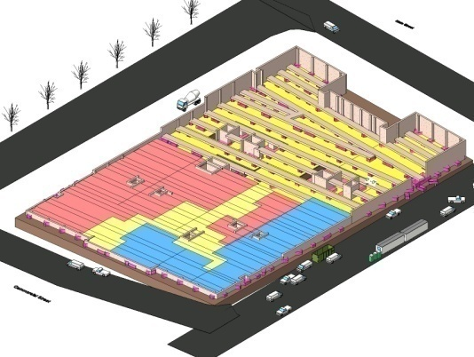
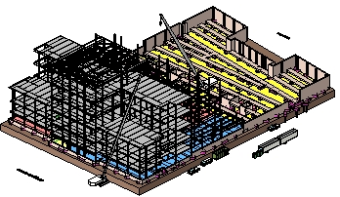
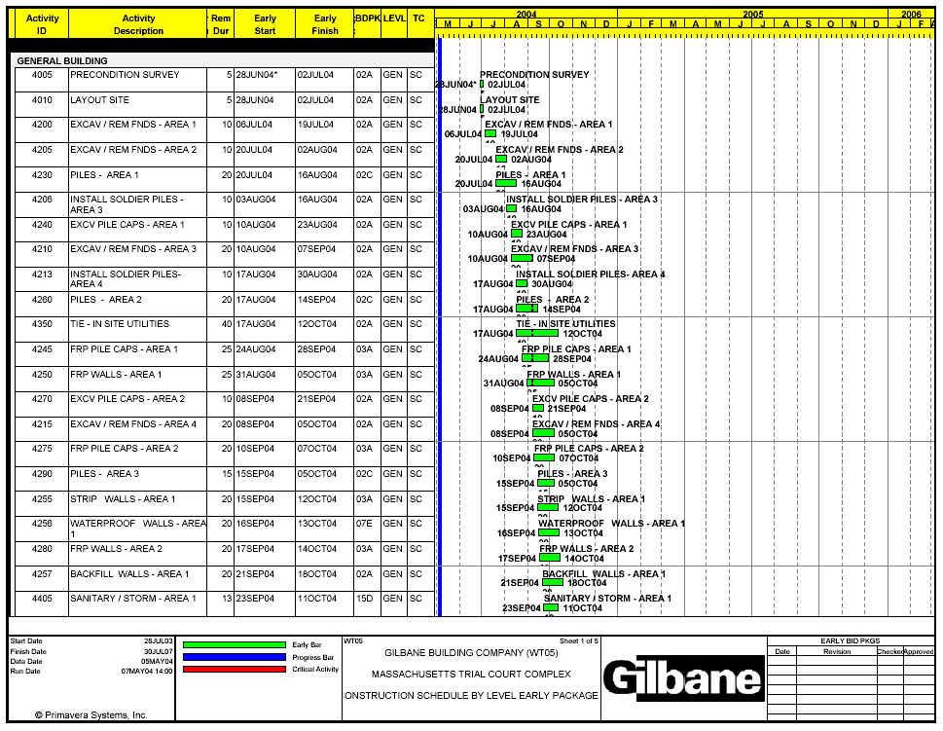
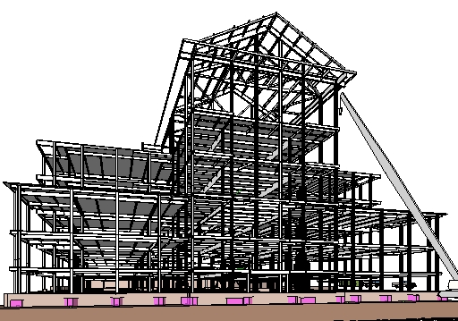
Research, 2000 - 2007
4D Model of the WPI Campus Center, Polat 2001
BIM on GIS of WPI Kaven Hall, Samdadia, 2004-05
BIM of Worcester Trial Courthouse, Mokbel & Aboulezz, 2005-06

Slide 8
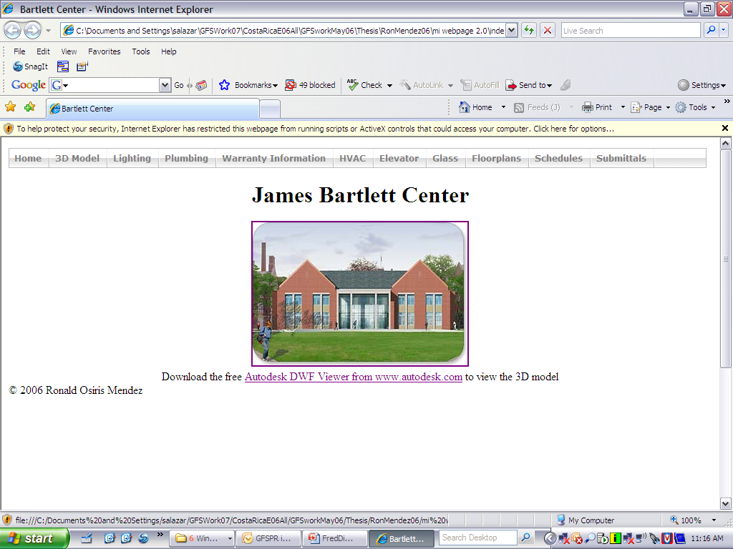
Demo

Slide 9
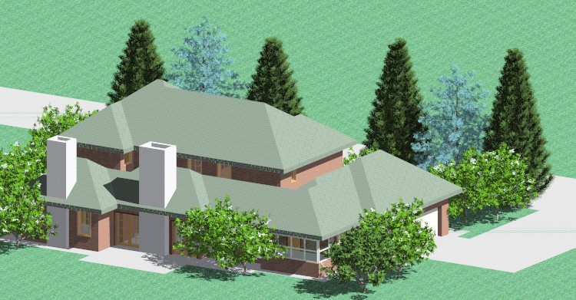
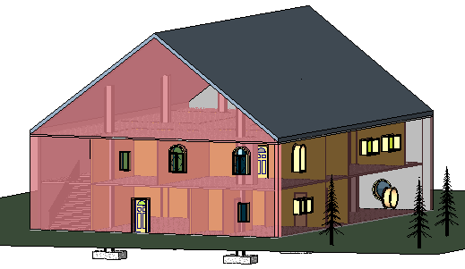
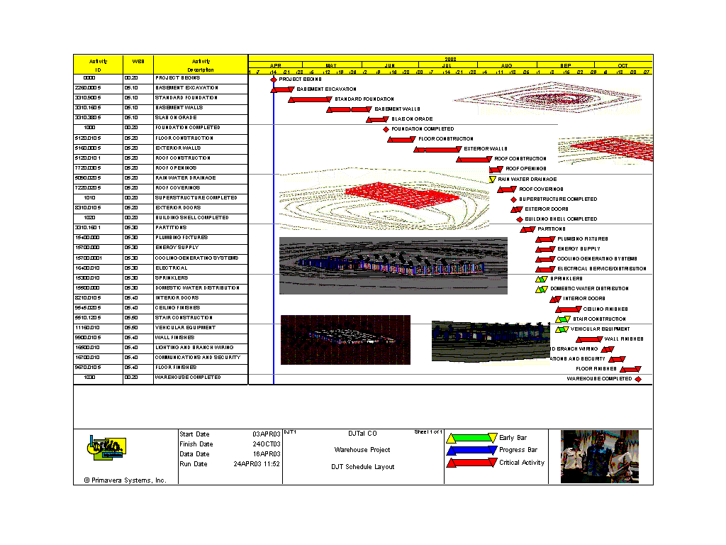
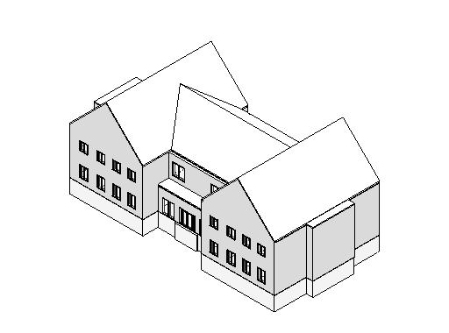
Graduate Courses
CE 585 Term Projects
Model by M. Aboulezz & H. Mokbel, 2002
Model by Y. Selamoglu, 2002
Model by Sweeney, Chang, Laherty & Handler 2007
4D Model by D. Manescu, J. Skoropowski & T. Farah, 2003

Slide 10
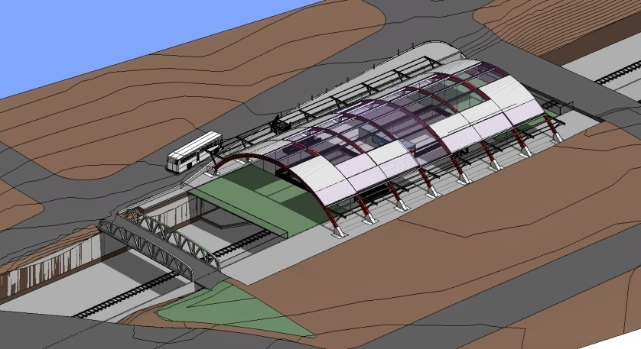
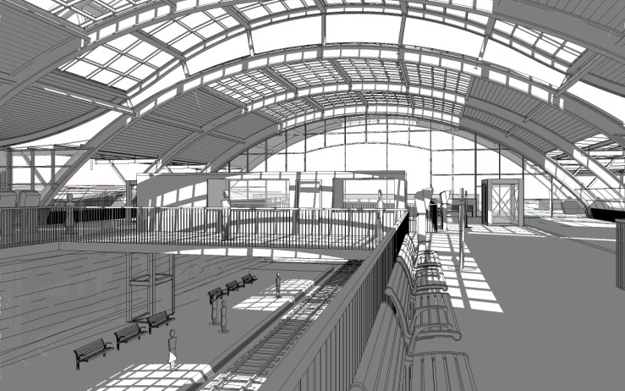
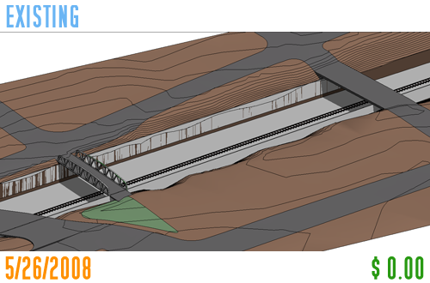
Collaborative Term Project
Spring 2008
Collaborative Model:
A. Gomes (Boston Architectural College), Architectural Design
C. Keegan, A. Petrocchi, B Skelcher (WPI – CE585), Constructability Analysis
N. Alborzfard, C Powers, (WPI – CE584), Cost Estimating

Slide 11
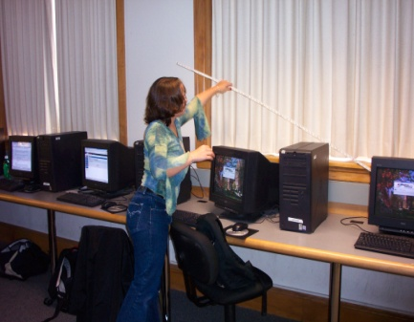
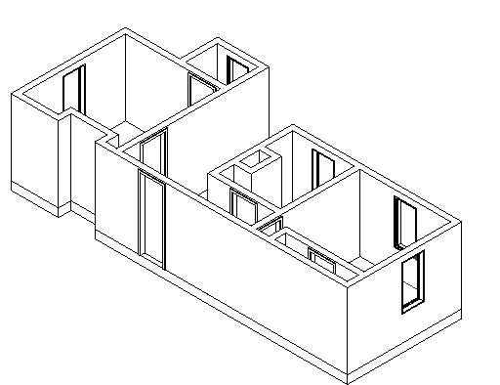
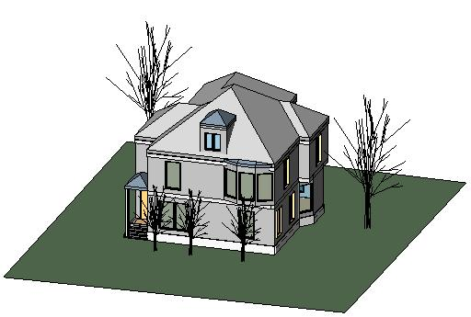
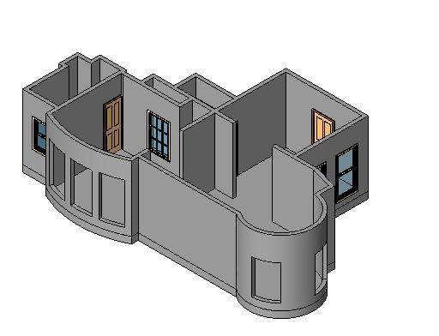
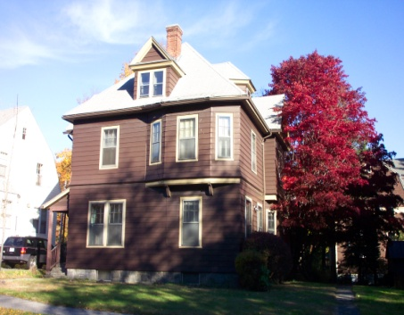
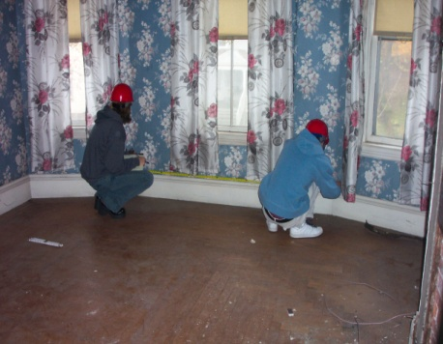
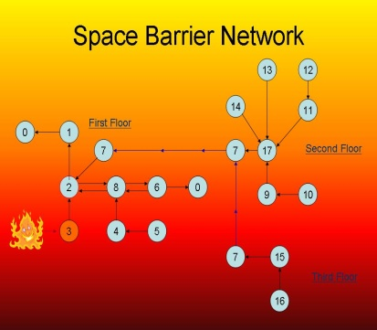
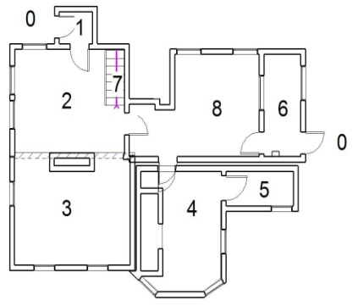
CE1030 Freshmen Class
3D Model by B. Privett, O. Thomollari, M. Tomaswick, M. Verrochi, Z. Orcutt, 2003
Fire Safety proposal by K. Collette, H. Doan, H. Fernando and M. Ferraro, 2003

Slide 12
Learning Styles Dimensions
Dr. Richard M. Felder
North Carolina State University
Processing: Active / Reflective
Perception: Sensing / Intuitive
Input Modality: Visual / Verbal
Understanding: Sequence / Global

Slide 13
Students’ Perceived Value (CE1030)
 | YES (03) | YES (06) | NO (03) | NO (06) | YES/NO (03) | YES/ NO (06)
Class Fits learning Style | 85% | 73% | 7% | 18% | 8% | 9%
BIM is a Helpful Tool | 88% | 86% | 0% | 5% | 12% | 9%
BIM Facilitates Group Work | 67% | 73% | 18% | 14% | 15% | 14%

Slide 14
CE203X:
Software Applications in CE
-Fall 08-
(G.Salazar, C. Conron, L. Malloy)

Slide 15
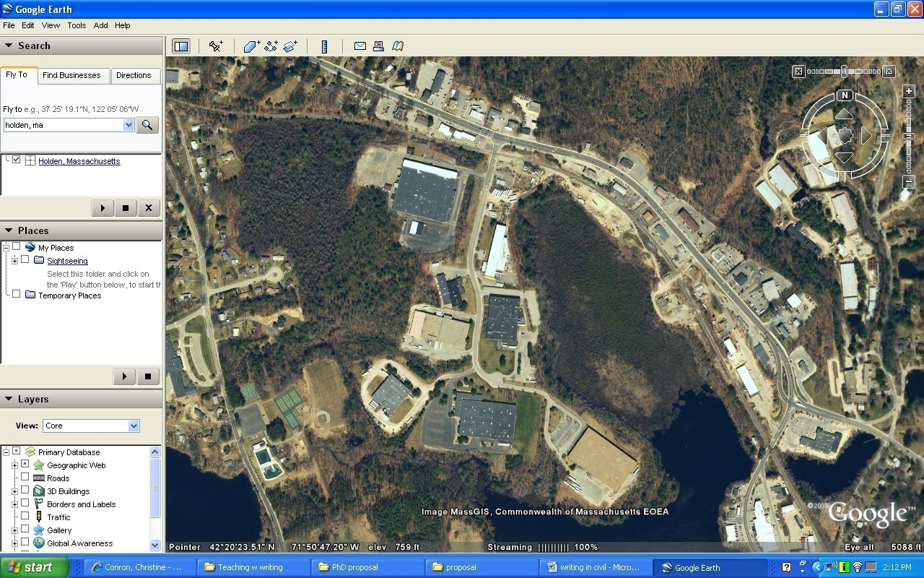
1
Intro
2
Basics

Slide 16
1
Intro
2
3
Basics
GIS

Slide 17
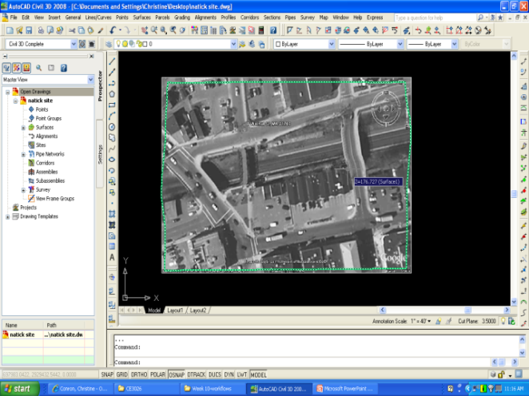
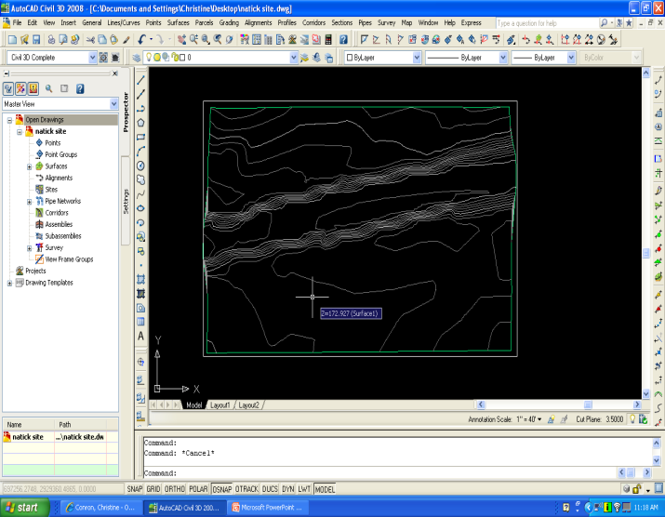
Civil 3D & Google Earth
The introduction of AutoCAD Civil 3D into the curriculum allows students to import data directly from Google Earth and create a rich base layer for a “student-sized” GIS.

Slide 18
1
Intro
2
3
4
Basics
GIS
Roads

Slide 19
1
Intro
2
3
4
Basics
GIS
Roads
5
Site

Slide 20
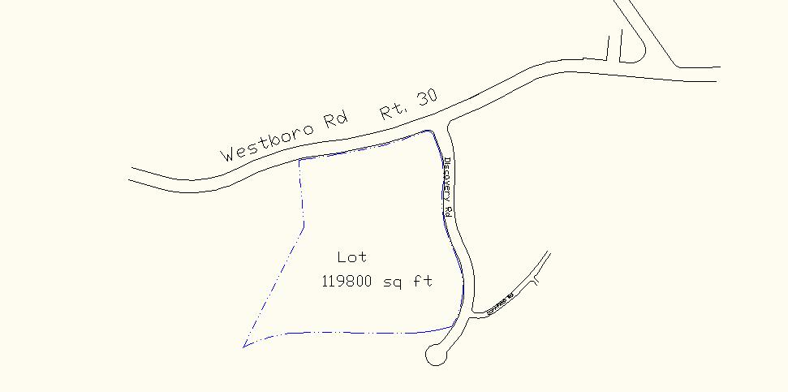
Site Location,
Commercial Zone: Grafton, MA

Slide 21
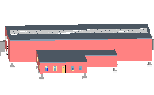
1
Intro
2
3
4
Basics
GIS
Roads
5
6
Site
Building

Slide 22
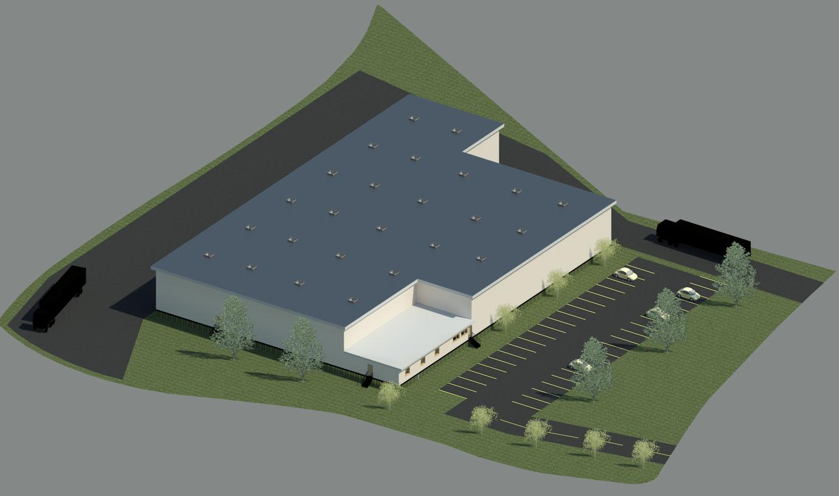
Student’s Project
New England Paper Supply
“One Industrial Drive”
Grafton, MA. 01519
Model by . D Deginault, H. Hoang & T. Glover, 2008
Westboro Rd.
Discovery Rd.

Slide 23
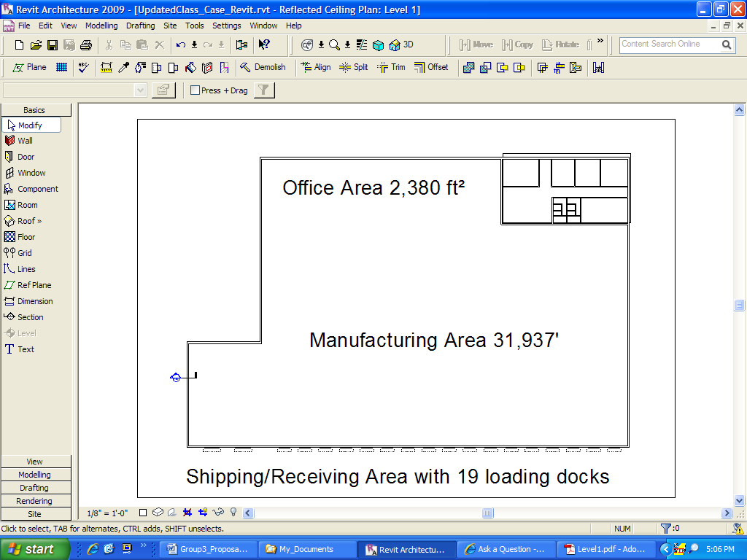

Slide 24
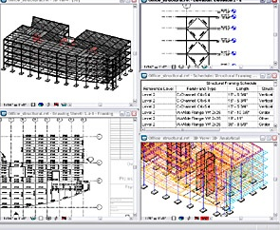
1
Intro
2
3
4
Basics
GIS
Roads
5
6
Site
Building
7
Structure

Slide 25
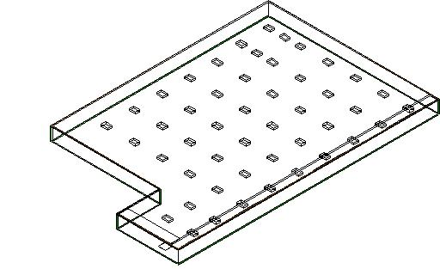
Solid concrete slab with casings for support columns.

Slide 26
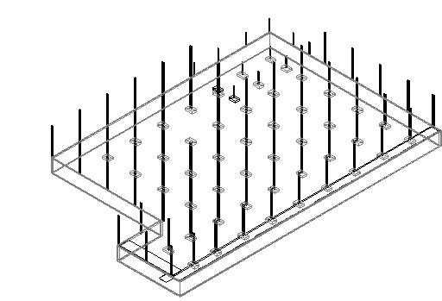
Support Columns in place.

Slide 27
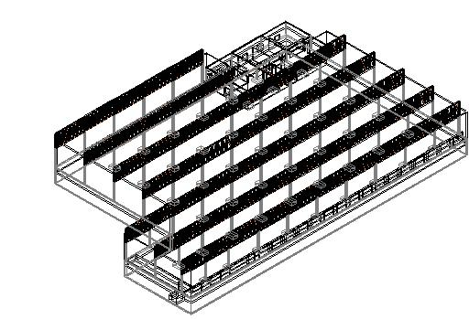
Steel framing, beams and trusses to ensure strength and integrity.

Slide 28
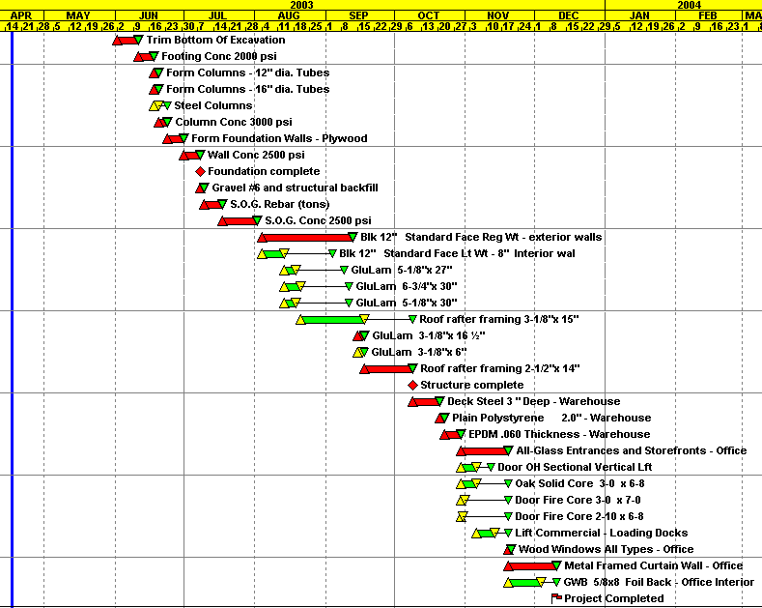
1
Intro
2
3
4
Basics
GIS
Roads
5
6
Revit
Building
7
Structure
8
CPM
G. Salazar

Slide 29
New England Paper Supply
Cost
Cost Breakdown:
Warehouse Area: 30,274 ft² ---------------Cost $3,632,880.00
(unit price $120/ft²)
Office Area: 2, 468 ft² ------------------------ Cost: $394,880.00
(unit price $160/ft²)
Paved Area: 42,600 ft² ----------------------- Cost: $170,500.00
Total: $4,198,260.00

Slide 30
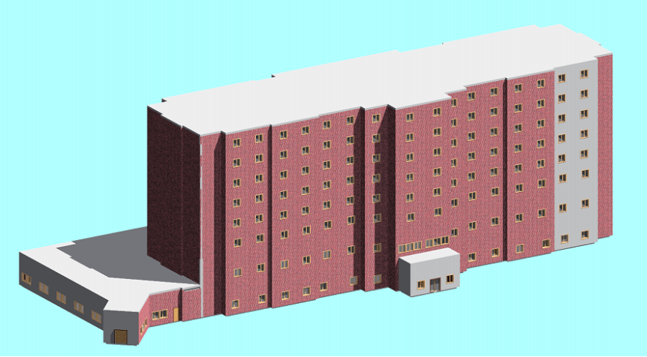



Student Projects
E-Buildings WPI Campus
by Brault, Krol & Molineaux, 2005
Low Income Housing Yucatan Mex,
by Dzib, Pacheco, Puc, Perera 2005
Model by Byron, Puma & Wolf-Jawroski, 2005
Object Oriented 3D Database Model for Fire Risk Analysis Studies, by V. Samdadia 2004

Slide 31

E- Projects 04 - 06
E-Projects 06
E-Buildings WPI Campus
by Halilaj & Mills, 2006
E-Buildings WPI Campus
by Brault, Krol & Molineaux, 2005
Object Oriented 3D Database Model for Fire Risk Analysis Studies, by V. Samdadia 2004

Slide 32


Student Projects, 2007 – 08
Model by N. Ambrosino, O. Cummings, M. Chachakis, J. Hehir. MQP 2008
Model by J. Bellofatto, M. Frasier,, K.Forward, M. Wood, MQP 2008

Slide 33





Industry Penetration & Transformation
Vivarium at Harvard University, Polat, Beacon-Skanska, 2001

Slide 34




Kaven Hall Proposed Renovation
Model by Aboulezz, Summer 2005

Slide 35
Lessons Learned
The BIM model facilitates the process of effective learning. It promotes active teamwork by involving the student in sharing, communicating, and group problem solving.
The BIM mode helps students to actively engage in the process of planning, designing, and interpreting construction related data.
The student starts using the BIM software without necessarily requiring previous design and construction related experience or a high level of computer drafting skills.
The introduction of the BIM model within the CEE curriculum creates future career opportunities for the students by gaining a competitive advantage in the job market and also become agents of change impacting the way the industry works today.

Slide 36

What is ahead
“True” Master Builder Program
www.wpi.edu/~salazar/wpibim/

Slide 37

Thank you

